Slide 1
Passion for future

Slide 2
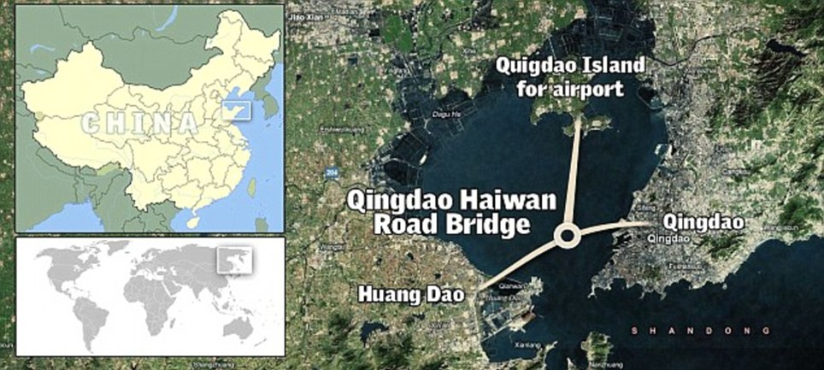

Slide 3
The great lessons from
CHINA way of approach

Slide 4
World's longest sea bridge IN China and links China 's eastern port city of Qingdao to the offshore island Huangdao. Twenty-four miles of fresh untouched tarmac stretch from Qingdao to Hungdao The road bridge, which is 110ft wide and is the longest of its kind, cost nearly £1billion to build.

Slide 5
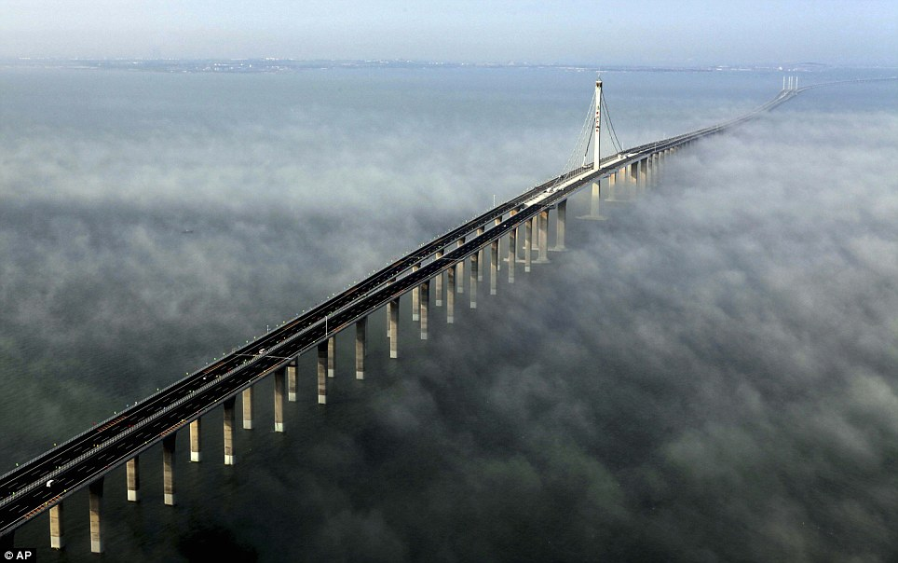

Slide 6
A bridge over misty waters: The immense £1billion structure which is supported by more than 5,000 pillars stretches for 24 miles along China's eastern port city of Qingdao to the offshore island Huangdao

Slide 7
Perfection in PLAN

Slide 8
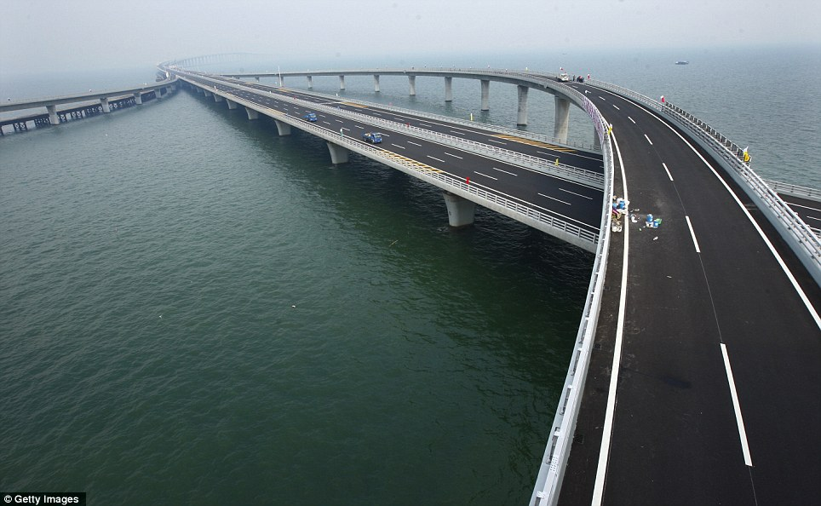

Slide 9
Engineering feat: The vast bridge, the largest cross-ocean bridge in the world, cost £960million and took four years to build
Chinese TV reports said the bridge passed construction appraisals on Monday and it, along with an undersea tunnel, would be opened for traffic today.
It took four years to build the bridge, which is supported by more than 5,000 pillars across the bay, and it is almost three miles longer than the previous record-holder - the Lake Pontchartrain Causeway in Louisiana .

Slide 10
Clarity in GOALS

Slide 11
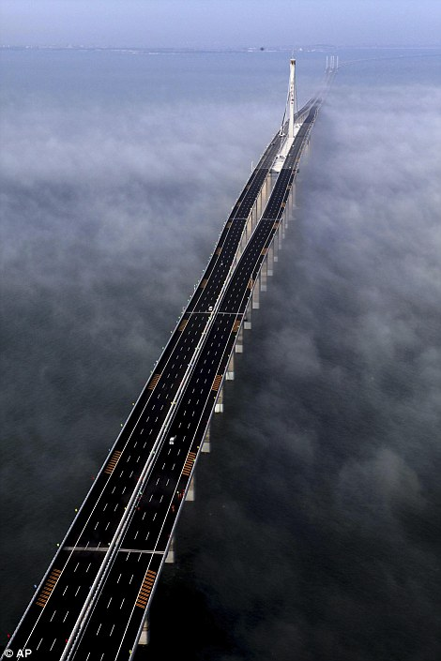

Slide 12
Lengthy: The bridge stretches into the distance further than the eye can see and right, the first few cars roll out across the surface

Slide 13
Great VISION

Slide 14
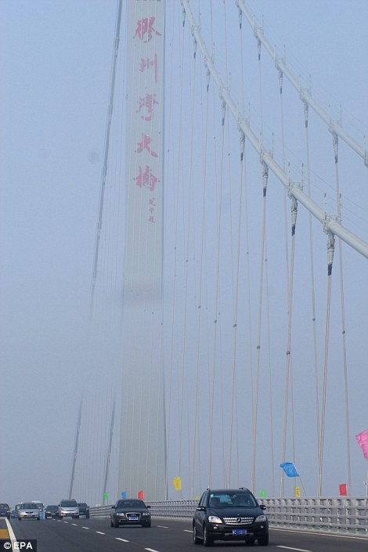

Slide 15
Open road: Drivers pass through the mist as they make some of the first passes over the 110ft wide bridge which is longer than any others of its kind

Slide 16
User RELEVENT

Slide 17
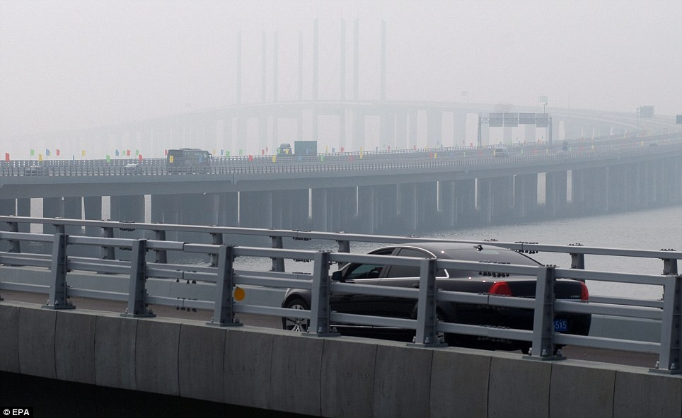

Slide 18
Flowers: The first vehicle runs into toll station to the applause of staff and passers-by after the bridge opened to traffic today

Slide 19
User FRIENDLY

Slide 20


Slide 21
Musical mileage: A brass band plays on the sides of the road as flags and banners herald in the opening of the bridge

Slide 22
Customer SATISFACTION

Slide 23


Slide 24
The start of things to come: Two cars edge through the toll gates that will raise revenue to maintain the £1billion bridge
That structure features two bridges running side by side and is 23.87 miles long.
The three-way Qingdao Haiwan bridge is 174 times longer than London 's Tower Bridge , spanning the River Thames, but cuts only 19 miles off the drive from Qingdao to Huangdao.
Two separate groups of workers have been building it from different ends of the structure since 2006.
After linking the two ends of the bridge on December 22, one engineer said: 'The computer models and calculations are all very well but you can't relax until the two sides are bolted together.

Slide 25


Slide 26
Don't keep me hanging: The suspension beams form an imposing sight as the reach through the clouds and look down upon colourful flags marking the bridge's grand opening

Slide 27
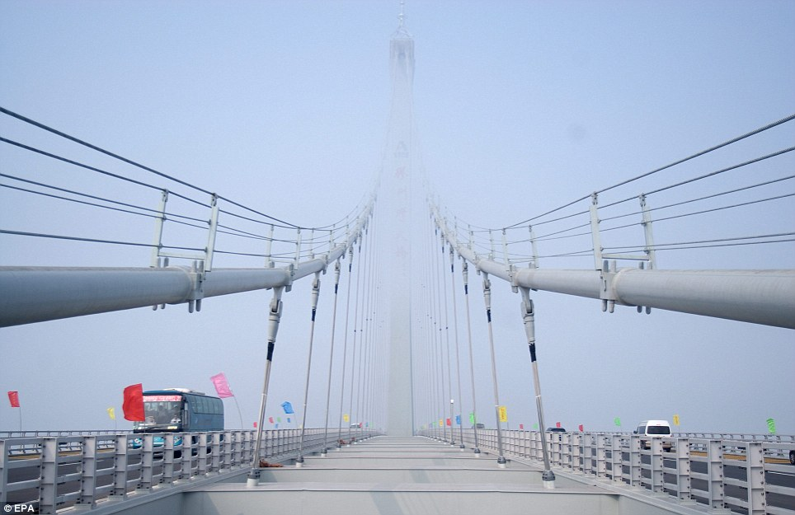

Slide 28
The long road home: The two roads which run alongside each other wind across The Jiaozhou Bay
'Even a few centimetres out would have been a disaster.'
The engineering feat will only hold the record as the longest sea bridge for a few years - it will be beaten by another Chinese bridge in the next decade.
Last December officials announced workers had begun constructing a bridge to link southern Guangdong province with Hong Kong and Macau .
Set to be completed in 2016, officials said the £6.5billion bridge will span nearly 30 miles.
It will be designed to cope with earthquakes up to magnitude 8.0, strong typhoons and the impact of a 300,000 tonne vessel.
But both structures will still be dwarfed by the longest bridge in the world, also in China .
The Danyang-Kunshan Grand Bridge is an astonishing 102 miles in length.

Slide 29
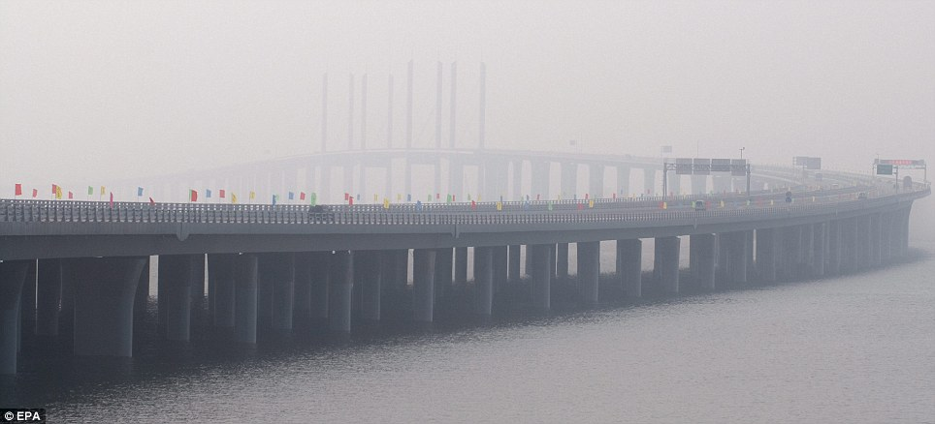

Slide 30
Record breaker: The Qingdao Jiaozhou bay bridge, spanning 26.4 miles between Qingdao and Huangdao, will open for traffic today

Slide 31
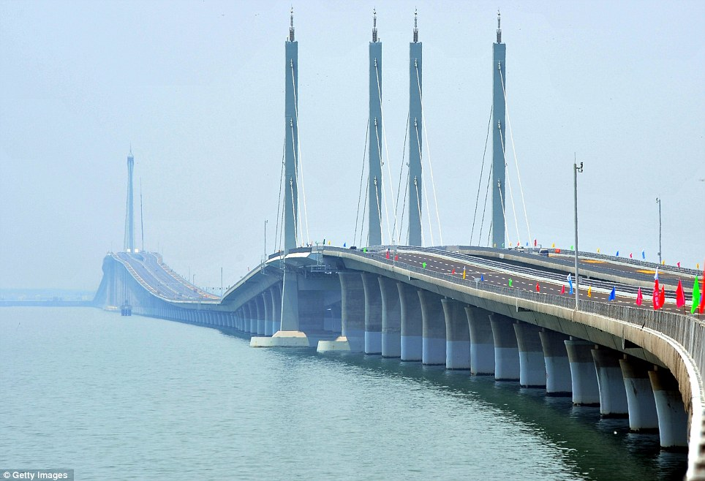

Slide 32
Impressive: Testing on the bridge was completed on Monday and it is expected to be opened to traffic for the first time today

Slide 33
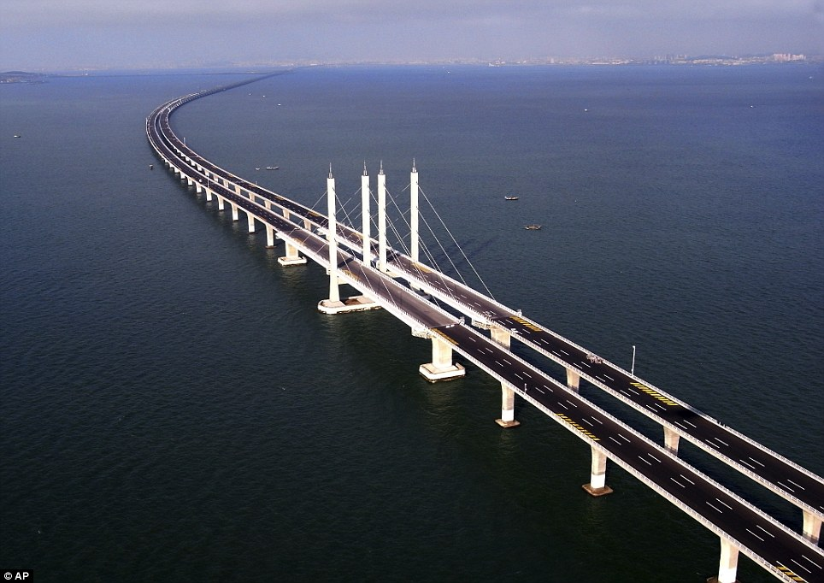

Slide 34
A driver's dream: Twenty-four miles of fresh untouched tarmac stretch from Qingdao to Hungdao

Slide 35
