Slide 1
POSITIVE . COMMUNE
Vision 2020

Slide 2
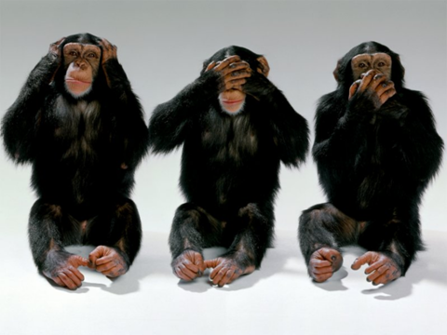
BE ENVISIONED

Slide 3
REALISE
OUR
POTTENTIALITIES

Slide 4
George Washington
Abraham lincon
Kalwin coolidge K.R.Narayanan
A.P.J. Abdulkalam Dheerubhai ambani
Narayana moorthi
GLASS OF WATER

Slide 5
WE SHOULD CHANGE OUR SELF TO EXTERNALISE OUR INBORN TALENTS
rope

Slide 6
GOAL
SETTING
It is planned future state
ball throw

Slide 7
DREAMS

Slide 8
small intentions are crime APJ
Hotel ballpass my goal democleas video

Slide 9

Fat lady
S PECIFIC
M EASURABLE
A attainable
R EALISTIC
T IME BOUND

Slide 10
ARE
YOU
SMART ?

Slide 11
SHORT TERM GOAL
LONG TERM GOAL
MEDIUM TERM GOAL
SQUARE

Slide 12
SUCCES SONG
_{ACT FIRST}
DO FAST
STAY LAST
BE THE BEST

Slide 13
4 PS
PASSION
POTTENTIAL
PURPOSE
PERSEVERENCE

Slide 14
DO
DIFFERENT
THINK

Slide 15
EACH ONE HAS DIFFERENT VIEWS

Slide 16
perception

Slide 17
communication
presentation
Consider
Anchoring
concentration

Slide 18
SUCCES SONG
_{ACT FIRST}
DO FAST
STAY LAST
BE THE BEST

Slide 19
Thank You
SUDAS KANNOTH
CONVENER
POSITIVE COMMUNE
944 711 4001

Slide 20
SUCCES SONG
_{ACT FIRST}
DO FAST
STAY LAST
BE THE BEST

