Slide 1
Effective
Professional
Trainer

Slide 2
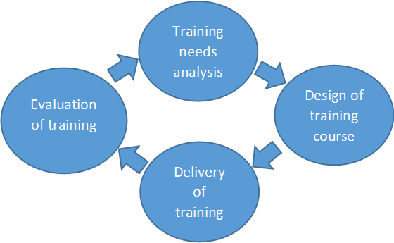

Slide 3
Bridge the gap
Understand the people
Previous training
Ambiance of facilities
Sad, Glad, Mad,

Slide 4
Benefits of TNA
Can prepare well
Can apply methodology
Help data collection
Authentic proper diagnose
Know the audience
Notes:
Authentic Result super market

Slide 5
SUDAS KANNOTH
SKATE-ToTs
Thank You
sudaskannoth@gmail.com
944 711 4001

