Slide 1
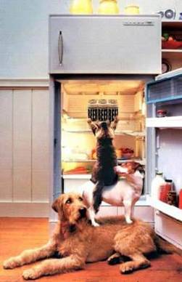
Working with a TEAM

Slide 3
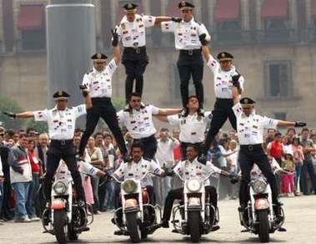
Leadership & Team building

Slide 4
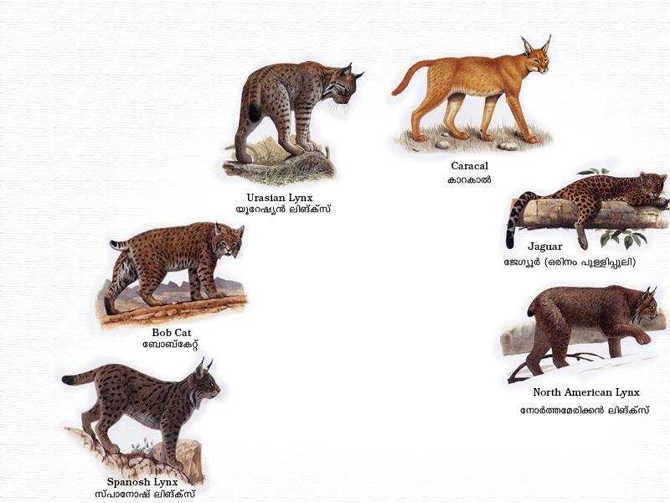
Group v/s Team

Slide 5
Why Teams?
Completing an assignment is time consuming and intellectually challenging
When several people use their skills and knowledge together, the result should be a better output
People working together can sustain the enthusiasm and lend support needed to complete a task.

Slide 6
How do Teams Work Best?
Teams succeed when members have:
Commitment to common objectives
Defined roles and responsibilities
Effective decision systems, communication and work procedures
Good personal relationships.
Notes:
According to Bob Mendonsa and Associates’ web page
http://www. trainingplus.com on Team building :
Team Building is a process and not an event.
Team Building is about both willingness and ability. Sometimes teams problems occur because team members lack important skills. Sometimes there are trust issues.
Team Building must address individual and group issues. People do not “disappear” when they choose to belong to a group. Any team building effort must address the strengths and development needs of individual team members that impact the group as a whole.
Of course the corollary is true and groups or teams fail when they:
Think differently
Have poor leadership
Have communications difficulties
Have competition between members

Slide 7
How to avoid nagging and get the best co- operation from your co workers

Slide 8
BE DIRECT
If you want something
Done, ASK.
Co-workers can resist hints,
Innuendoes.
TEAM

Slide 9
SAY LESS
Some people resent following orders. Be subtle. You set goals for each person.
TEAM

Slide 10
BAN BLAMING
Finding fault prevents both sides from seeking another way to solve the problem. Presents facts wherever possible.
TEAM

Slide 11
TEAM
NEGOTIATE
Instead of demanding ask how the task can be done. Suggest ways to help.

Slide 12
TEAM
LET IT GO
If you find yourself nagging others too much, it may be time evaluate your own duties. Do not compensate for your own lack of progress. Recognize the time and efforts of colleagues.

Slide 13
TEAM
STAY FOCUSED
Do not generalize.
Note only current offense.

Slide 14
REALIGN PRIORITIES
Non co operating people have different priorities. Show how both will benefit if the task gets completed.
TEAM

Slide 15
Characteristics of Effective Teams
Common goal
Open communication
Constructive conflict resolution
Mutual trust
Belief in synergy
Value contributions
Support and respect
Good leader
au

Slide 16
Team Roles and The Leader
Task Master
Innovator
Organizer
Evaluator
Finisher

Slide 17
Leader Skills & Characteristics
Patience
Flexibility
Decisiveness
Tact
Communication skills
Sense of humor
Authority
Knowledge

