Slide 1
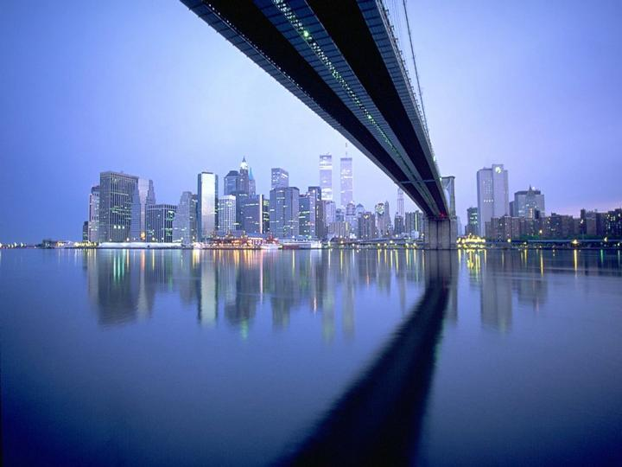
Reflections on life

Slide 2
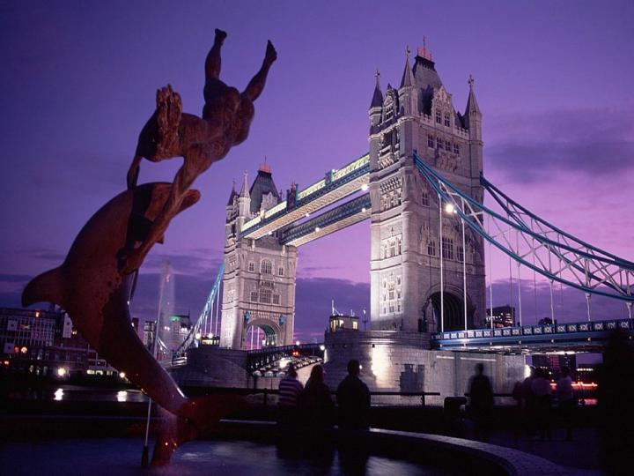
Our life cannot always be full of happiness but it can always be full of love!

Slide 3
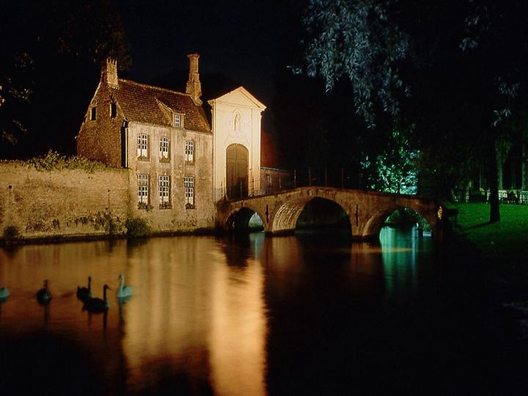
He who is blind to the view of our souls, will not enjoy and see
life as it is.

Slide 4
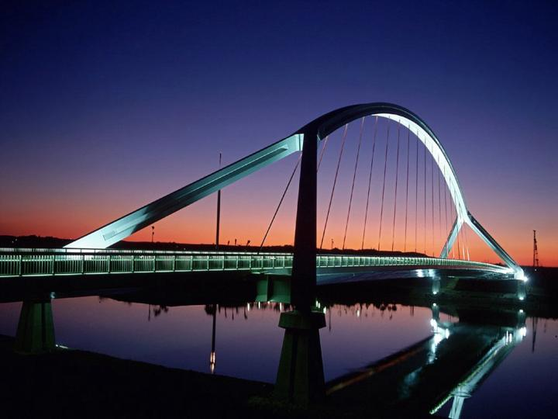
The more you plan, the less likely you will experience chance, therefore live life to the fullest.

Slide 5
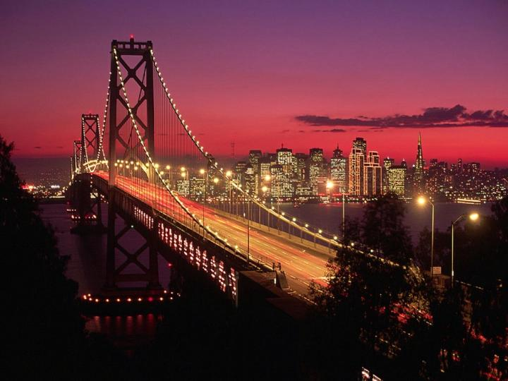
A true friend is one who holds your hand and thus touches your heart.

Slide 6
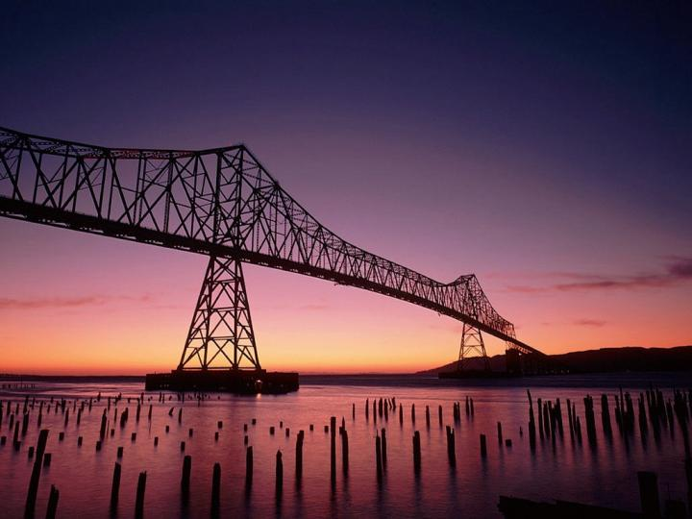
When we get married, we won’t know what lies ahead
Until we hit the waves of life at sea.

Slide 7
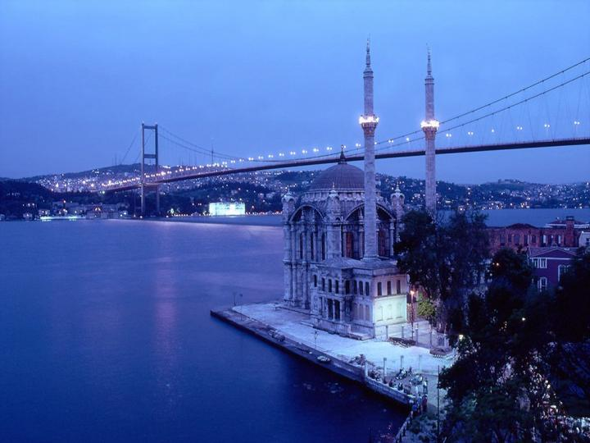
Life is reality without
An eraser!

Slide 8
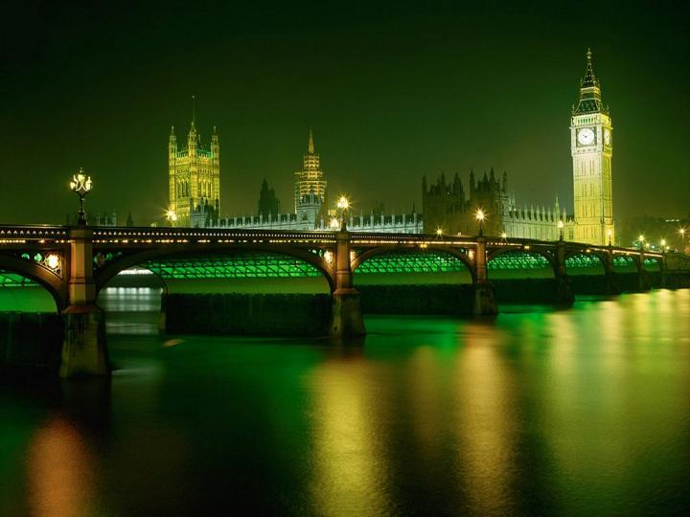
Nothing in the future, will correct those moments that you have missed in the past.

Slide 9
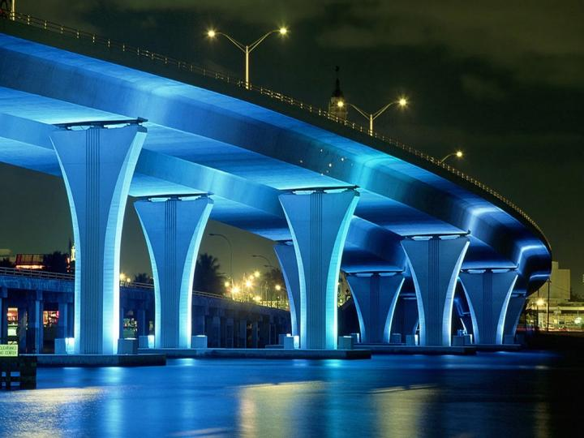
Don’t waste time with someone who won’t support you in time of need.

Slide 10
Always look at the bright side of life. If there is no bright side, wait until the future turns to light.

Slide 11
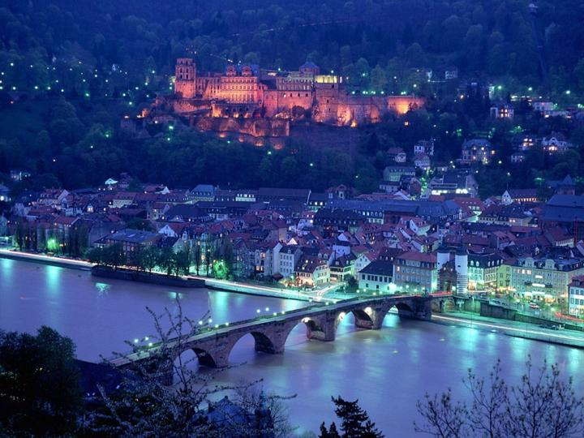
Don’t cry over what has happened in the past, but be happy that you could enjoy the moment.

Slide 12
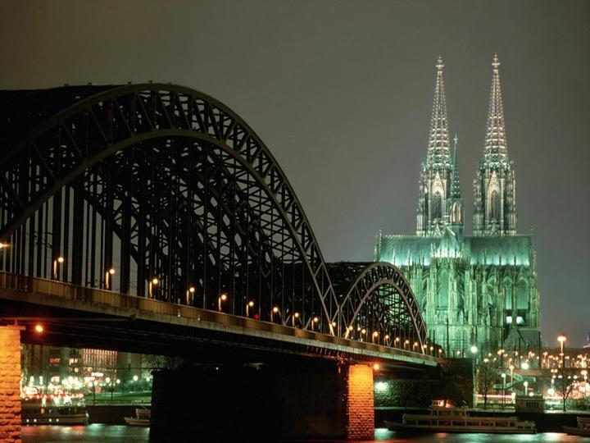
Always remember the words from a true friend:
“I’ll be there for you”

Slide 13
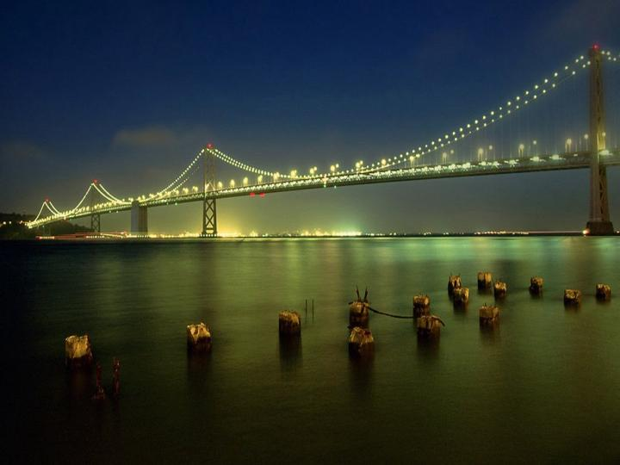
Work, as if you don’t need money.
Love, as if nobody has hurt you.
Dance, as if nobody was watching you.
Sing, as if nobody was listening.
Live, as if this was paradise on earth.

Slide 14
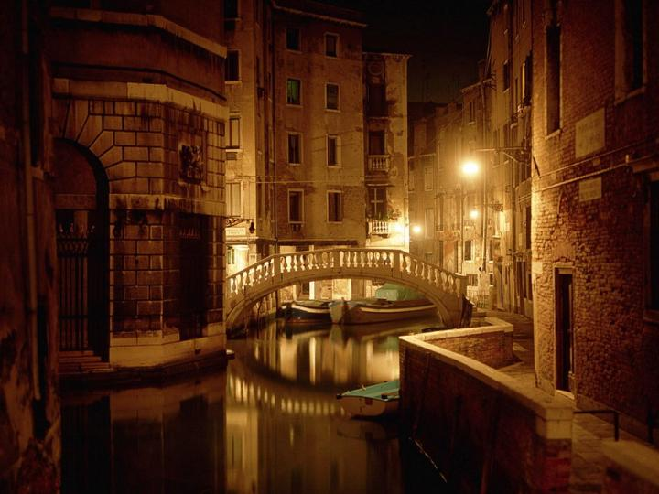
Don’t dispair, the nicest things will happen to you when you least expect them...

Slide 15
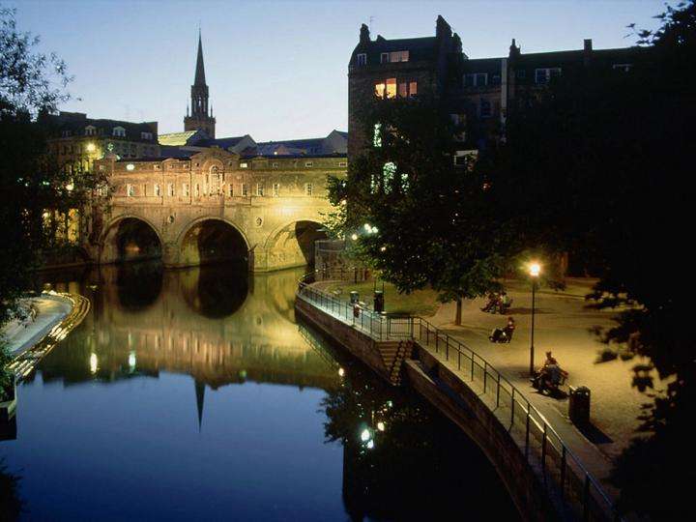
Feel free to share this with friends even those that you don’t talk to very often...
And remember:
“Everything that happens, happens for a reason!”

