Slide 1

Challenge yourself
www.caretrainingsolutions.com

Slide 2


Slide 3
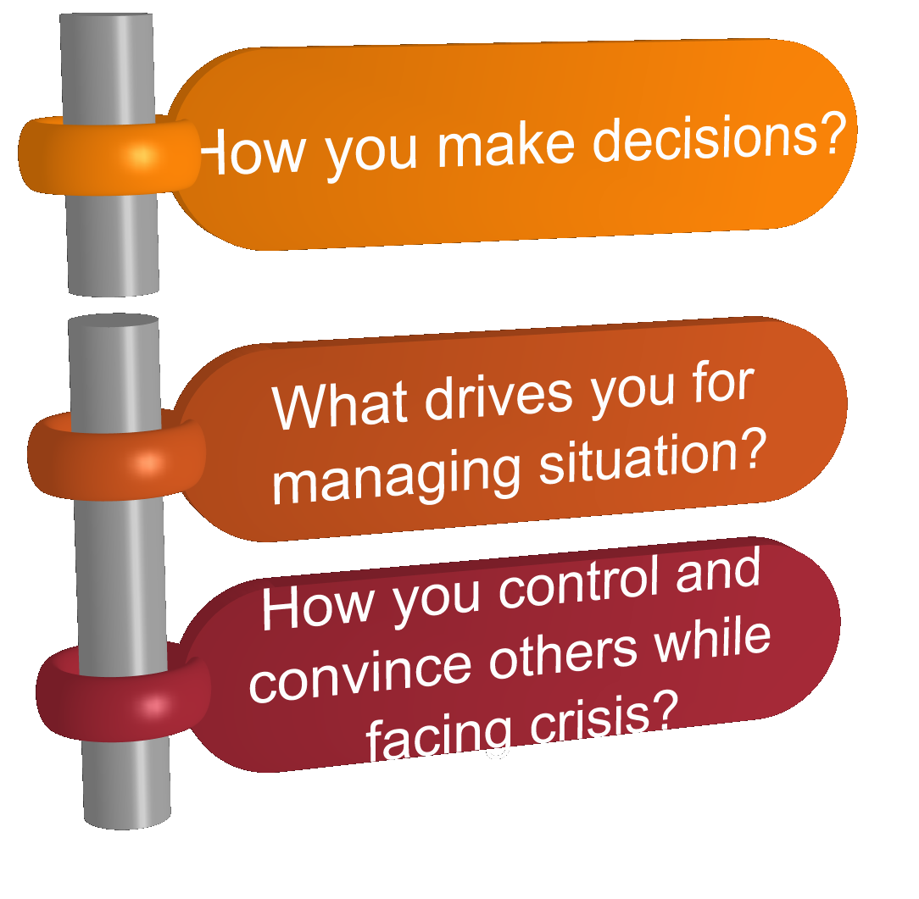
Decisions
www.caretrainingsolutions.com

Slide 4
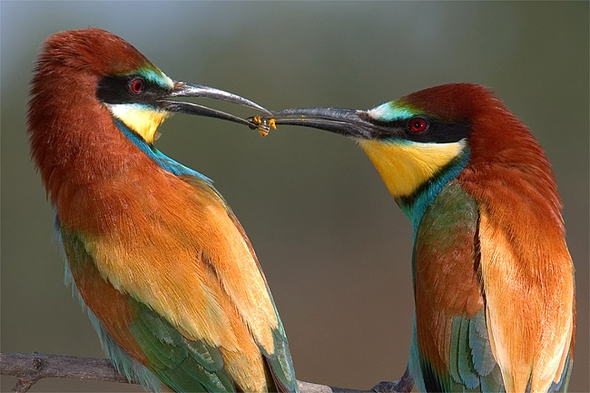
Decisions
On the basis of
Feelings & Thoughts
www.caretrainingsolutions.com

Slide 5


On the basis of drives
www.caretrainingsolutions.com

Slide 6
Sort

Slide 7
Set in order

Slide 8
Shine

Slide 9
Standerdize

Slide 10
Sustain

Slide 11
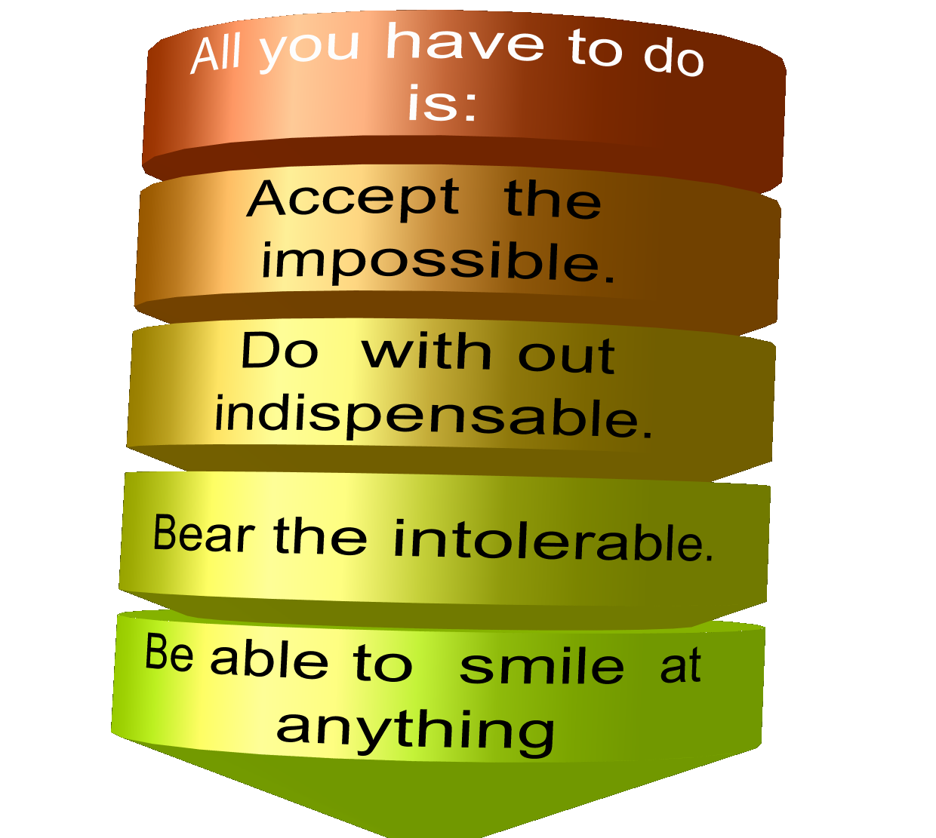
LIFE IS EASIER THAN YOU THINK
www.caretrainingsolutions.com

Slide 12


