Slide 1
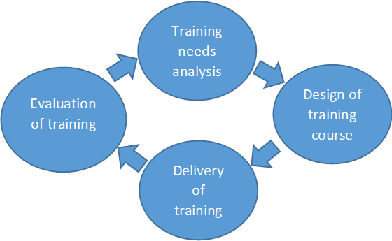
PC ToTs

Slide 2
PC ToTs
Pre course evaluation
Ongoing evaluation
Post course evaluation

Slide 3
PC ToTs

