Slide 1
Two Tough Questions

Slide 2
Question 1:
If you knew a woman who was pregnant, who had 8 kids already, three of them are deaf, two are blind, one mentally retarded, and she had syphilis! Would you recommend that she have an abortion?

Slide 3
If your answer is YES . . . .. . . you just killed Beethoven the GREAT musician because He was born as the 9th child with above mentioned...

Slide 4
Question 2: It is time to elect a new world leader, and only your vote counts. Here are the facts about the three candidates.
Candidate A: Associates with crooked politicians, and consults with astrologist. He's had two mistresses. He also chain smokes and drinks 8 to 10 martinis a day.
Candidate B: He was kicked out of office twice, sleeps until noon , used opium in college and drinks a quart of whiskey every evening.
Candidate C: He is a decorated war hero. He's a vegetarian, doesn't smoke, drinks an occasional beer and never cheated on his wife.

Slide 5
Which of these candidates would be your choice?

Slide 6
Candidate A is Franklin D. Roosevelt.

Slide 7
Candidate B is Winston Churchill.

Slide 8
Candidate C is Adolph Hitler.

Slide 9
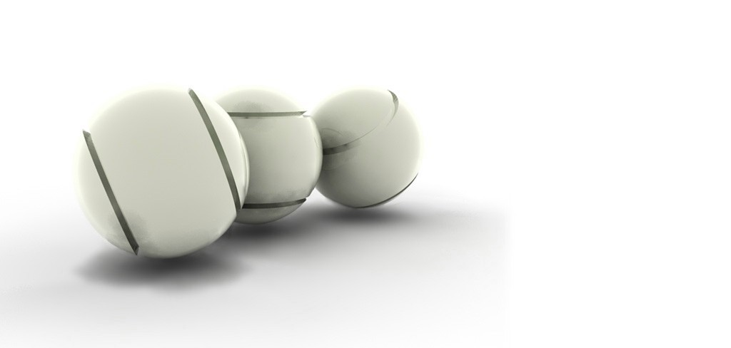
Judgment
Makes a person think before judging someone !!!!
By the way, Who are we to judge anyone?

Slide 10
Decisions on the basis of?????
Thoughts
Feelings
????????

