Slide 1
PC ToTs
Delivery

Slide 2
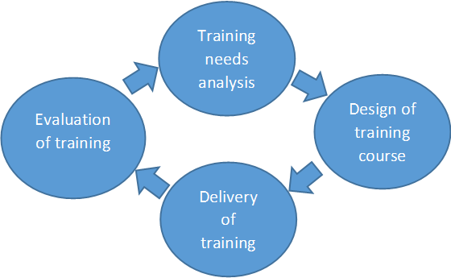
PC ToTs

Slide 3
Establish ground rules
Suitable Ice breaker
Participation through interaction and activities
Use 10 laws of presentation skill
Timely Appreciation
Time consciousness
Use visual aids
Question and Pause
Punching session

Slide 4
PC ToTs
Seating Arrangement

Slide 5
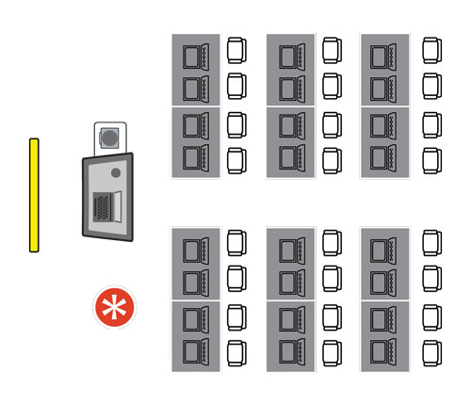
PC ToTs
Traditional Classroom

Slide 6
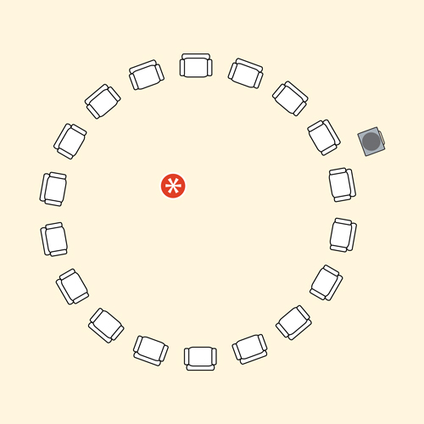
PC ToTs
Round Shape

Slide 7
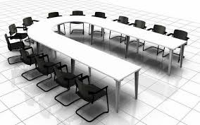
PC ToTs
Conference Mode

Slide 8
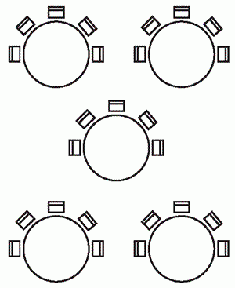
PC ToTs
Cluster shape

Slide 9
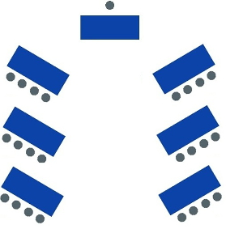
PC ToTs
V shape

Slide 10
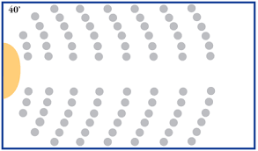
PC ToTs
Theatre Mode

Slide 11
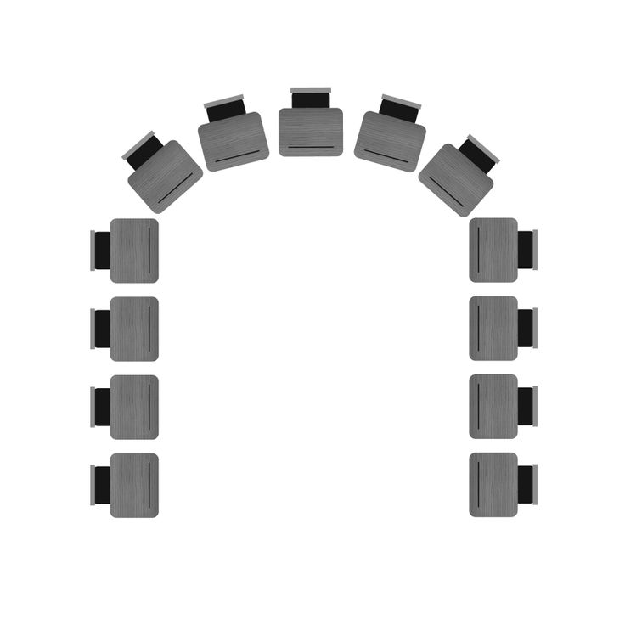
PC ToTs
U shape

Slide 12
PC ToTs
?

Slide 13
PC ToTs
Art of Asking Questions
Ask questions that stimulate discussion and interaction.
2. Ask questions begin with ‘What & How’ rather than ‘Why.’
3. Questioning Silence.

Slide 14
PC ToTs
Art of Responding Questions
Set the ground rule in the beginning.
2. Repeat the question.
3. Use eye contact.
4. Respect the group.
5. Cover all the parts of the room.
6. Do not bluff.
7. Things not say.

Slide 15
Avoid saying
“That is a good question!”
“I’m glad you asked a question.”
“Does that answer your question?”
Better say
“That’s an interesting question!”
“That’s an intriguing question!”
“What other question do you have?”
“Would you like me to get into more detail?”

Slide 16
Evaluation Sheet
Name of Trainer:
Topic:
(Put √ in the relevant boxes)
 |  | Excellent | Very good | Good | Average
 | Trainer
1 | Presentation Skill
2 | Non-Verbal Communication(Gestures,Facial Expression, Movements, etc.
3 | Eye contact
 | Content of the Training
1 | Aptness of the points discussed
2 | Relevance to the present scenario
3 | Practical Application of the points
4 | methods
5 | overall performance

