Slide 1
GATE
Games & Activities for Training Enrichment
Organized by
KERALA COUNCELLORS AND TRAINERS TRADE UNION
KCTTU, KASARGOD
21.12.19
Saturday
Faculty
Sudas kannoth
LIBERTY SCHOOL OF COMMERCE, KALANAD , UDUMA
KASARGOD

Slide 2
WHO IS HE /ROCKET
Happy
Presentation skill
Self motivation
Relationship
Recognition
Gratitude
Respect
Ice break
.
Notes:
Positive qualities

Slide 3
WALK STOP STOP WALK
Concentration
Focus
Open mindedness
Listening
Flexible
Stress management
Alert
Ice breaker
.
Notes:
WALK STOP, CLAP NAME, JUMP DANCE

Slide 4
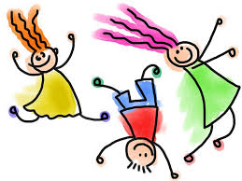
MERGE SONG
Inspiring
Passion
Humour
Relationship
Flexible
Help others
Smart
Togetherness
Common goal
Activity
.

Slide 5
MICKI MICKI HAI HAI
Relationship
Self motive
Listening
Tension
Flexible
Quick response

Slide 6
BALLOON TRAIN
Honesty
Confidence
Open minded
Restlessness
Humour
Discipline
Time management
Trust your team
Concentration
Mutual understand
Caring
Patience
.

Slide 7
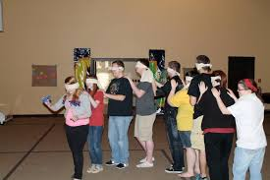
BLIND SPOT
Leadership
Communication
Patience
Listening
Assertive
Time management
Vision
Restlessness
Planning
Focus
.

Slide 8
PIPE THROW
Practice
Concentration
Confidence
Time management
Commitment
Positive attitude
Win win situation
Help others
Patience
.

Slide 9
HUNTING
One rupee note ----100 points
Flower ---50
Soda bottle ---100
One revenue stamp ---100
One banana peel ---50
Stone --20
Red socks one pair ---100
Chilly with red shade --50
Whistle -----300
Couples -----1000
Green leaf -----50
Blue kerchief ------100
1000 rupees note ------1000
Pen drive ----100
Photograph of Mahatma
Gandhi--200 (not rupees)

Slide 10
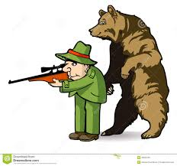
Leadership
Delegation
Energetic
Planning
Team building
Smart
Curiosity
Inspire
Open minded
Creativity
Interpersonal skill
.

Slide 11
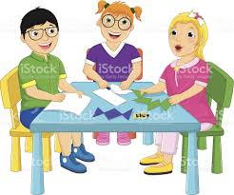
BROKEN SQUARE
Delegate
Communication
Confidence
Commitment
Positive attitude
Creativity
Patience
Team building
Vision
Time management
Sharing
Crisis management
Problem solving
Activity
.

Slide 12
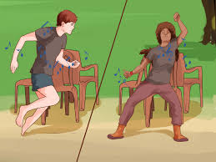
7 SEAT GAME
Patience
Flexible
Idea
Time managent
Leadership
Positive attitude
Honesty
Confidence
Intuition
Focus
Innovation
Planning
Co-ordination
Conditioning
Team work
.
Notes:
7 seat

Slide 13
INSIDE ROPE
Risk management
Flexible
Time management
Team building
Competition
Goal
Competitive
Stress
.
Notes:
Pair middle one kettu . Azhikanam shafi sir

Slide 14
Patience
Idea
Open minded
Time management
Team building
Concentration
Observation

Slide 15
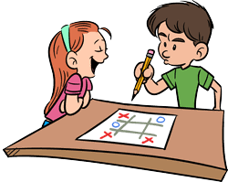
TIC TAC TOE
Honesty
Confidence
Commitment
Positive attitude
Focus
Planning
Time management
Team building
Concentration
Observation
.

Slide 16
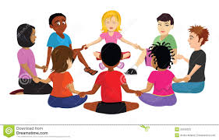
NAME GAME
Relationship
Humour
Self motivate
Listening
Organise
Curiosity
Patience
Confidence
Ice break
.

Slide 17
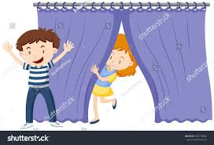
MAN CATCHING
Planning
Relationship building
Curiosity
Leadership
Funny
Responsibility
Conviction
Remembrance
Quick capture
.
Notes:
Conviction uracha viswasam

Slide 18
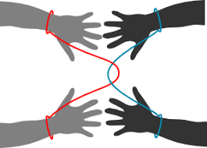
ROPE ESCAPE
Idea
Open minded
Humour
Relationship building
Likable
Risk management
Curiosity
Emotional control
Creativity
Think differently
.

Slide 19
INSIDE ROPE
Thinking out of the box
Positive attitude
Innovative
Humour
Leadership
Idea
intuition
.

Slide 20
ONE MINUTE SILENT
Listening
Smart
Value of time
Individual behaviour analysis
.

Slide 21
ALPHABETIC SHAPES
Concentration
Flexible
Proactive
Risk
Listening
Time managent
Emotional control
Activity
.
Notes:
Proactive -convert positive action

Slide 22
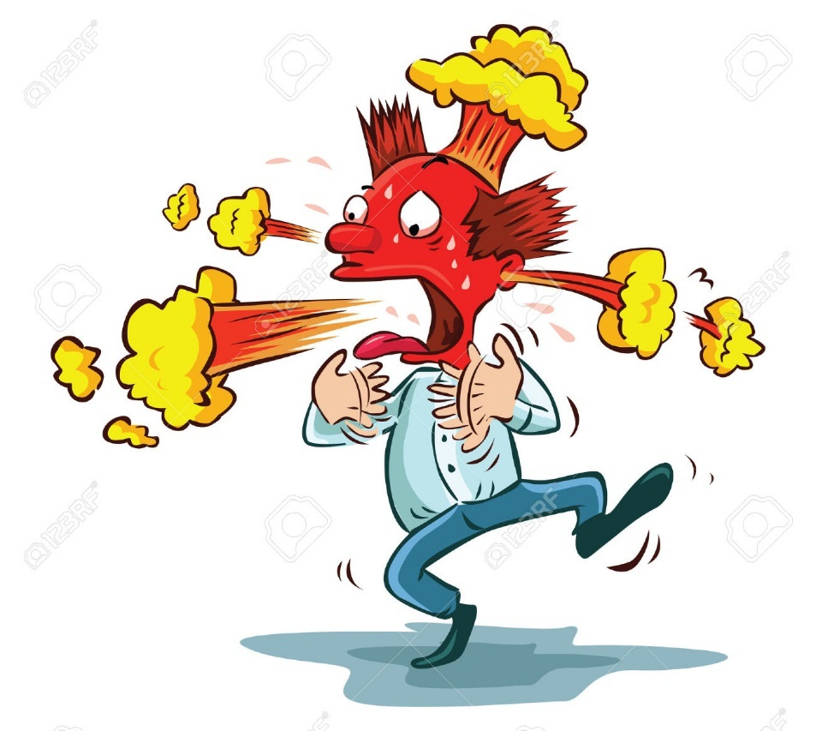
FIRE SWALLOW
Confidence
Competition
Happiness
Opportunity
Smart
Curiosity
Activity
.

Slide 23
COMMUNICATION
Oral Presentation
Creative Thinking
Listening
Activity

Slide 24
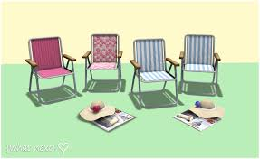
WITHOUT CHAIR
Confidence
Commitment
Positive attitude
Patience
Courage
Conviction
Curiosity
Trust
Discipline
.
Notes:
Conviction dridaviswasam

Slide 25
SUDAS KANNOTH
POSITIVE COMMUNE
Soft skill training team
Thank You
sudaskannoth@gmail.com
944 711 4001

