Slide 1
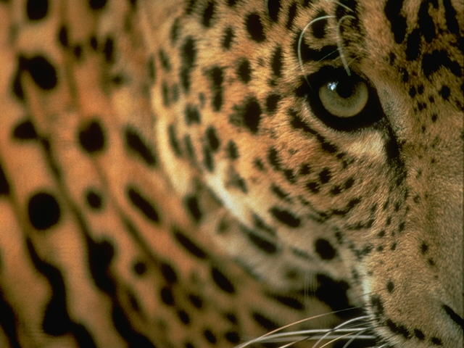
The Most

Slide 2
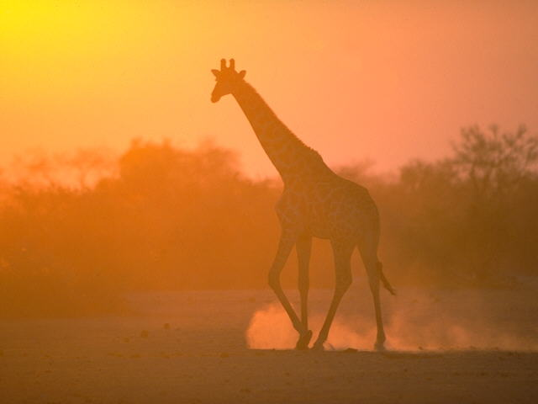
The most selfish one letter word...........
“I"
Avoid it.

Slide 3
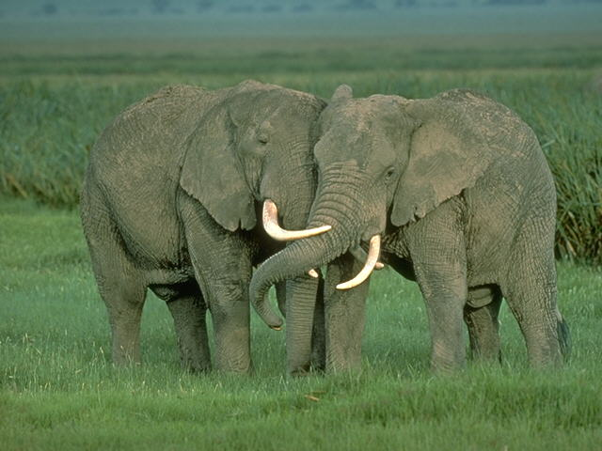
The most satisfying two-letter word.......
"WE"
Use it.

Slide 4
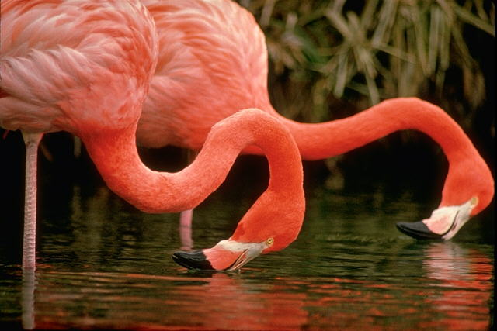
The most poisonous three-letter word.....
"EGO"
Kill it.

Slide 5
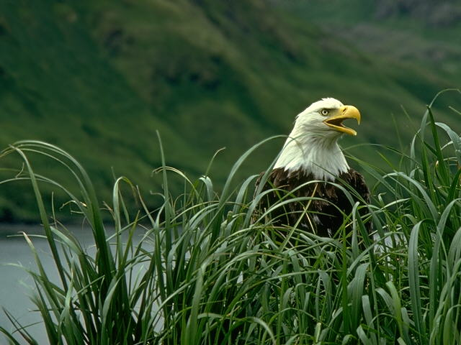
The most used four-letter word...........
"LOVE"
Value it.

Slide 6
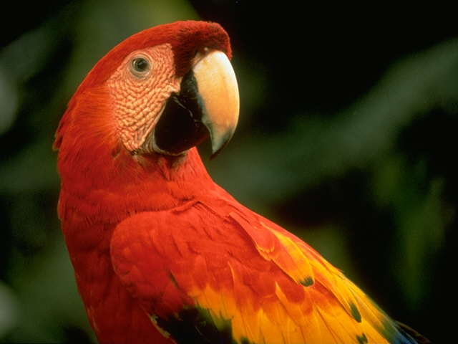
The most pleasing five-letter word.......
“SMILE"
Keep it.

Slide 7
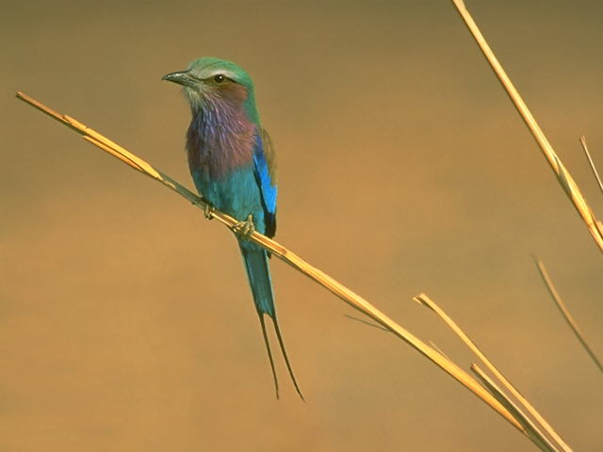
The fastest spreading six-letter word...
"RUMOUR"
Ignore it.

Slide 8
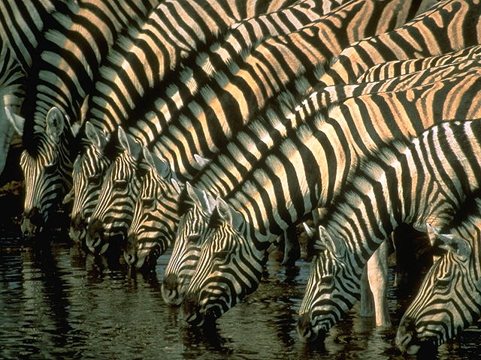
The hardest working seven-letter word..
"SUCCESS"
Achieve it.

Slide 9
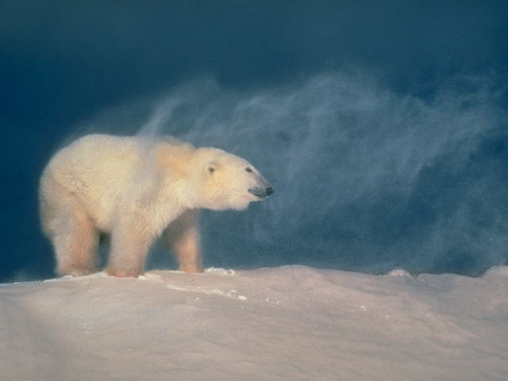
The most enviable eight-letter word....
“JEALOUSY"
Distance it.

Slide 10
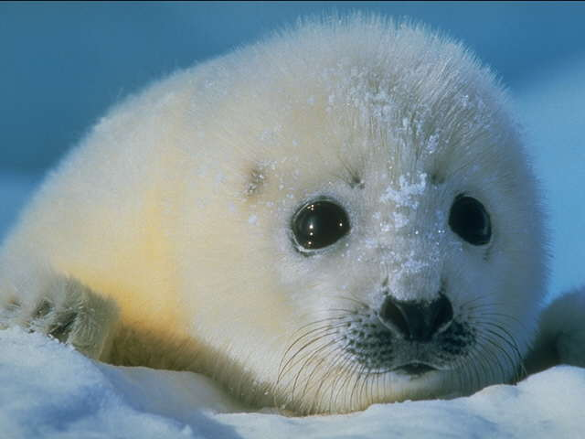
The most powerful nine-letter word....
“KNOWLEDGE"
Acquire it.

Slide 11
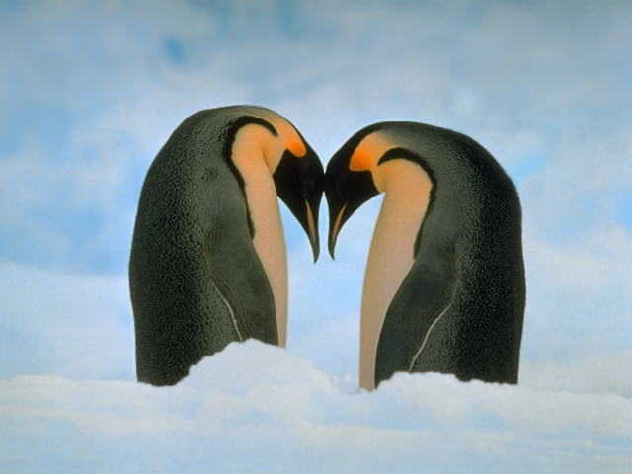
The most essential ten-letter word....
“CONFIDENCE"
Trust it.

Slide 12
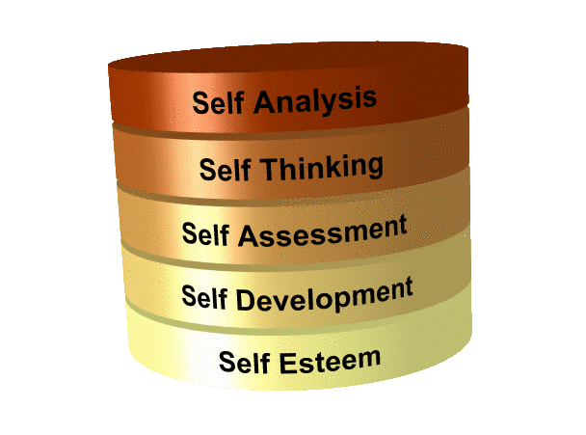
YOU ARE THE KEY

