Slide 1
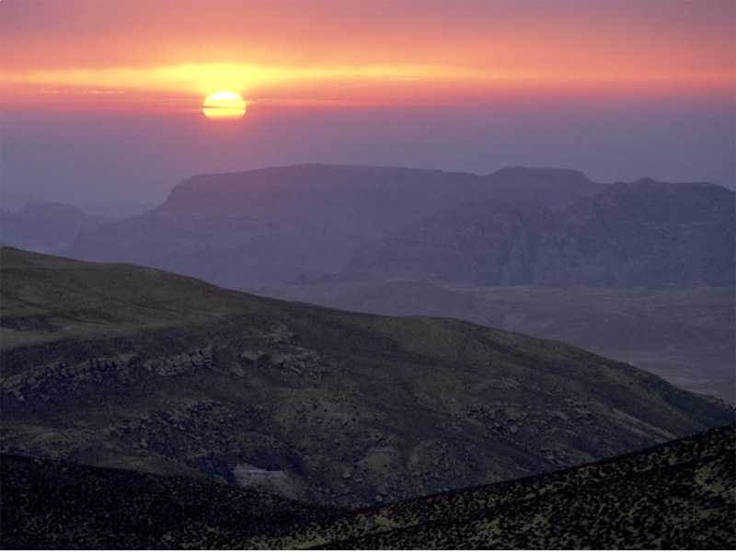
If you woke up today with no pain you are luckier than most

Slide 2
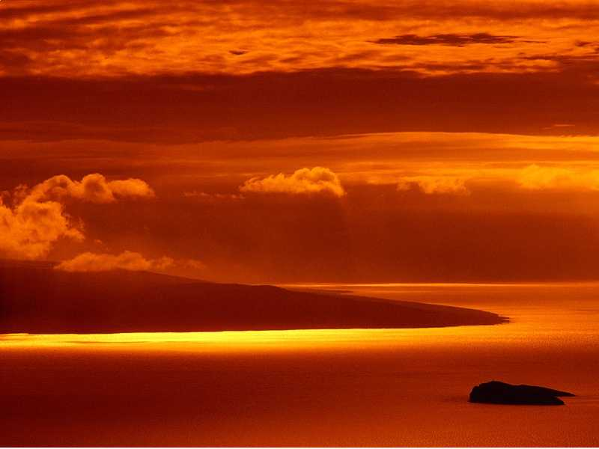
If you have never known the dangers of war, loneliness of prison, or hunger……..
……….you are better off than 500 million
people in the world

Slide 3
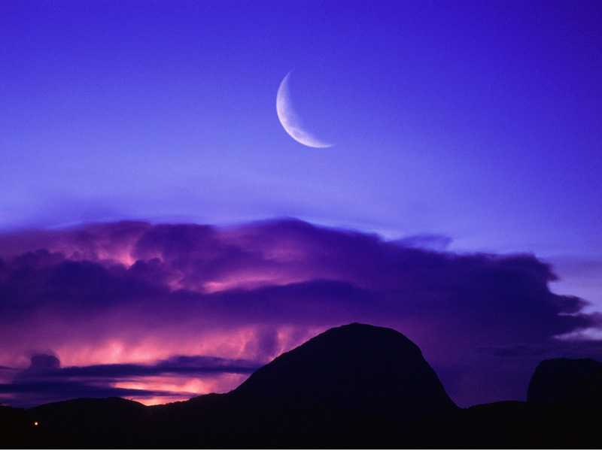
If you can go to your mosque, church, or temple or follow your beliefs without persecution…..
You are luckier than more than 3 million people on this planet.

Slide 4
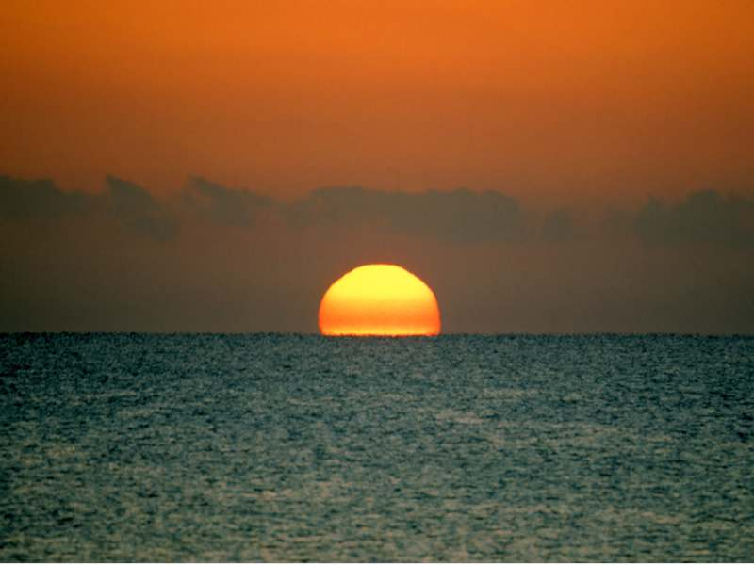
If your basic needs are covered,……
……you are richer than 75%
of the rest of the world.

Slide 5
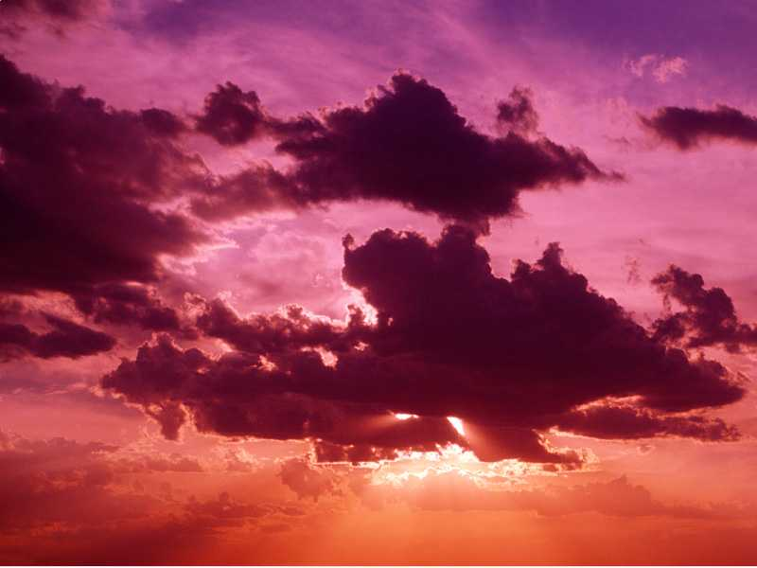
If you even have some savings,
….you are part of the 10% of the most prosperous people in the world

Slide 6
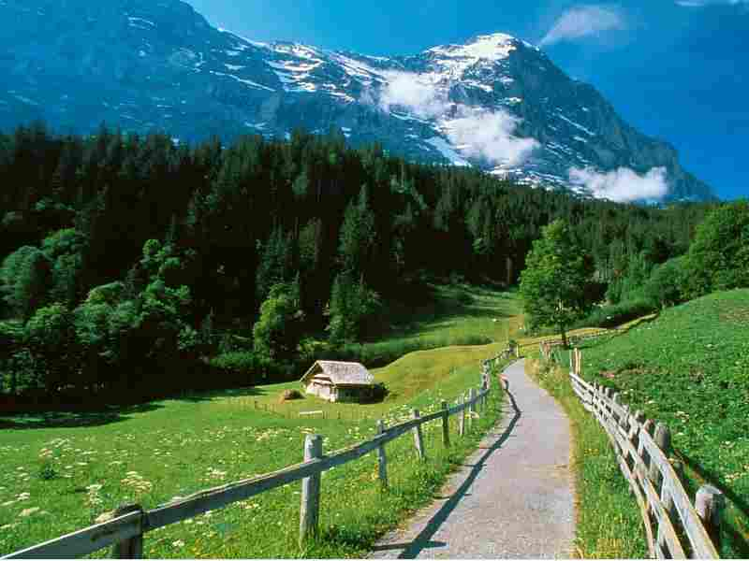
If you saw your parents grow old together….
…you are almost unique

Slide 7
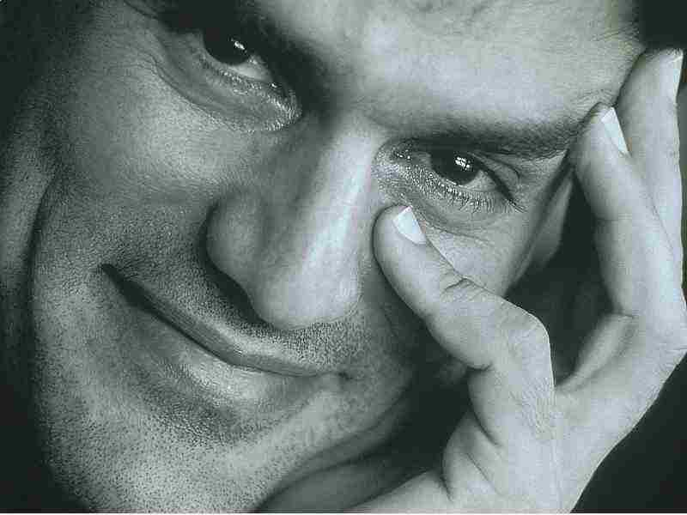
If you smile and appreciate life, you are lucky……..
……because lots of people can, but they don’t.

Slide 8
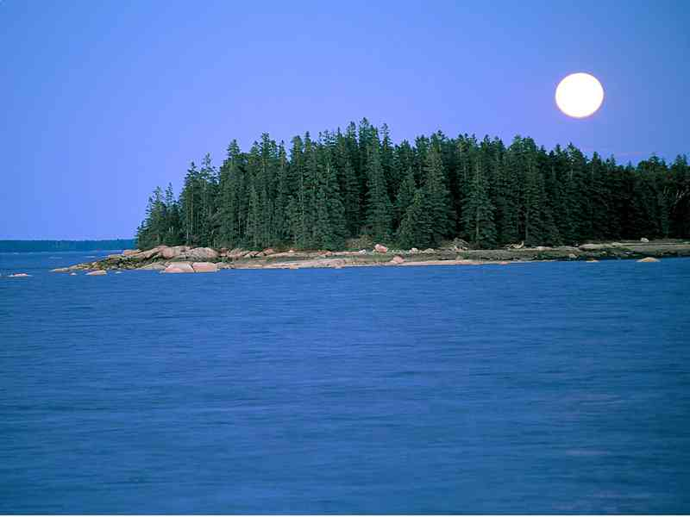
If you have someone whose hand you can hold, or can hug, or even just a shoulder to touch
…be happy, you will never be lonely.

Slide 9
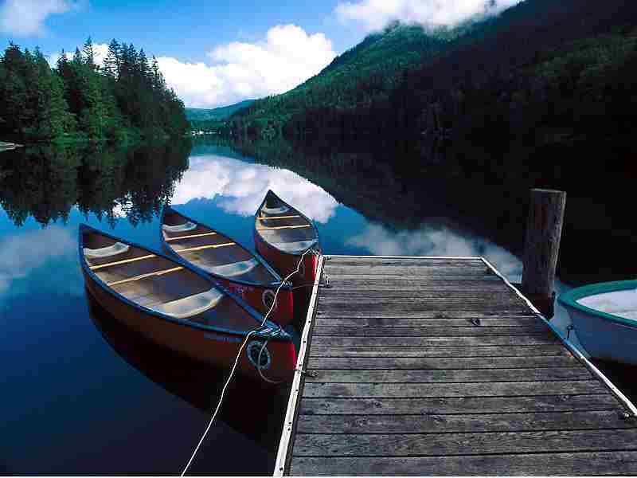
If you can read this message, you are doubly blessed.
First someone remembered you and more than 2 million people on this planet cannot read.

Slide 10
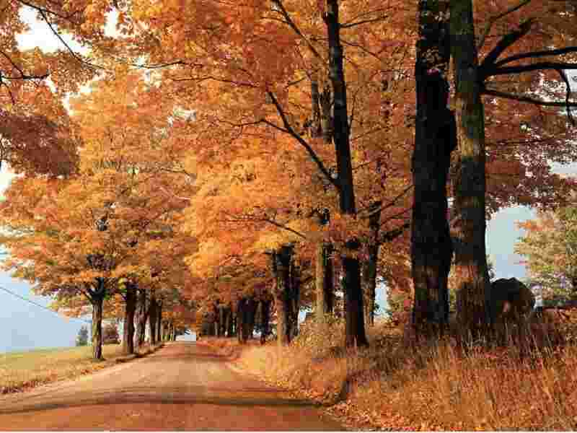
Dwell on your luck and send this message
To others who maybe do not appreciate
What they have

