Slide 1
The pencil parable
In the beginning, the Pencil Maker spoke to the pencil saying,
"There are five things you need to know before I send you out into the world. Always remember them and you will become the best pencil you can be."

Slide 2
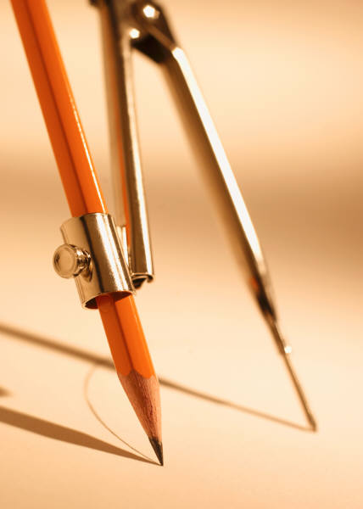
First:
You will be able to do many great things, but only
if you allow yourself to be held in Someone's hand.

Slide 3
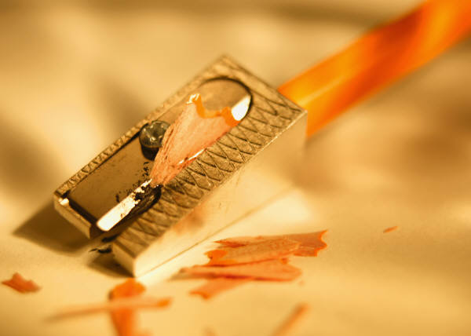
Second:
You will experience a painful sharpening from time to time, but this is required if you are to become a better pencil.

Slide 4
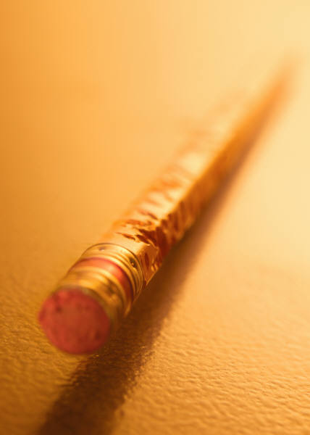
Third:
You have the ability to correct any mistakes you might make.

Slide 5
Fourth:
The most important part of you will always be what's inside.

Slide 6
Fifth:
No matter what the condition, you must continue to write. You must always leave a clear, legible mark no matter how difficult the situation.

Slide 7
The pencil understood, promising to remember, and went into the
box fully understanding its Maker's purpose.

Slide 8
Now replacing the place of the pencil with you; always remember them and never forget, and you will become the best person you can be.

Slide 9
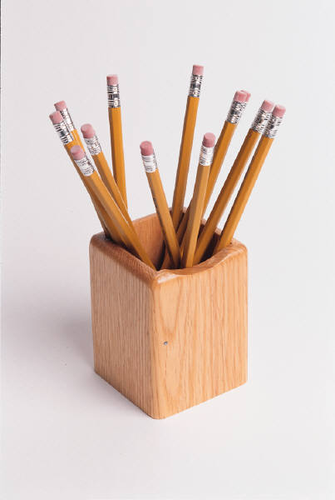
One:
You will be able to do many great things, but only if you allow yourself to be held in God's hand. And allow other human beings to access you for the many gifts you possess.

Slide 10
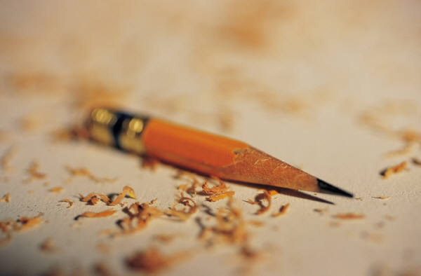
Two:
You will experience a painful sharpening from time to time, by going through various problems, but you'll need it to become a stronger person.

Slide 11
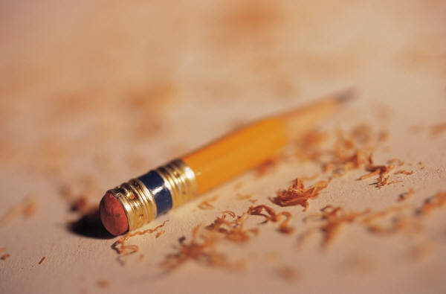
Three
You will be able to correct mistakes you might make or grow through them.

Slide 12
Four:
The most important part of you will always be what's on the inside.

Slide 13
And Five:
On every surface you walk, you must leave your mark. No matter what the situation, you must continue to serve God in everything.

Slide 14
Everyone is like a pencil... created by the Maker for a unique and special purpose.
By understanding and remembering, let us proceed with our life on this earth having a meaningful purpose in our heart and a relationship with God daily.
You were Made to do Great Things!

