Slide 1

High Performing Mindset

Slide 2


Slide 3
Seven Elements of
High Performing Mindset

Slide 4
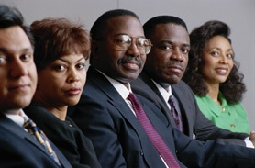
1. Desire
The motivation to succeed comes from the burning desire to achieve a purpose. Napoleon Hill wrote, "Whatever the mind of man can conceive and believe, the mind can achieve.”

Slide 5

A burning desire is the starting point of all accomplishment. Just like a small fire cannot give much heat, a weak desire cannot produce great results.

Slide 6

2. Commitment
Integrity and wisdom are the two pillars on which to build and keep commitments.

Slide 7

3. Responsibility
People with character accept responsibilities. They make
decisions and determine their own destiny in life.

Slide 8

Accepting responsibilities involves taking risks and being accountable which is sometimes uncomfortable.

Slide 9

Most people would rather slay in their comfort zone and live passive lives without accepting responsibilities. They drill through life waiting for things to happen rather than making them happen.

Slide 10

Responsible people don't
think that the world owes them a living.

Slide 11
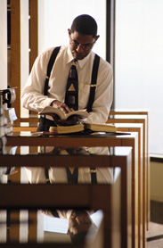
4. Hard Work
Excellence is not something that you run into by accident. It takes a lot of preparation and character.

Slide 12

Everyone likes to win but how many are willing to put in the effort and time to prepare to win? It takes sacrifice and self-discipline.

Slide 13
THE HUMAN MIND IS LIKE A PARACHUTE IT ONLY WORKS WHEN IT IS OPEN

Slide 14

5. Positive Believing
Positive believing is a lot more than positive thinking. It is having a reason to believe that positive thinking will work.

Slide 15


Slide 16

Positive believing is an attitude of confidence that comes with preparation. Having a positive attitude without making the effort is nothing more than having a wishful dream.

Slide 17

6. The Power of Persistence
Persistence means commitment and determination. It is a commitment to finish what you start.

Slide 18

When we are exhausted, quitting, looks good. But winners endure. Ask a winning athlete. He endures pain and finishes what he started. Lots of failures have begun well but have not concluded anything.

Slide 19
Persistence comes from purpose. Life without purpose is drifting.
A person who has no purpose will never persevere and will never be fulfilled.

Slide 20


Slide 21

7. Pride of Performance
Excellence comes when the performer takes pride in doing his best.

Slide 22
Pride of performance does not represent ego.
It represents pleasure with humility.
The quality of the work and the quality and the worker are inseparable.
Half-hearted effort does not produce half results; it produces no results.

Slide 23

Every job is a self-portrait of the person who does it, regardless of what the job is, whether washing cars, sweeping the floor or painting a house. Pride comes from within, which is what gives the winning edge.

Slide 24

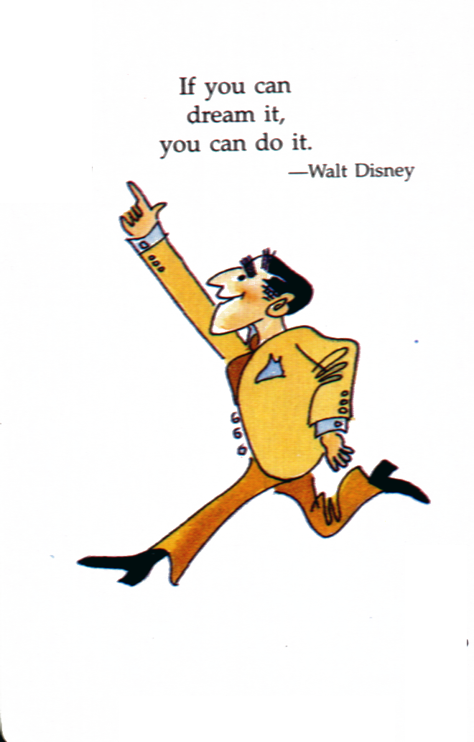

Slide 25

Thank you
CARE
Total training solutions
Email:carehrd@gmail.com
94460 30237

