Slide 1
ELECTRIC INTEGERS
UNDERSTANDING OF ENNEAGRAM IN COACHING AND MENTORING

Slide 2
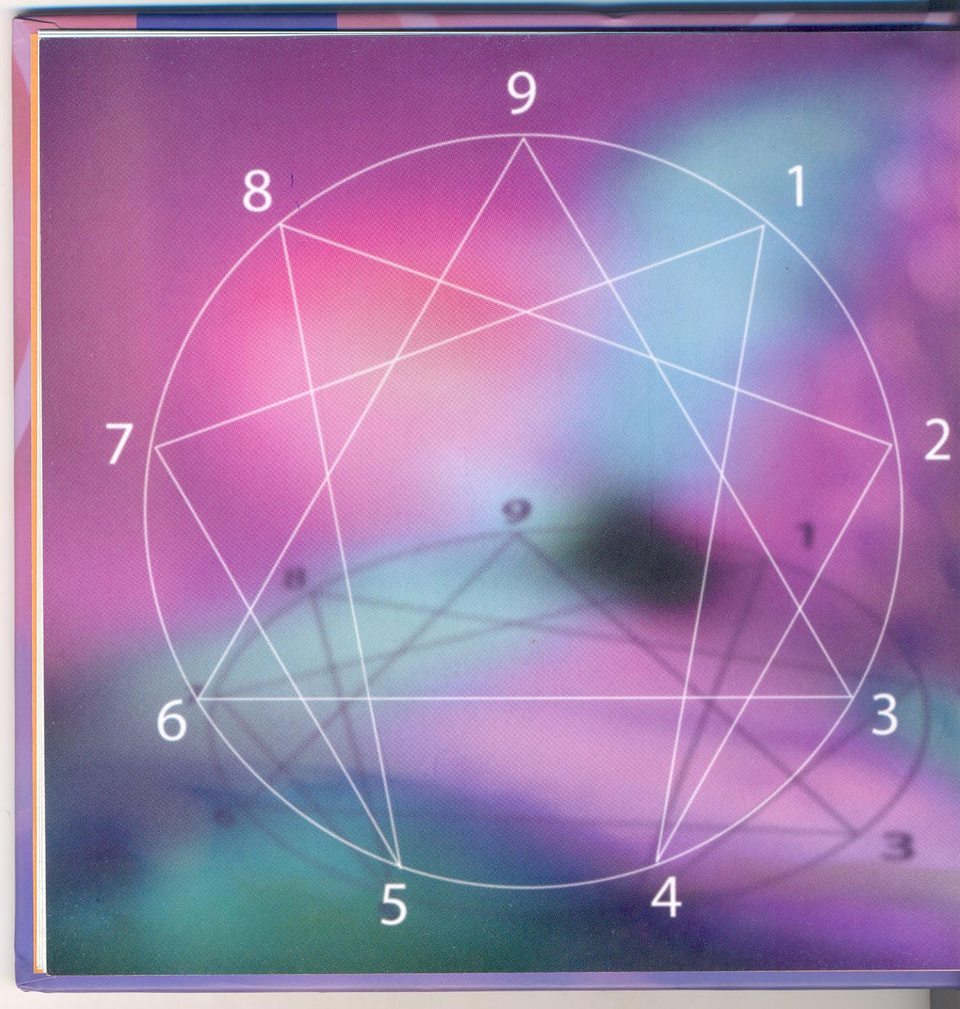
ENNEAGRAM

Slide 3
WHY COACHING
UNLOCKING THE POTENTIAL OF PEOPLE
MAXIMISE THEIR EFFECTIVENESS
HELPING RATHER THAN FORCING
YOU HAVE TO TAKE ONE STEP AT A TIME

Slide 4
Coaching is about providing encouragement as opposed to threats
It is about empowering inspiring rather than directing and controlling them
An understanding of Enneagram gives insights to your coaching process

Slide 5
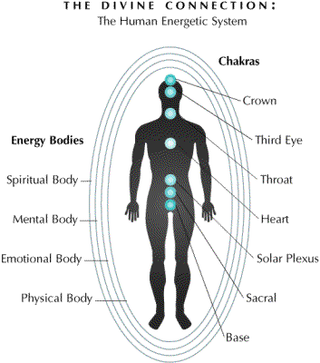

Slide 6
Enneagram describes nine personality types which are radically different in their way of responding to the world
The nine types
Exercise 1 Strength weakness
You ,father ,mother ,grandfather,grandma
Exercise 2 Emotional index meathod

Slide 7
Exercise 3 reading ,rereading and understanding in Enneagram style
Nine personality types and diagram

Slide 8
Look back to history
Enneagram has its roots from /before Pythagoran era Bc 425
Pythagoras is a mysterious figure (after Euclid )and thought that whole of the cosmos can be described in terms of whole numbers 1,2,3,….
Pythagorans thought that things are numbers and whole cosmos is a scale of numbers

Slide 9
In Enneagram we describe personality types in numbers from 1 to 9
If we divide 1 by 3,6,9 & 7 we get the following results.
Eg . 1/3 = 0.333
1/6 = 0.166667166667
1/9= 0.1111
1/7= 0.1428571428571
This is one base of the development of Enneagram.
The wholeness of unity (1) gets fragmented into nine types
The wholeness of a personality can be connected to wholeness of cosmos

Slide 10
Personality has different faces. Enneagram describes has to a nine faced gem.Each face should be polished in order to get the brightness.
Here in this session of Electrical Integers we learn
How to integrate fragments of our personality in to whole
How to help others to integrate their personality by understanding Enneagram
How this model can be applied in coaching

Slide 11
You should understand what the term polarity means
Positive and Negative
Exercise-4
Write down 3 polarities in this class room.
Polarity is the reason for energy flow and
It flows from positive to negative

Slide 12
Has the universe any polarity ?
Is it balanced ?
How it is balanced?
The polarity is the reason for fragmentation

Slide 13
To integrate we have to balance the polarity of these fragements first.
In Enneagram this polarity is termed as healthy - unhealthy, redeemed – unredeemed and integration – disintegration
Figure Integration

Slide 14
For Integration you should see the brightness in side
The each fragments should be polished and brightened
Each fragments respresents faces of your personality.
Every thought you have has an energy which fragements you or unite which either strengthern or weaken you

Slide 15
These fragmenting or weakenig thoughts should be eliminated for you to get integrated
If you are happy then you have learned to see goodness and beauty everywhere
If you are unhappy you cannot see out side of you what you failed to see inside

Slide 16
How to increase your energy level
Become conscious of your thoughts - low energy and high energy thinking
Make meditation regular practice
Become conscious of the foods you eat
Retreat from low energy substances - alcohol,drugs ect…
Become conscious of the energy level of the music you listen to
Become aware of the energy levels of your home environment

Slide 17
Reduce your exposure to very low energy level of commerical and cable television
Enhance your energy field with photographs
Become conscious of the energy levels of your acquaintances ,friends and extended family
Monitor your activities and where they take place
Extend acts of kindness, asking for nothing in return

Slide 18


Slide 19


Slide 20


Slide 21


Slide 22


Slide 23


Slide 24


