Slide 1
High Performing Leadership

Slide 3
What is Leadership ?
A leader articulates and embodies a vision and goals, and enables others to share and achieve them
Leadership is a state of mind….leadership is about vision, spirit, and character; getting diverse individuals to work together as a team

Slide 4
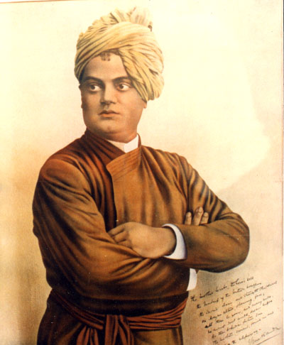
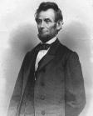
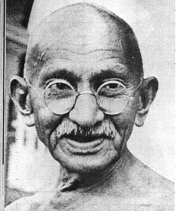
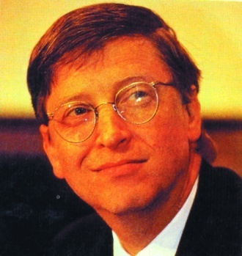
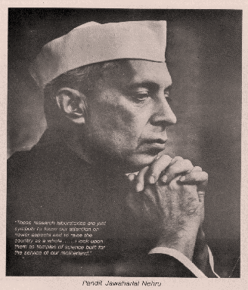
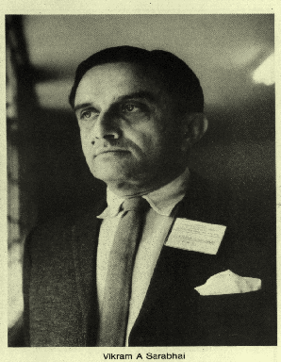
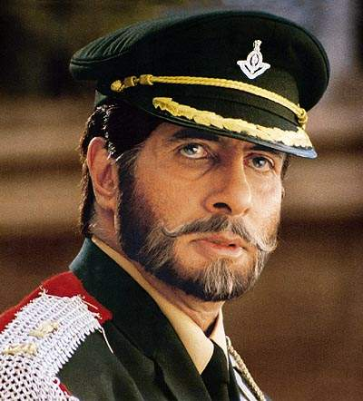
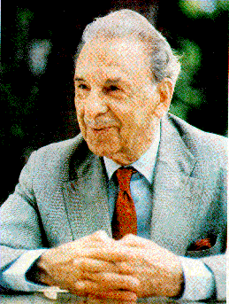
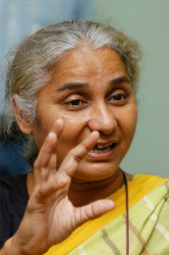
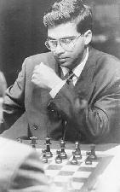
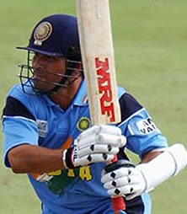
Influencers

Slide 5
Elements of High Performing Leadership
High Performing Leadership
Leader as Vision Creator
Leader as Team Builder
Leader as
Tasks Allocator
Leader as
People Developer
Leader as Motivation Stimulator

Slide 7
Leader as Vision Creator
Monitoring Action Plan Execution
Creating Vision
Setting Goals
Developing Action Plan

Slide 9
Leader as Team Builder
Effective Leaders develop and nurture……
Great Team
Clear Goals
Clear measures of performance
Clear job roles
Team identity and spirit
Sense of fun and enjoyment
Open and honest communication
Task
People

Slide 10
Leader as Tasks Allocator
Leaders get things done through people….
Tasks
Result
Leaders
People
Effective leaders, therefore, need to understand the value of allocating tasks or delegating and know how to do it

Slide 12
Leader as People Developer
Leadership is about developing leaders, not followers
Leadership is about creating a legacy, one that will propel the organization to new levels of success even when the leader has moved on

Slide 13
Leader as People Developer
Leader
Follower Development and Learning Plan
Follower

Slide 14
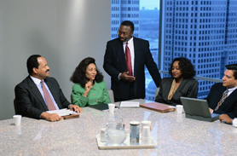
Leader as Motivation Stimulator

Slide 16
Leader as Motivation Stimulator
Leaders establish the vision for the future and set the strategy for getting there; they motivate and inspire others to go in the right direction
Motivation = the willingness to exert high level of effort to reach organizational goals

Slide 17
Leader as Motivation Stimulator
Collaboration
Three C’s of Motivation
Content
Choice

Slide 18
Leader as Motivation Stimulator
Inspire by Example
Leader as Motivation Stimulator
Create and communicate a clear vision of the goals

Slide 19
Ask yourself
How well do I treat people from whom I can gain nothing?
Am I transparent with others?
Do I role play based on person[s] I am with?
Am I the same person when I am in the spotlight as I am when I am alone?
Do I quickly admits wrong doings without being pressed to do so?

Slide 20
Ask yourself
Do I put other people ahead of my personal agenda?
Do I have an unchanging standard for moral decisions or do circumstances determine my choices?
Do I make difficult decisions even when they have a personal cost attachment to it?
When I have something to say about people, do I talk to them or about them?
Am I accountable to at least another person for what I think say and do?

Slide 22
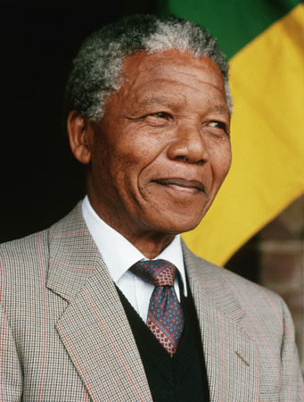
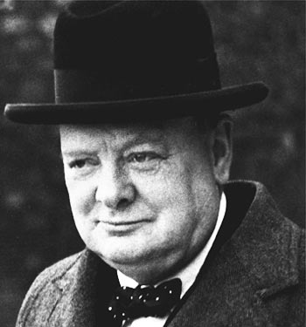
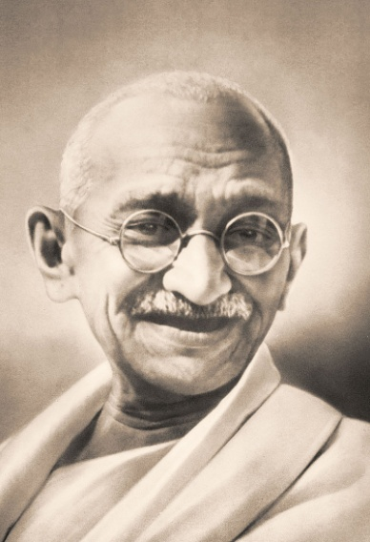
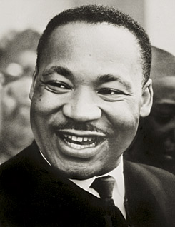
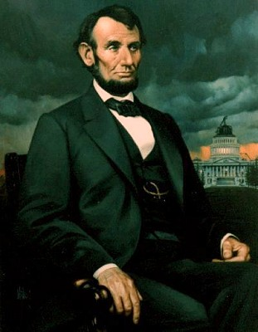
Leadership Excellence
Thoughts From The Greatest Leaders Of All Times
Nelson Mandela
Sir Winston Churchill
M.K.Gandhi
Martin Luther King
Abraham Lincoln
“A small body of determined spirits fired by an unquenchable faith in their mission can alter the course of history.”
M.K.Gandhi

Slide 23
Leadership Excellence
Thoughts From The Greatest Leaders Of All Times
Nelson Mandela
Sir Winston Churchill
M.K.Gandhi
Martin Luther King
Abraham Lincoln
“Strength does not come from physical capacity. It comes from an indomitable will.”
M.K.Gandhi

Slide 24
Leadership Excellence
Thoughts From The Greatest Leaders Of All Times
Nelson Mandela
Sir Winston Churchill
M.K.Gandhi
Martin Luther King
Abraham Lincoln
“Education is the most powerful weapon which you can use to change the world.”
Nelson Mandela

Slide 25
Leadership Excellence
Thoughts From The Greatest Leaders Of All Times
Nelson Mandela
Sir Winston Churchill
M.K.Gandhi
Martin Luther King
Abraham Lincoln
“I have always felt that a politician is to be judged by the animosities he excites among his opponents.”
Sir Winston Churchill

Slide 26
Leadership Excellence
Thoughts From The Greatest Leaders Of All Times
Nelson Mandela
Sir Winston Churchill
M.K.Gandhi
Martin Luther King
Abraham Lincoln
“Our scientific power has outrun our spiritual power. We have guided missiles and misguided men.”
Martin Luther King

Slide 27
Leadership Excellence
Thoughts From The Greatest Leaders Of All Times
Nelson Mandela
Sir Winston Churchill
M.K.Gandhi
Martin Luther King
Abraham Lincoln
“Force is all-conquering, but its victories are short-lived.”
Abraham Lincoln

Slide 28
Thank you
Care
Total Training Solutions-
Cochin-18
94460 30237
Email: carehrd@gmail.com

