Slide 1
THE PEOPLE AROUND YOU
.

Slide 2
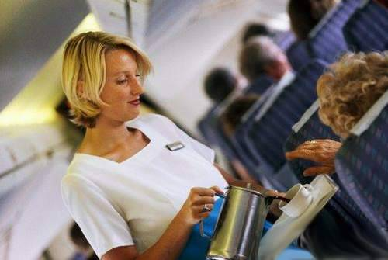
The following event took place during a transantlantic flight on October 14, 1998.
A lady was seated next to a black gentleman.

Slide 3
The woman, visibly upset, asked the flight attendant to find another seat for her as she didn’t want to sit next to someone so unpleasant.
The flight attendant told her that the flight was quite full, but that she would check and see if there was room in first class.

Slide 4
The rest of the passengers watched the scene with shock and disgust, not only because this woman was so obnoxious and rude, but for the fact that she would actually be moved to first class.
The poor man felt terribly uncomfortable about this whole scene but was cordial enough not to react.

Slide 5
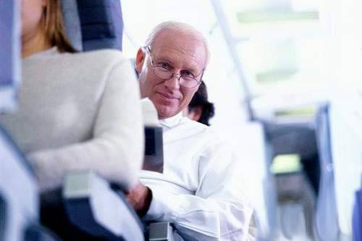
The climate in the cabin was of complete tension, but the lady seemed pleased and very happy to be moving to first class away from this person.

Slide 6
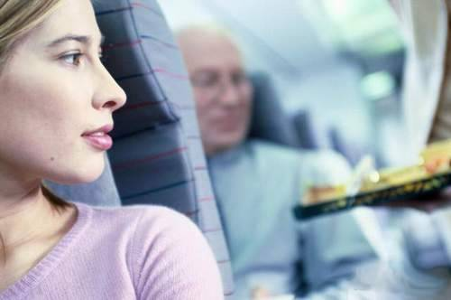
A few minutes later the flight attendant returned and informed the woman:
“Excuse me ma’am, the flight is indeed pretty full…
…Fortunately I found a seat available in first class.

Slide 7
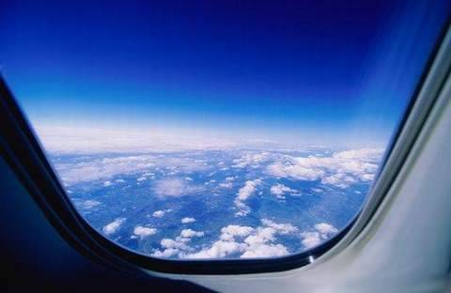
“It took me a while because in order to make that change I had to get permission from the captain.
He told me that we shouldn’t force anyone to have to sit next to someone so unpleasant, and authorized the change right away.”
The other passengers couldn’t believe what they were hearing… and the woman, with a triumfant expression on her face, proceeded to get up from her seat.

Slide 8
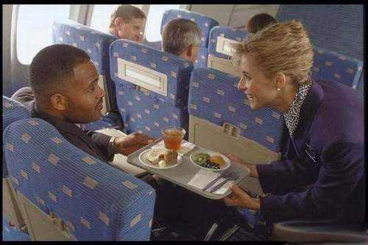
Then the flight attendant turned towards the black man and said:
-”Sir… would you be so kind as to follow me to your new seat in first class? On behalf of our airline, the captain offers you his apology for the fact that you had to put up with someone so unpleasant sitting next to you.”

Slide 9
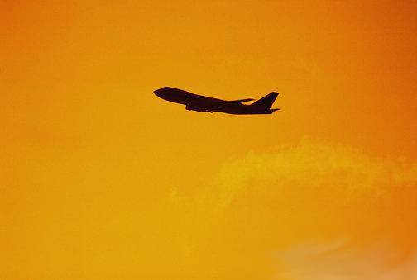
All the passengers applauded and gave a standing ovation to the crew for handling the situation so well.
That year, the captain and the flight attendant were awarded for their actions on that flight. Due to this, the company realized they had not placed sufficient priority on customer service training for their employees.

Slide 10
The Airline made immediate changes!
Since this event, in all of their offices and in clear sight of their personnel, the following message is posted:

Slide 11
“People may forget what you said to them.
People may forget what you do to them.
But they will never forget the way you made them feel.”

