Slide 1
LINK METHORD

Slide 2
LINK METHORD
1.CANDLE

Slide 3
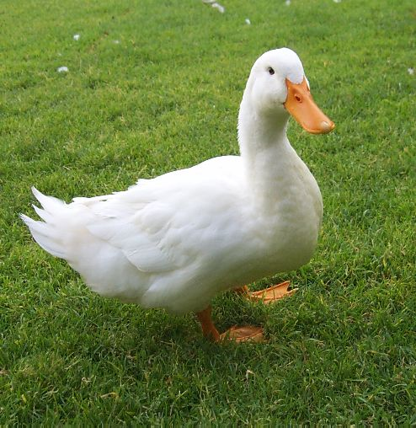
LINK METHORD
2.DUCK

Slide 4
LINK METHORD
3.HEART

Slide 5
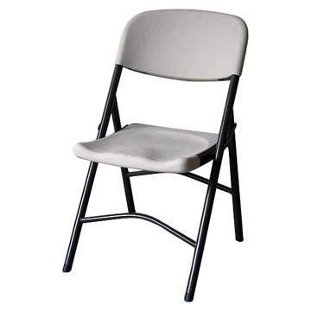
LINK METHORD
4.CHAIR

Slide 6
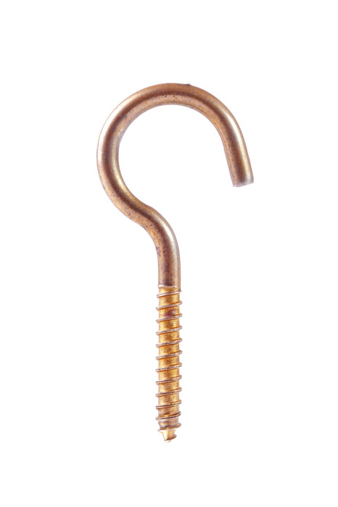
LINK METHORD
5. HOOK

Slide 7
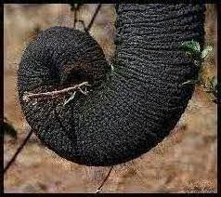
LINK METHORD
6. TRUNK

Slide 8
LINK METHORD
7.MOUNTAIN

Slide 9
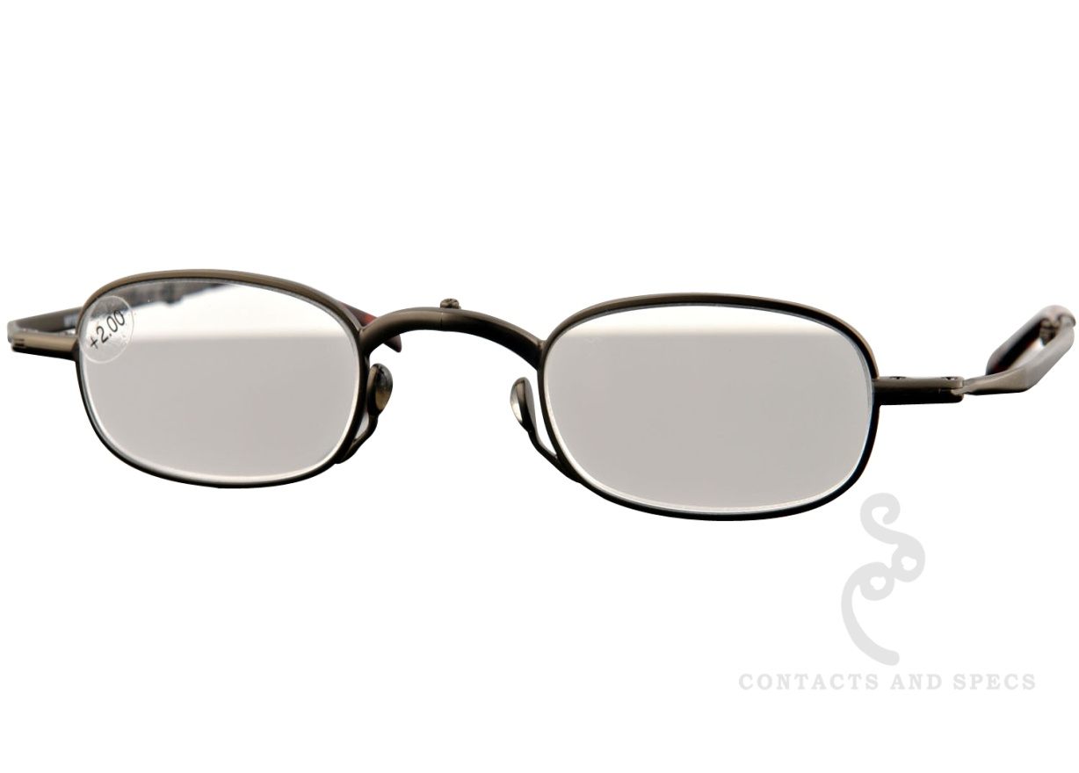
LINK METHORD
8.SPEX

Slide 10
LINK METHORD
9.BALOON

Slide 11
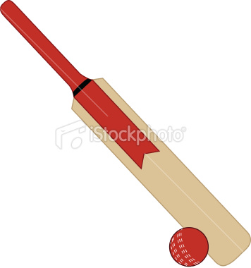
LINK METHORD
10
BAT AND BALL

Slide 12
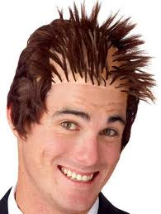
LINK METHORD
11.HAIR

Slide 13
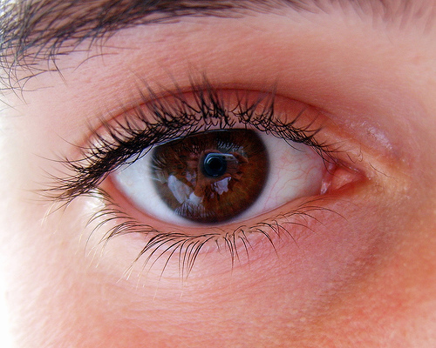
LINK METHORD
12.EYE

Slide 14
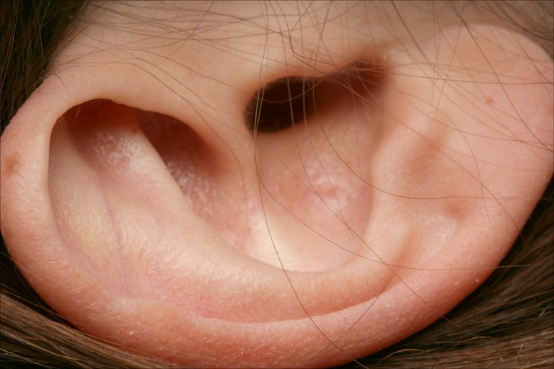
LINK METHORD
13. EAR

Slide 15
LINK METHORD
14. NOSE

Slide 16
LINK METHORD
15. MOUTH

Slide 17
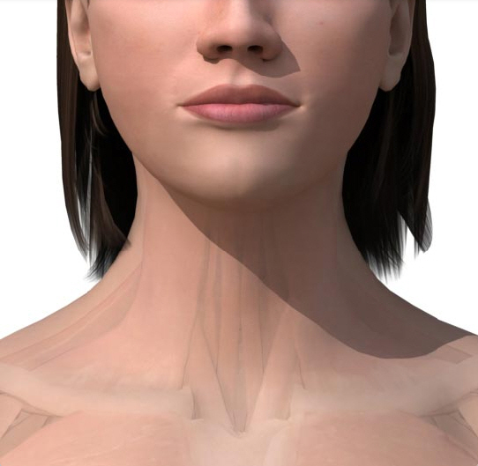
LINK METHORD
16. NECK

Slide 18
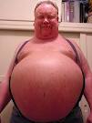
LINK METHORD
17. STOMACH

Slide 19
LINK METHORD
17. STOMACH

Slide 20
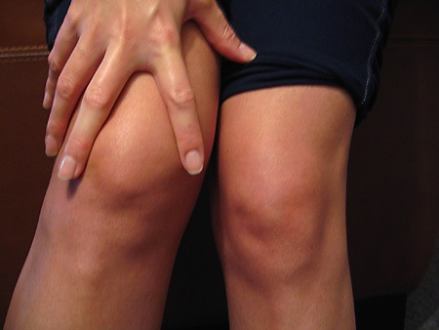
LINK METHORD
19. KNEE

Slide 21
LINK METHORD
20. FOOT

Slide 22
LINK METHORD
21. SUN

Slide 23
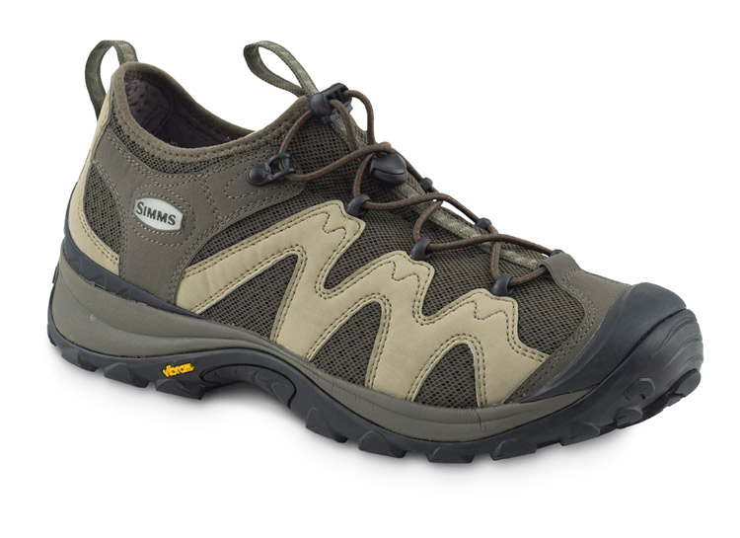
LINK METHORD
22. SHOE

Slide 24
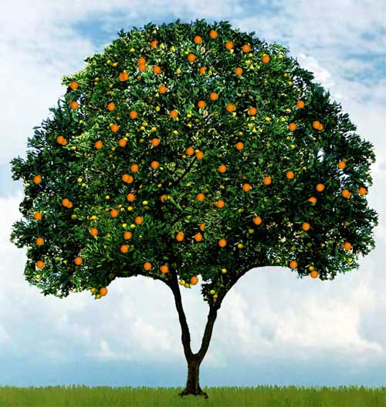
LINK METHORD
23. TREE

Slide 25
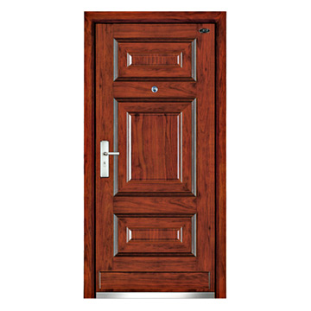
LINK METHORD
24. DOOR

Slide 26
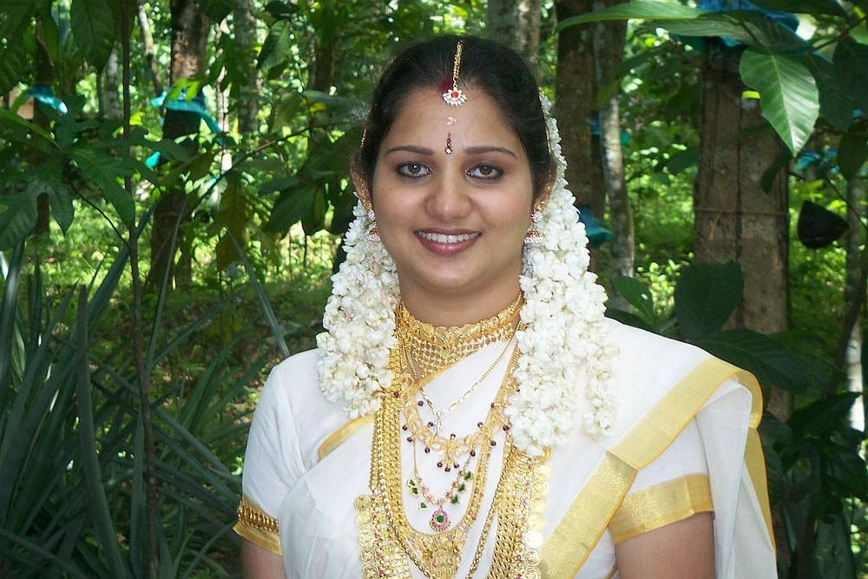
LINK METHORD
25. WIFE

Slide 27
LINK METHORD
26. VICKS

Slide 28
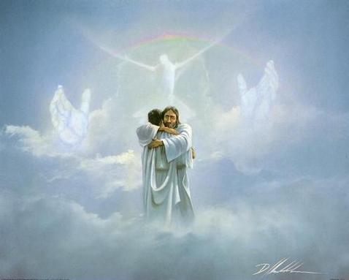
LINK METHORD
27. HEAVEN

Slide 29
LINK METHORD
28. PLATE

Slide 30
LINK METHORD
29. WINE

Slide 31
LINK METHORD
30. THIRSTY

Slide 32
LINK METHORD
THANK YOU

