Slide 1
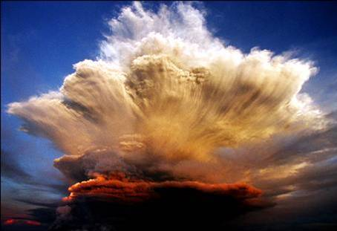
I wish you
the strength
of all elements

Slide 2
Find the new avenues

Slide 3
Rejuvenate your inner power

Slide 4
Alter your perception

Slide 5
Give the best

Slide 6
Recall your memories

Slide 7
A chance to take a chance

Slide 8
Never ever give up

Slide 9
Can we be friends

Slide 10
Enhance positivism

Slide 11
Feel the fragrance

Slide 12
Enjoy the fragrance

Slide 13
Life is drawing without an eraser

Slide 14
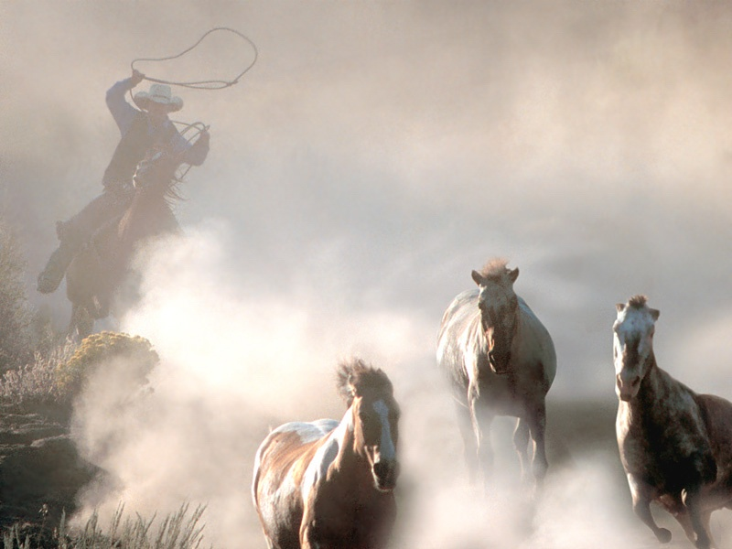
I wish you always:
Air to breath,
Fire to warm you,
Water to drink and
The earth to live in.

