Slide 1

Ways to inspire your Organization, your team, yourself.
www.carehr.com. email: carehrd@gmail.com.

Slide 2


Personality conflict
It happens to all of us in business, social, and even family encounters. We meet people with common interests and instantly establish a rapport. We may laugh at the same things, or discover perhaps that we’ve had very similar life experience. Then we meet others and it is a challenge just to hold a conversation. We’re on guard, uncomfortable and sometimes, inexplicably hostile.
Why?
www.carehr.com. email: carehrd@gmail.com.

Slide 3

Personality traits
Personality is not black or white, but rather like a kaleidoscope, composed of many twists and preferences.
www.carehr.com. email: carehrd@gmail.com.

Slide 4
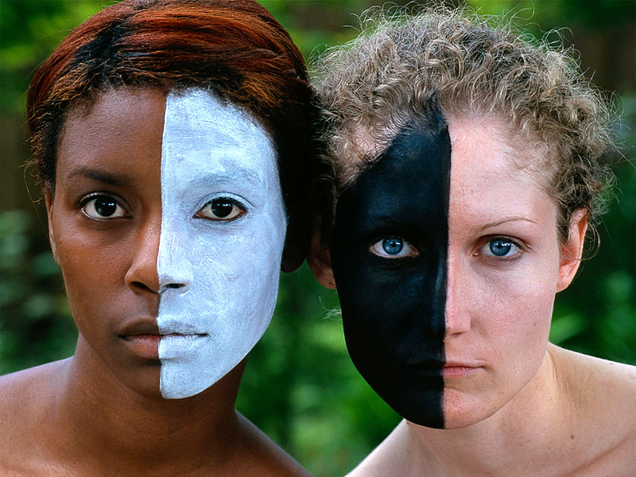
We can only understand our own personality by opening our eyes to a whole new kind of understanding of ourselves and others. Personality is a solid core of traits reflecting the unique essence of a particular human being.
www.carehr.com. email: carehrd@gmail.com.

Slide 5
Your personality traits determine whether you are easily depressed, casual, formal, cautious, or carefree.
They determine whether you are passive or assertive.
Do you dash off at the last minute for an appointment or always arrive at a meeting with time to spare?
Do you prefer to play a quiet game of chess on your personal computer or would you rather dance the night away with your friends?
www.carehr.com. email: carehrd@gmail.com.

Slide 6
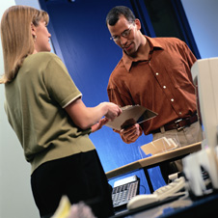
Your personality is key to how you react to those and other situations.
It is what causes you to act and react the way you do.

Slide 7
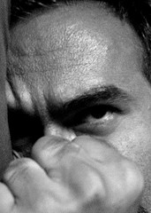
Your behavior code
Your personality includes a behavior code a core of thoughts and feelings that tells you how to conduct your self in different situation
www.carehr.com. email: carehrd@gmail.com.

Slide 8
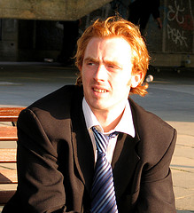
Your behavior code directs your emotional and or rational reaction when confronted by an adverse situation. It is the active on going process in your heart and mind that dictates how you think, feel and behave.
www.carehr.com. email: carehrd@gmail.com.

Slide 9

Types of personalities.
Power players
Team players
Diplomatic players
Party players
www.carehr.com. email: carehrd@gmail.com.

Slide 10
Type :1
Are the POWER PLAYERS. They like to have things done their own way and can have problems with authoritarian figures who may not allow them to do everything they want to do. Type is like to work , and if given a proper motivation are highly productive individuals. They want to knowledgeable in everything they do and actively seek out respect and recognition. They like to be in the driver’s seat and will aggressively pursue any management position that will allow them to climb the ladder.
www.carehr.com. email: carehrd@gmail.com.

Slide 11
Type :2
Type 2 are the TEAM PLAYERS. They look for opportunities to bring happiness to others. They’ll hold doors open for others, offer rides when someone’s car breaks down , and volunteer for company charity functions. More than anything else they want others to like and respect them. Type 2’s are in their best element when people listen to them and appreciate them. They’ll readily admits to any mistakes they make and will seek out corrective advice in their search to be understood. Type 2s need to be constantly thanked for any good work that they do and come equipped with a strong sense of integrity.

Slide 12
Type :3
Type 3s are the DIPLOMATIC PLAYERS who will do almost anything to avoid confrontations. They like to work on teams where confrontations are neutralized with team consensus. Type 3s dominant need to always feel good about themselves. Although they are amiable people , they exhibit silent stubbornness when they are treated unkindly. They will open up instantly to people who are kind and will recoil like snakes to people who are hostile. They will seldom render an opinion unless it is solicited.
www.carehr.com. email: carehrd@gmail.com.

Slide 13
Type :4
Type 4s are the PARTY PLAYERS. They are the happiest of all the personality types and consider life to be one big party at which they are the hosts. Type 4s need to be noticed and are in constant search for praise. As perpetual optimists, they believe they have the world by a tail and will only confide their fears and frustrations to people they trust. Looking good socially is very important to type 4’s . Friendships command a high priority in their lives because popularity answers one of their basic needs. Easily bored they actively seek adventure and can never sit still for long periods of time.
www.carehr.com. email: carehrd@gmail.com.

Slide 14
Motivating basics
People have reasons for what they do.
People act to gain something they believe is good for them.
People have to believe their goals are attainable.
The value of a goal can change when unknown benefits are undesirable.
www.carehr.com. email: carehrd@gmail.com.

Slide 15
Strengths of TYPE 1
Excel with logical and creative thinking.
Thrive on independence and in competitive situations.
Are natural leaders who are committed to productivity.
Verbally communicate their thoughts well.
Set goals comfortably and with confidence.
Are highly disciplined and make decisions quickly.
Thrive in leadership and power situations.
Are direct and quick with suggestions.
Operate well under extreme pressure.
Maintain high self-esteem.
Are very dependable.
Give work a high priority and take commitments seriously.
www.carehr.com. email: carehrd@gmail.com.

Slide 16
Weaknesses of TYPE 1
Are self serving and consider themselves always right, even when they are wrong.
Are inconsiderate and insensitive to the feelings of others.
Promote turmoil and conflict if it suits their needs.
Are quick to be adversely judgmental of others rather than themselves.
Blame others for their misfortunes rather than taking personal responsibility.
www.carehr.com. email: carehrd@gmail.com.

Slide 17
Weaknesses of TYPE 1
Dislike being told what to do and will challenge upper management.
Are highly competitive, sometimes preventing them from seeing the big picture.
Consider work more important than personal relationships.
Can be very intimidating and arrogant if they are in their self-righteous mode.
www.carehr.com. email: carehrd@gmail.com.

Slide 18
Corrective measures for TYPE 1
Offer them challenges that includes things they like to do.
Type is are basically selfish. Offer them rewards and bonuses for good work.
Type is hide their insecurities, so avoid talking about their personal failures.
Appeal to their desire to be highly productive at whatever they do.
www.carehr.com. email: carehrd@gmail.com.

Slide 19
Corrective measures for TYPE 1
Always explain to type 1s, in a logical order, what you want them to do.
If you are trying to motivate type 1 to resolve personal conflicts, remember that they tend to be insensitive people. Appeal them on logical, rather than emotional , terms.
Type 1s are impatient, so always make sure you address the main subject first to capture their attention.
Be careful not to cross type 1s. They can become very forgiving and impossible to motivate.
www.carehr.com. email: carehrd@gmail.com.

Slide 20
Strengths of TYPE 2
High achievers with a deep sense of purpose.
Highly disciplined with a strong goal orientation backed by superb follow-through.
Stable , dependable, and emotionally solid.
Analytically oriented and receptive to others’ ideas and suggestions.
Respectful of authority, and work well behind the scenes to support their boss.
Loyal forever to friends and people they trust.
Self-sacrificing, impressionable, and sensitive.
www.carehr.com. email: carehrd@gmail.com.

Slide 21
Weaknesses of TYPE 2
Can become highly emotional, smug, and self-righteous in confrontations.
Are rigid in their principles and unwilling to negotiate with people they don’t like or don’t respect.
Expect others to understand them and to be sensitive toward their feelings.
www.carehr.com. email: carehrd@gmail.com.

Slide 22
Weaknesses of TYPE 2
Can become easily discouraged if they fail to meet their goals.
Crave job security and become highly emotional if job insecurity develops.
Tend to downplay the capabilities of others relative to their own capabilities.
Will avoid public exposure in adverse situations.
www.carehr.com. email: carehrd@gmail.com.

Slide 23
Corrective measures for TYPE 2
Reward Type 2s. They like to cover their walls with award plaques.
Reinforce their need for security whenever the opportunity presents itself.
Limit the risk level of whatever assignments you delegate to them.
Be sensitive and sincere when conversing with Type 2s.
www.carehr.com. email: carehrd@gmail.com.

Slide 24
Corrective measures for TYPE 2
Promote creativity and allow them ample time to collect their thoughts on creative ideas.
Avoid demanding immediate action unless you have their full co operation.
Earn their trust and respect before you place demands on them.
www.carehr.com. email: carehrd@gmail.com.

Slide 25
Strengths of TYPE 3
Are quiet, reflective, peaceful, and blendable in all situations
Accept whatever life dishes out.
Are comfortable with others and receptive to their ideas because they are superb listeners.
Recognize the values of setting goals and objectives.
www.carehr.com. email: carehrd@gmail.com.

Slide 26
Strengths of TYPE 3
Receptive to suggestions and appreciate exposure to many possibilities.
Are calm under pressure and can function well in crisis situations.
Work well in bureaucratic environments and respect leadership qualities in others.
www.carehr.com. email: carehrd@gmail.com.

Slide 27
Weaknesses of TYPE 3
Are bored and often detached from their job.
Are unsure of themselves, resist making commitments, and take the passive approach to anything they do.
Are ambivalent about setting goals that require real commitments.
Fear confrontation and can be easily manipulated.
www.carehr.com. email: carehrd@gmail.com.

Slide 28
Weaknesses of TYPE 3
Are dishonest with their feelings, which can be misleading.
Will not openly contribute to a conversation unless coaxed.
Take a wait-and-see attitude rather than making a decision now.
Lack consistency in setting goals and measuring accomplishments.
Respect leadership but resent harsh leaders.
Are not high producers, fear change, and are difficult to motivate.
www.carehr.com. email: carehrd@gmail.com.

Slide 29
Corrective measures for TYPE 3
Be sensitive but firm when communicating with type 3s.
Listen carefully to what they have to say and look for nonverbal clues of expression.
Accept their individuality and provide a work structure that’s comfortable for them.
Constantly offer them ideas for goals and present them with opportunities for involvement.
Constantly monitor their progress toward complimenting assigned goals, and be prepared to initiative corrective action whenever appropriate.
www.carehr.com. email: carehrd@gmail.com.

Slide 30
Strengths of TYPE 4
Are not afraid to make tough management decisions.
Are highly optimistic, very self-confident, and accept others easily.
See life as an experience to be enjoyed, and readily volunteer for challenging assignments.
Are highly energy individuals who inspire others to co operate and excel.
www.carehr.com. email: carehrd@gmail.com.

Slide 31
Strengths of TYPE 4
Are spontaneous thinkers with excellent communication skills.
Are energized by large groups, such as work teams, and are willing to accept guidance from others.
Demand action and productivity from others on key projects.
Are strong visual learners who are willing to compromise in order to get things done.
www.carehr.com. email: carehrd@gmail.com.

Slide 32
Weaknesses of TYPE 4
Are self-centered, irresponsible, and unreliable.
Talk a lot about what they are going to do yet provide little action to get it done.
Can handle stress for only short periods of time.
Do not like to commit to long-term goals.
Often speak before thinking and freely interrupt others.
Are unwilling to dedicate themselves to cause unless they are fun.
Make insensitive jokes about serious and sensitive issues.
www.carehr.com. email: carehrd@gmail.com.

Slide 33
Corrective measures for TYPE 4
Always be positive with them.
Promoted reward and recognition events for completing well- defined goals.
Allow them to verbally express themselves, listening carefully to what they say.
Don’t be too serious or intense when criticizing.
Totally control their schedules with regular follow-up sessions to make sure they’re meeting their commitments.
www.carehr.com. email: carehrd@gmail.com.

Slide 34

www.carehr.com. email: carehrd@gmail.com.

Slide 35
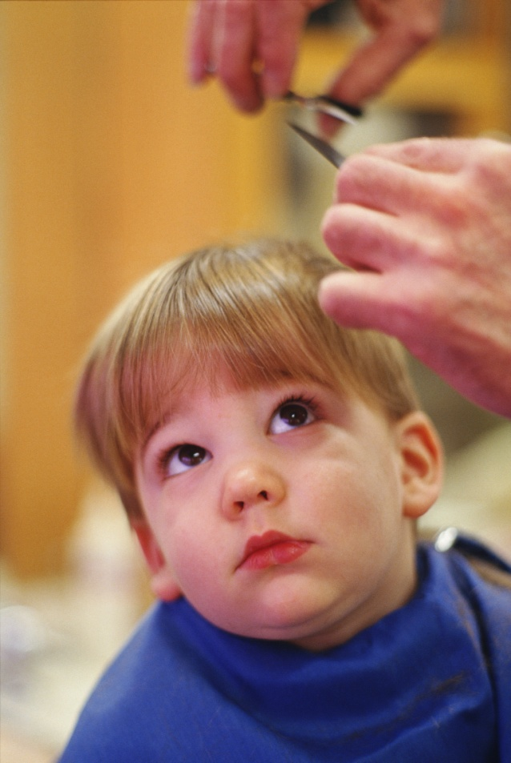
IMPROVING YOUR
PERSONALITY’S CHARACTOR
Your character is developed over the years by personal design and the level of commitment you have toward life principles. Once character is established, it cannot be easily altered, and over time, becomes as solid as your personality.
www.carehr.com. email: carehrd@gmail.com.

Slide 36

We know that the development of character is a learned process. As a result, we should constantly be seeking ways to eliminated or neutralize personality weaknesses by applying positive character strengths .
www.carehr.com. email: carehrd@gmail.com.

Slide 37
Celebrate your own diversity
Our tendency is to ask, which fruit is best? The answer is, that’s a dump question.

Slide 38
Grapes
Natural abilities include
Grapes may have troubles
Being reflective
Being sensitive
Being flexible
Being creative
Preference for working in groups
Giving exact answer
Focusing on one thing at a time
Organizing

Slide 39
Grapes learn best when they:
To expand their style, grapes need to:
Can work and share with others
Balance work with play
Can communicate
Are noncompetitive
Pay more attention to details
Not rush into things
Be less emotional when making some

Slide 40
Oranges
Natural abilities:
Oranges may have trouble:
Experimenting
Being independent
Being curious
Creating different approaches
Creating change
Meeting time limits
Following a lecture
Having few options or choices

Slide 41
Oranges learn best when they:
To expand their style, oranges need to
Can use trial and error
Produce real products
Can complete are self-directed
Delegate responsibility
Be more accepting of others’ ideas
Learn to prioritize.

Slide 42
Bananas
Bananas may have trouble
Natural abilities
Understanding feelings
Dealing with opposition
Answering “what if” question.
Planning
Fact finding
Organizing
Following directions

Slide 43
Learn best when they:
To expand styles, bananas need to:
Have an orderly environment
Have specific outcomes
Can trust others to do their part
Have predictable situations.
Express their own feelings more
Get explanations of others’ views
Be les rigid

Slide 44
Melons
Natural abilities include:
Melons may have trouble:
Debating point of view
Finding solutions
Analyzing ideas
Determining value or importance
Working in groups
Being criticized
Convincing others diplomatically

Slide 45
Learn best when they :
To expand style, melons need to:
Have access to resources
Can work independently
Are respected for intellectual ability
Follow traditional methods
Accept imperfection
Consider all alternatives
Consider others’ feelings

Slide 46
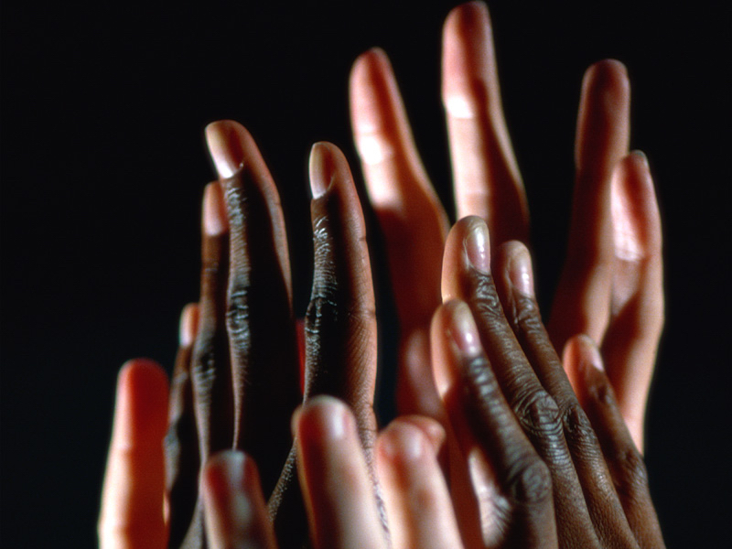
Five basic character traits to improve your own personality.
Intimacy
Power
Communications
Self-esteem
Commitment
www.carehr.com. email: carehrd@gmail.com.

Slide 47

Learn to appreciate the unique strengths and limitations of each personality. Then study them so you can strengthen the inherent weaknesses of your own personality type.
www.carehr.com. email: carehrd@gmail.com.

Slide 48


Slide 49
Thank you

Slide 50
Total training solutions
Web: www.carehr.com.
Email: carehrd@gmail.com
Mob: 94462 60237
2nd floor, Mather square
Opp. North railway station
Cochin-18

