Slide 1
POSITIVE COMMUNE (Soft skill training team) Presents
GATE
Games & Activities for Training Enrichment
. Faculty
Sudas kannoth

Slide 2
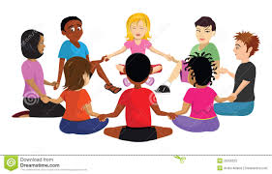
NAME GAME
Relationship
Humour
Self motivate
Listening
Organise
Curiosity
Patience
Confidence
Ice break
.

Slide 3
WALK STOP STOP WALK
Concentration
Focus
Listening
Open mindedness
Flexible
Stress management
Ice breaker
.
Notes:
WALK STOP, CLAP NAME, JUMP DANCE

Slide 4
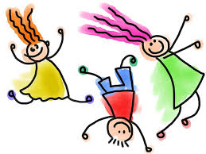
MERGE SONG
Relationship
Inspiring
Humour
Flexible
Help others
Smart
.

Slide 5
MICKI MICKI HAI HAI
Relationship
Self motive
Listening
Tension
Flexible
Quick response
Ice break
.

Slide 6
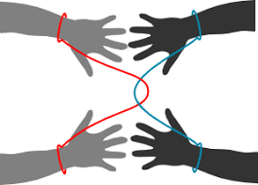
ROPE ESCAPE
Idea
Open minded
Humour
Likable
Risk management
Curiosity
Relationship building
Emotional control
.

Slide 7
BALLOON TRAIN
Honesty
Confidence
Open minded
Restlessness
Humour
Discipline
Time management
Trust your team
.

Slide 8
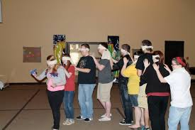
BLIND SPOT
Leadership
Non verbal Communication
Patience
Listening
Assertive
Time management
Vision
Restlessness
Planning
Focus
.

Slide 9
HUNTING
One rupee note ----100 points
Flower ---50
Soda bottle ---100
One revenue stamp ---100
One banana peel ---50
Stone --20
Red socks one pair ---100
Chilly with red shade --50
Whistle -----300
Couples -----1000
Green leaf -----50
Blue kerchief ------100
1000 rupees note ------1000
Pen drive ----100
Photograph of Mahatma
Gandhi--200 (not rupees)

Slide 10
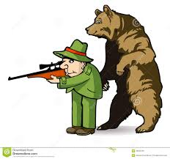
HUNTING
Leadership
delegation
Energetic
Planning
Team building
Smart
Curiosity
Inspire
Open minded
.

Slide 11
CIRCLE PASS
Competitive
Flexible
Time management
Team building
Goal
Competitive
Stress
.
Notes:
MATHEW RAPHEL

Slide 12
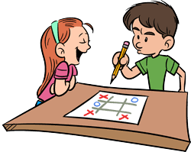
TIC TAC TOE
Honesty
Confidence
Commitment
Positive attitude
Focus
Planning
Time management
Team building
.

Slide 13
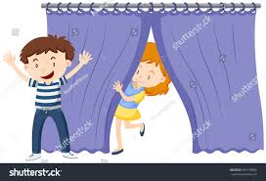
MAN CATCHING
Planning
Relationship building
Curiosity
Leadership
Funny
Responsibility
Conviction
.
Notes:
Conviction uracha viswasam

Slide 14
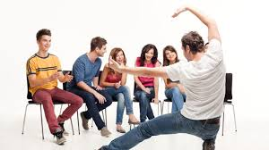
DUMB CHARADES
Stage fear
Time management
Intuition
Assertive
Curiosity
Creativity
Listening
Acting skill
Self motivation
Communication
Trust your team
.

Slide 15
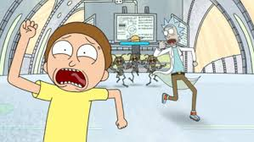
SEAT CATCHING
Energetic
Emotional control
Self motivation
Ethical
Risk
Confidence
Focus
Happy
.

Slide 16
ALPHABETIC SHAPES
Concentration
Flexible
Proactive
Risk
Listening
Time managent
Emotional control
.
Notes:
Proactive -convert positive action

Slide 17
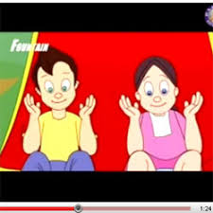
CLAP PUZZLE , RAIN, CHENDA
Smart
Energetic
Listening
Organised
Curiosity
Concentration
Refreshing
Happiness
Focus
Time management
.
.

Slide 18
FRUIT SALAD
Energetic
Self motivated
Humour
Emotional control
Discipline
Risk management
.

Slide 19
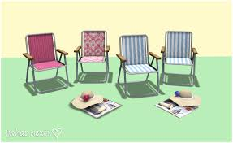
WITHOUT CHAIR
Confidence
Commitment
Positive attitude
Patience
Courage
Conviction
Curiosity
.
Notes:
Conviction dridaviswasam

Slide 20
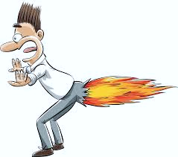
FIRE COTTON
Confidence
Competition
Happiness
Opportunity
Smart
Curiosity
.

Slide 21
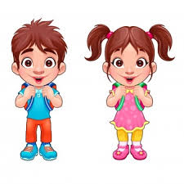
MATHAJI
Listening
VAK
Focus
Curiosity
.

Slide 22
ONE MINUTE SILENT
Listening
Smart
Leadership
Focus
Value of time
Individual behaviour
analysis
.

Slide 23
SUDAS KANNOTH
POSITIVE COMMUNE
Soft skill training team
Thank You
sudaskannoth@gmail.com
944 711 4001

