Slide 1

Celebrate your own diversity
Our tendency is to ask, which fruit is best? The answer is, that’s a dump question.

Slide 2
Grapes
Natural abilities include
Grapes may have troubles
Being reflective
Being sensitive
Being flexible
Being creative
Preference for working in groups
Giving exact answer
Focusing on one thing at a time
Organizing

Slide 3
Grapes learn best when they:
To expand their style, grapes need to:
Can work and share with others
Balance work with play
Can communicate
Are noncompetitive
Pay more attention to details
Not rush into things
Be less emotional when making some

Slide 4
Oranges
Natural abilities:
Oranges may have trouble:
Experimenting
Being independent
Being curious
Creating different approaches
Creating change
Meeting time limits
Following a lecture
Having few options or choices

Slide 5
Oranges learn best when they:
To expand their style, oranges need to
Delegate responsibility
Be more accepting of others’ ideas
Learn to prioritize.
Can use trial and error
Produce real products
Can complete are self-directed

Slide 6
Bananas
Natural abilities
Bananas may have trouble
Planning
Fact finding
Organizing
Following directions
Understanding feelings
Dealing with opposition
Answering “what if” question.

Slide 7
Learn best when they:
To expand styles, bananas need to:
Have an orderly environment
Have specific outcomes
Can trust others to do their part
Have predictable situations.
Express their own feelings more
Get explanations of others’ views
Be less rigid

Slide 8
Melons
Natural abilities include:
Melons may have trouble:
Debating point of view
Finding solutions
Analyzing ideas
Determining value or importance
Working in groups
Being criticized
Convincing others diplomatically

Slide 9
Learn best when they :
To expand style, melons need to:
Have access to resources
Can work independently
Are respected for intellectual ability
Follow traditional methods
Accept imperfection
Consider all alternatives
Consider others’ feelings

Slide 10
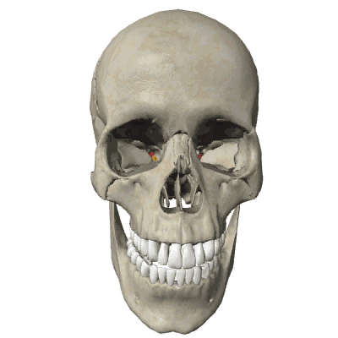

Slide 11
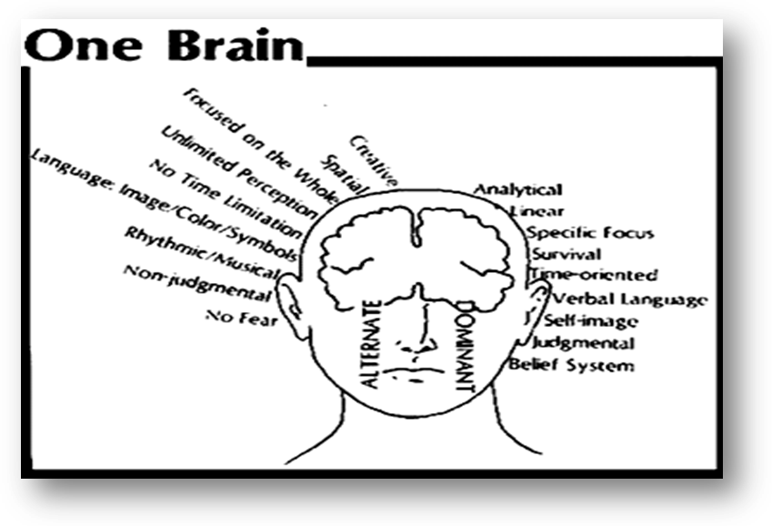

Slide 12
