Slide 1

8 Click

Slide 2
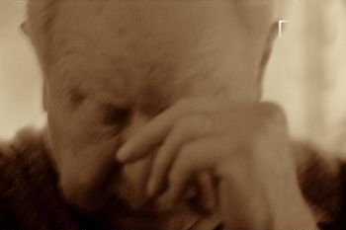

Dear son...

Slide 3
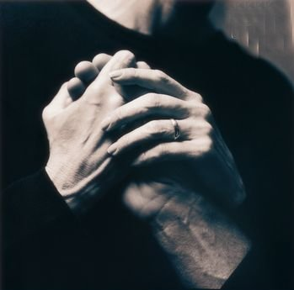
The day that you see me old and I am already not, have patience and try to understand me …

Slide 4
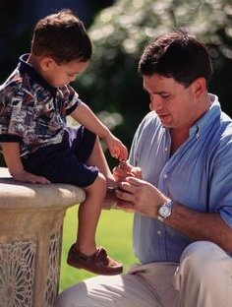
If I get dirty when eating… if I can not dress… have patience. Remember the hours I spent teaching it to you.

Slide 5
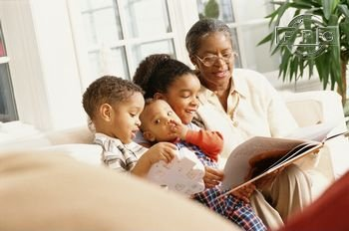
If, when I speak to you, I repeat the same things thousand and one times… do not interrupt me… listen to me.
When you were small, I had to read to you thousand and one times the same story until you get to sleep…

Slide 6
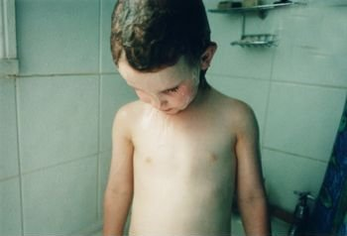
When I do not want to have a shower, neither shame me nor scold me…
Remember when I had to chase you with thousand excuses I invented, in order that you wanted to bath…

Slide 7

When you see my ignorance on new technologies… give me the necessary time and not look at me with your mocking smile…

Slide 8
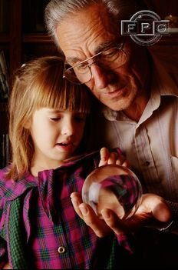
I taught you how to do so many things… to eat good, to dress well… to confront life…

Slide 9
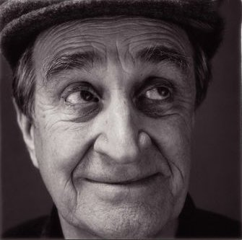
When at some moment I lose the memory or the thread of our conversation… let me have the necessary time to remember… and if I cannot do it, do not become nervous… as the most important thing is not my conversation but surely to be with you and to have you listening to me…

Slide 10
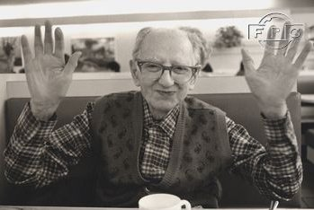
If ever I do not want to eat, do not force me. I know well when I need to and when not.

Slide 11
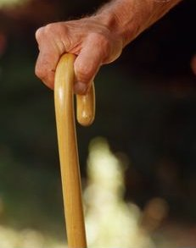
When my tired legs do not allow me walk...

Slide 12
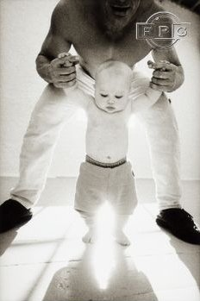
… give me your hand… the same way I did when you gave your first steps.

Slide 13
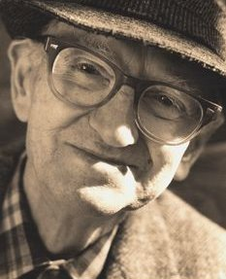
And when someday I say to you that I do not want to live any more… that I want to die… do not get angry… some day you will understand…

Slide 14
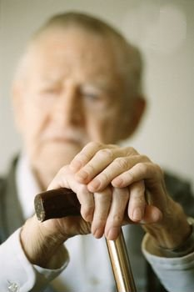
Try to understand that my age is not lived but survived.

Slide 15
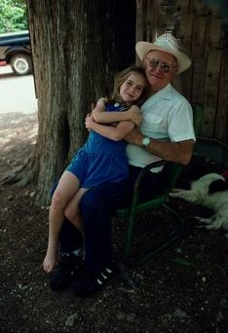
Some day you will discover that, despite my mistakes, I always wanted the best thing for you and that I tried to prepare the way for you..

Slide 16
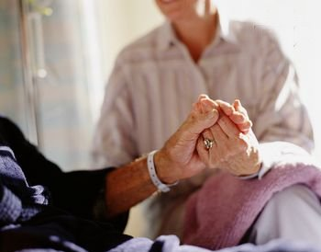
You must not feel sad, angry or impotent for seeing me near you. You must be next to me, try to understand me and to help me as I did it when you started living.

Slide 17
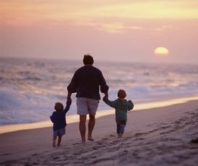
Help me to walk… help me to end my way with love and patience. I will pay you by a smile and by the immense love I have had always for you.

Slide 18
I love you son…
Your father

Slide 19
8 To end the music and to go out.

