Slide 1
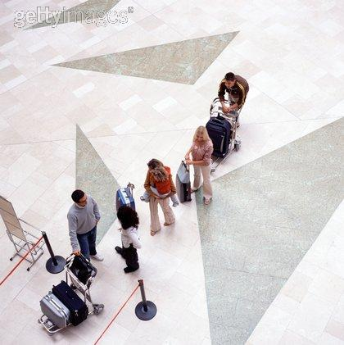
“ A young lady was waiting for her flight in the boarding room of a big airport.

Slide 2
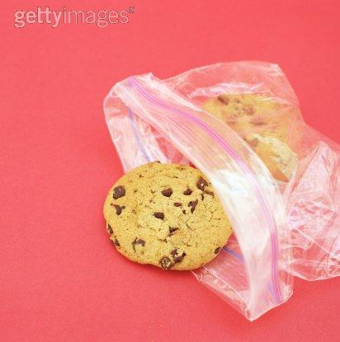
As she had to wait for hours, she decided to buy a book and to spend her time. She bought,a packet of cookies too.

Slide 3
She sat down on a armchair, in the VIP room of the airport, to rest and read in peace.

Slide 4
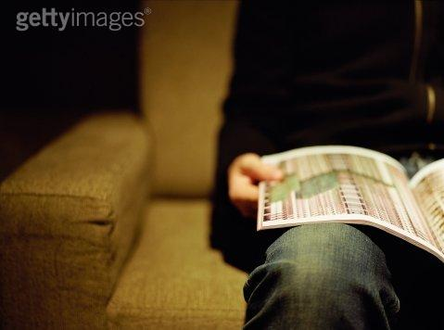
Beside the armchair where the packet of cookies were kept,a man sat down, opened his magazine and started reading.

Slide 5
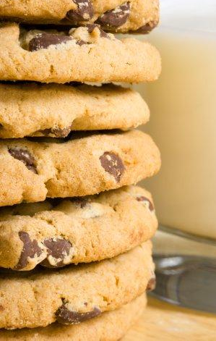
When she ate the first cookie, the man took one also. She felt infuriated but didn’t say anything. She just thought:
“What a nerve! If I was in the mood I would punch his eye so that he does not forget this daring!”

Slide 6
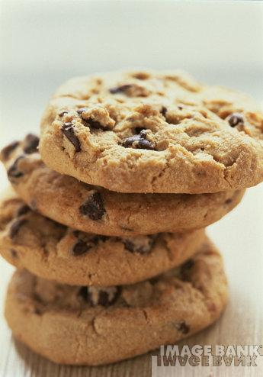
To each cookie she ate, the man ate another one.
That was letting her fume up with rage but she couldn’t react.

Slide 7
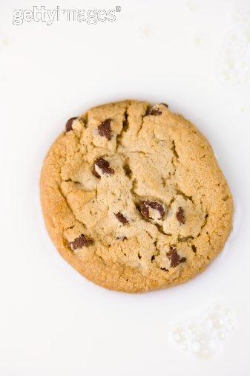
When only one cookie remained, she thought: “ah... What will this abused man do now?”
Then, the man, divided the last cookie through the middle, giving her the other half.

Slide 8
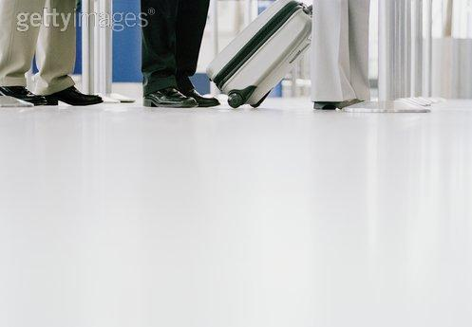
Ah! That was too much!
She was too angry!
Then, she caught her book, caught her things and headed to the boarding place.

Slide 9
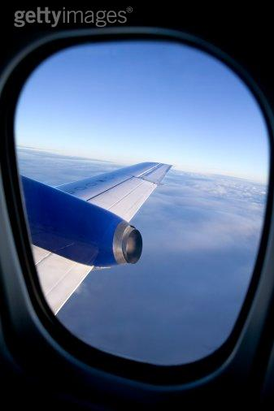
When she sat down on her seat, inside the plane, she looked into her purse to take her eyeglasses, and, for her surprise, her packet of cookies was there, untouched,closed!

Slide 10
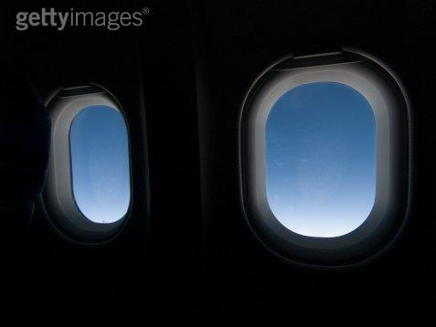
She felt so ashamed!! She realized that she was the wrong one...
She had forgotten that her cookies were kept in her purse.

Slide 11
The man divided his cookies with her, without feel infuriated, nervous or mad...

Slide 12
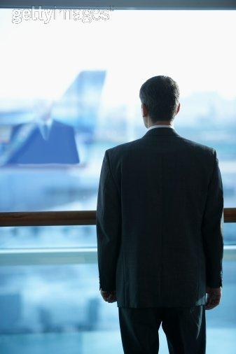
...while she was very mad, thinking that he was dividing her cookies . And there was no more time to explain herself... Nor to apologize!”

Slide 13
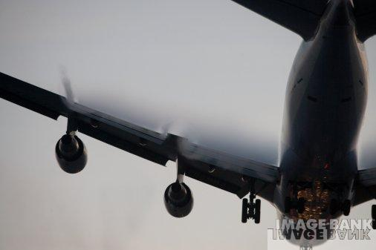
There are 4 things that u can’t recover...

Slide 14
The stone...
...after shot!

Slide 15
The word... palavra...
...after pronounced!

Slide 16
The occasion...
... after lost!

Slide 17
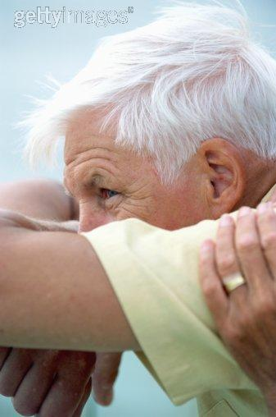
The time...
...after gone!

