Slide 1
The SEVEN CHALLENGES

Slide 2
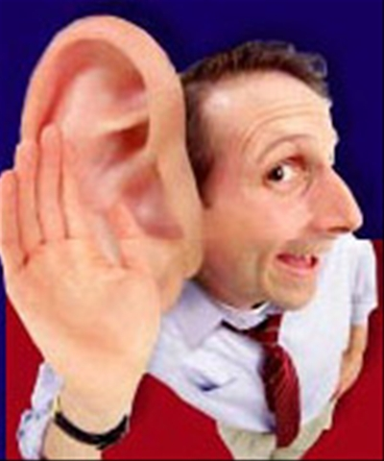
Challenge one 1:
Listening more carefully and more responsively
Acknowledging the feelings and wants that others are expressing - compassionately allowing people to feel whatever they feel (which sets the example for others to hear & accept my feelings also)
Challenge 1:

Slide 3
Challenge two 2:
Explaining my conversational intent and inviting consent
By using conversational openers such as, "Right now I would like to take a few minutes and ask you about... [subject]." The more important the conversation, the more important it is to know & share the overall goal.

Slide 4
Challenge three 3:
Expressing myself more
clearly and more completely
Giving my listeners the information they need to understand (mentally reconstruct) my experiences. One good way is to use "the five I-messages": what/how I observe, feel, interpret/evaluate, want, and hope for.

Slide 5
Challenge four 4:
Translating my criticisms and
complaints into requests
Explaining the positive results of having my request granted -- doing this for both my own complaints and the complaints that others bring to me.

Slide 6
Challenge five 5:
Asking questions more "open-endedly" and more creatively
"How did you like that movie?" is an open-ended question that invites a wide range of answers. "Did you like it?" suggests only "yes" or "no" as answers and does not encourage discussion. (How do you feel about this suggestion?)

Slide 7
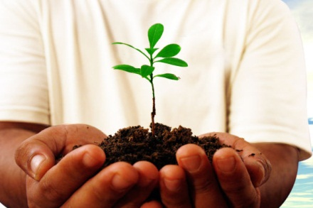
Challenge six 6
Thanking… Expressing more appreciation
Gratitude, encouragement and delight. In a world full of problems, look for opportunities to give praise. Both at home & at work, it is the bond of appreciation that makes relationships strong enough to allow for problem-solving.

Slide 9
Challenge seven 7:
Making the effort...
Making better communication an important part of my everyday life... by seeing each conversation as an opportunity to grow in skill, awareness and compassion and turning each opponent into a learning and problem-solving partner.

