Slide 1
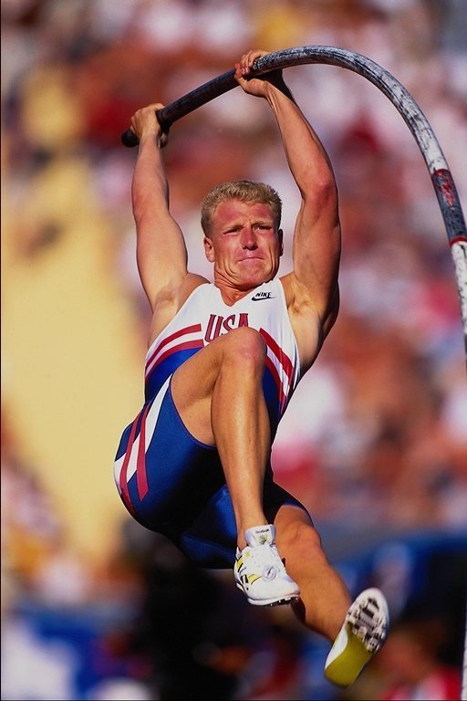
GETUP

Slide 2
GRATEFUL

Slide 3
EMPATHETIC

Slide 4
THINKING

Slide 5
UNDERSTANDING

Slide 6
POSITIVE

