Slide 1
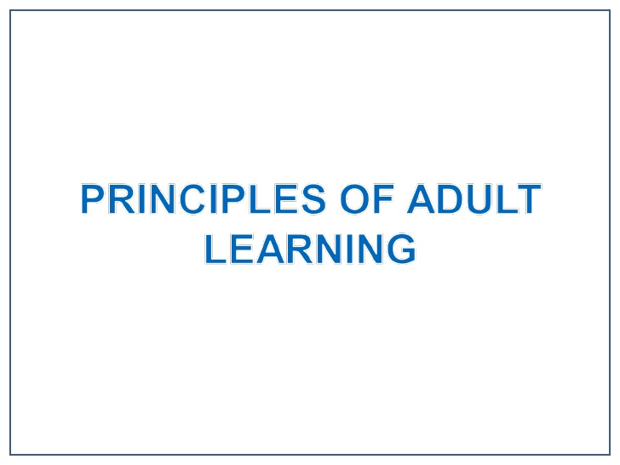
PC ToTs

Slide 2
PC ToTs
Pedagogy
Andragogy

Slide 3
PC ToTs Learners’ Role
Pedagogy(Class room)
Andragogy(Adult,Non Formal)
Follow instructions
Passive reception
Receive information
Little responsibility for
learning process
Offer ideas based on experience
Active participation
Responsible for learning process

Slide 4
PC ToTs Motivation for Learning
Pedagogy(Class room)
Andragogy(Adult,Non Formal)
External: Forces of society (family, religion, tradition, etc.)
Learner does not see immediate benefit
From within oneself
Learner sees immediate application

Slide 5
PC ToTs Choice of Content
Pedagogy(Class room)
Andragogy(Adult,Non Formal)
Teacher-controlled &
Learner has little or no choice
Centered on life or
workplace problems
expressed by the learner

Slide 6
PC ToTs
Adults must recognize the need to learn
Adults want to apply new learning back on the job.
Adults want to integrate past experience with new material
Adults prefer concrete to abstract
Adults need a variety of training methods
Adults learn better in an informal and comfortable environment.
Adults want to solve realistic problems.

Slide 7
Factors affect the speed at which people learn
Psychological
Environmental
Emotional
Sociological
Physical
Intellectual and Experiential
Age

Slide 8
PC ToTs
Cognitive Overload

Slide 9
PC ToTs
Participation breeds Commitment
Everyone brings something to the table
Non threatening environment
The mind seeks to complete familiar patterns

