Slide 1


Challenge yourself
www.caretrainingsolutions.com

Slide 2


Slide 3
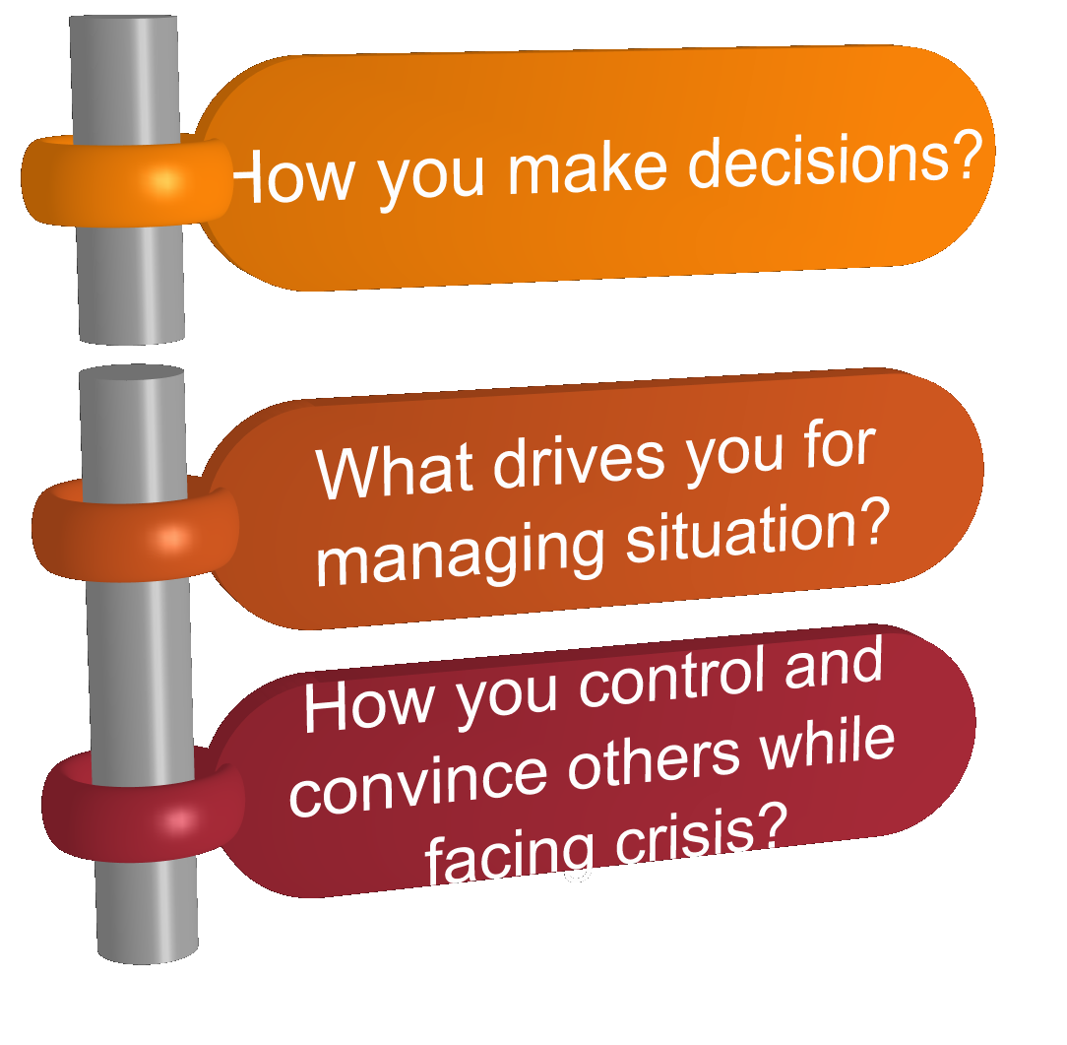
Decisions
www.caretrainingsolutions.com

Slide 4
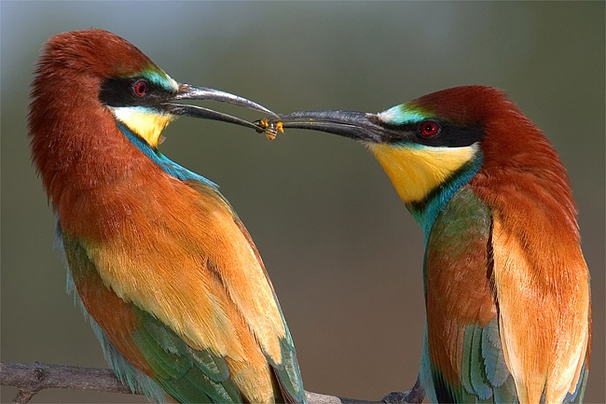
Decisions
On the basis of
Feelings & Thoughts
www.caretrainingsolutions.com

Slide 5


On the basis of drives
www.caretrainingsolutions.com

Slide 6
Sort

Slide 7
Set in order

Slide 8
Shine

Slide 9
Standerdize

Slide 10
Sustain

Slide 11
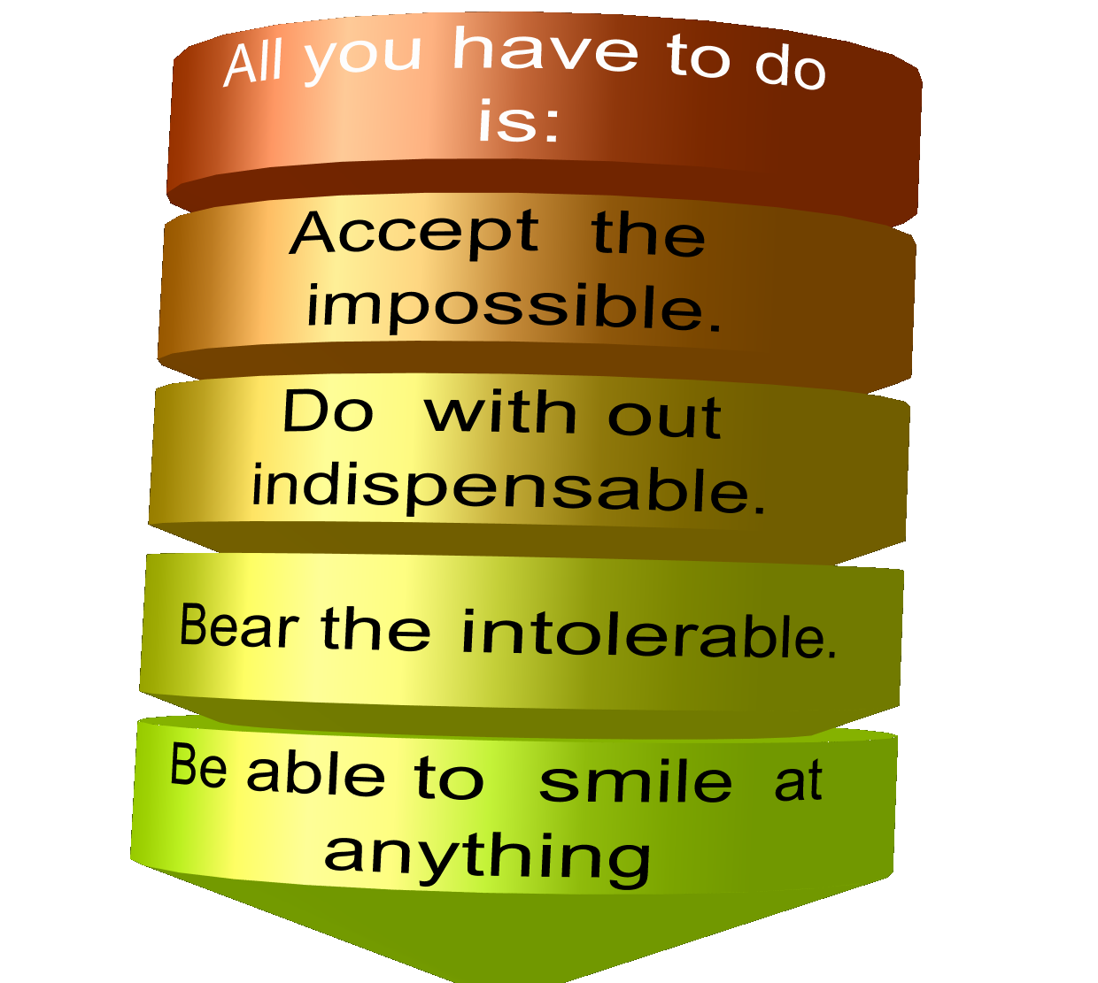
LIFE IS EASIER THAN YOU THINK
www.caretrainingsolutions.com

Slide 12


Slide 13
Total training solutions
Cochin-18
Mob:94462 60237
94460 30237
Email: carehrd@gmail.com
Web: www.carehr.com

