Slide 1
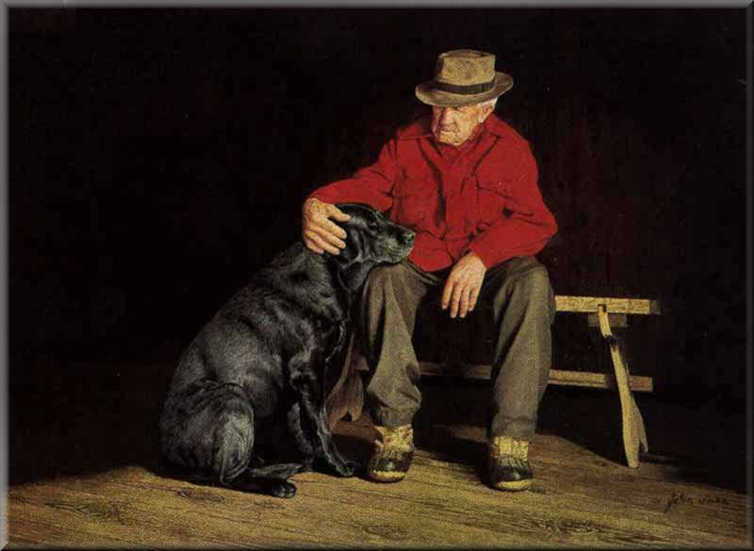
The Wise Old Man
Click to start.

Slide 2
A man of 92 years, short, very well-presented, who takes great care in his appearance, is moving into an old people’s home today.
His wife of 70 has recently died, and he is obliged to leave his home.
After waiting several hours in the retirement home lobby, he gently smiles as he is told that his room is ready.

Slide 3
As he slowly walks to the elevator, using his cane, I describe his small room to him, including the sheet hung at the window which serves as a curtain.
- "I like it very much", he says, with the enthusiasm of an 8 year old boy who has just been given a new puppy.
-"M. Gagné, you haven’t even seen the room yet, hang on a moment, we are almost there. "

Slide 4
" That has nothing to do with it ", he replies.
" Happiness is something I choose in advance. Whether or not I like the room does not depend on the furniture, or the decor – rather it depends on how I decide to see it. "
" It is already decided in my mind that I like my room. It is a decision I take every morning when I wake up. "

Slide 5
" I can choose. I can spend my day in bed enumerating all the difficulties that I have with the parts of my body that no longer work very well, or I can get up and give thanks to heaven for those parts that are still in working order. "

Slide 6
" Every day is a gift, and as long as I can open my eyes, I will focus on the new day, and all the happy memories that I have built up during my life. "
" Old age is like a bank account. You withdraw in later life what you have deposited along the way. "

Slide 7
So, my advice to you is to deposit all the happiness you can in your bank account of memories.
Thank you for your part in filling my account with happy memories, which I am still continuing to fill…

Slide 8
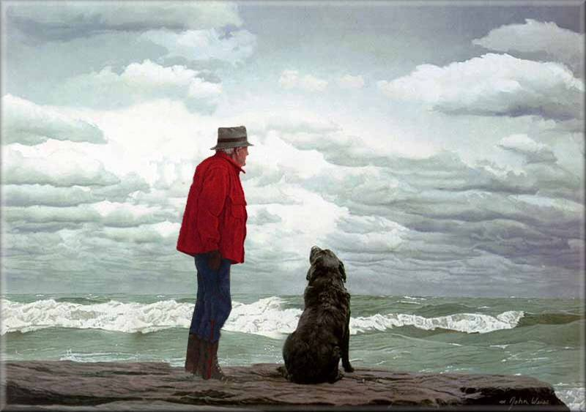
Remember these simple guidelines for happiness.
1. Free your heart from hate.
2. Free your mind from worry.
3. Live simply.
4. Give more.
5. Expect less.

Slide 9
If you would like, send this message on….it is the way we touch each other with simple truths that spreads goodness in the world. Who knows, a miracle may happen as a result….

