Slide 1

POSITIVE COMMUNE
(Soft skill training team)
Presents
GATE
Games & Activities for Training Enrichment
Programme director Faculty
JOMISHA Sudas kannoth
2018 june 24 Sunday
Sona residency
Kannur

Slide 2
TRAINING METHODOLOGIES
Presentation
Role-play
Simulation
Case study
Brain storming
Buzz group
Group discussion
Demonstration
Games and activities
Notes:
What and How to effectively doing these 8 points

Slide 3
TRAINING METHODOLOGIES
Group discussion
Presentation
Brain storming
Buzz group
Role-play
Simulation
Case study
Demonstration
Games and activities
Notes:
What and How to effectively doing these 8 points

Slide 4

NAME GAME
Relationship
Humour
Self motivate
Listening
Organise
Curiosity
Patience
Confidence
Ice break
.

Slide 5

ROCKET
Happy
Presentation skill
Self motivate
Relationship
Recognition
Gratitude
Respect
Ice break
.
Notes:
Positive qualities

Slide 6

WALK STOP STOP WALK
Concentration
Focus
Open mindedness
Listening
Flexible
Stress management
Alert
Ice breaker
.
Notes:
WALK STOP, CLAP NAME, JUMP DANCE

Slide 7
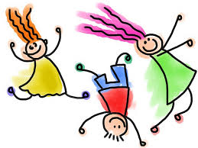
MERGE SONG
Inspiring
Passion
Humour
Relationship
Flexible
Help others
Smart
Togetherness
Common goal
Activity
.

Slide 8

MICKI MICKI HAI HAI
Relationship
Self motive
Listening
Tension
Flexible
Quick response

Slide 9

BALLOON TRAIN
Honesty
Confidence
Open minded
Restlessness
Humour
Discipline
Time management
Trust your team
Concentration
Mutual understand
Caring
Patience
.

Slide 10
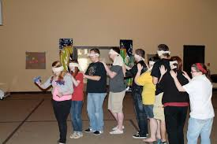
BLIND SPOT
Leadership
Communication
Patience
Listening
Assertive
Time management
Vision
Restlessness
Planning
Focus
.

Slide 11

PIPE THROW
Practice
Concentration
Confidence
Time management
Commitment
Positive attitude
Win win situation
Help others
Patience
.

Slide 12
HUNTING
One rupee note ----100 points
Flower ---50
Soda bottle ---100
One revenue stamp ---100
One banana peel ---50
Stone --20
Red socks one pair ---100
Chilly with red shade --50
Whistle -----300
Couples -----1000
Green leaf -----50
Blue kerchief ------100
1000 rupees note ------1000
Pen drive ----100
Photograph of Mahatma
Gandhi--200 (not rupees)

Slide 13
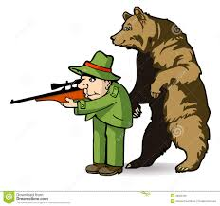
Leadership
Delegation
Energetic
Planning
Team building
Smart
Curiosity
Inspire
Open minded
Creativity
Interpersonal skill
.

Slide 14
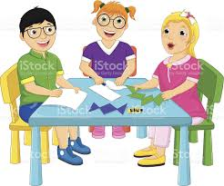
BROKEN SQUARE
Delegate
Communication
Confidence
Commitment
Positive attitude
Creativity
Patience
Team building
Vision
Time management
Sharing
Crisis management
Problem solving
Activity
.

Slide 15
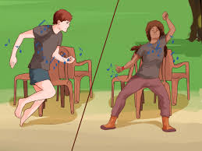
7 SEAT GAME
Patience
Flexible
Idea
Time managent
Leadership
Positive attitude
Honesty
Confidence
Intuition
Focus
Innovation
Planning
Co-ordination
Conditioning
Team work
.
Notes:
7 seat

Slide 16
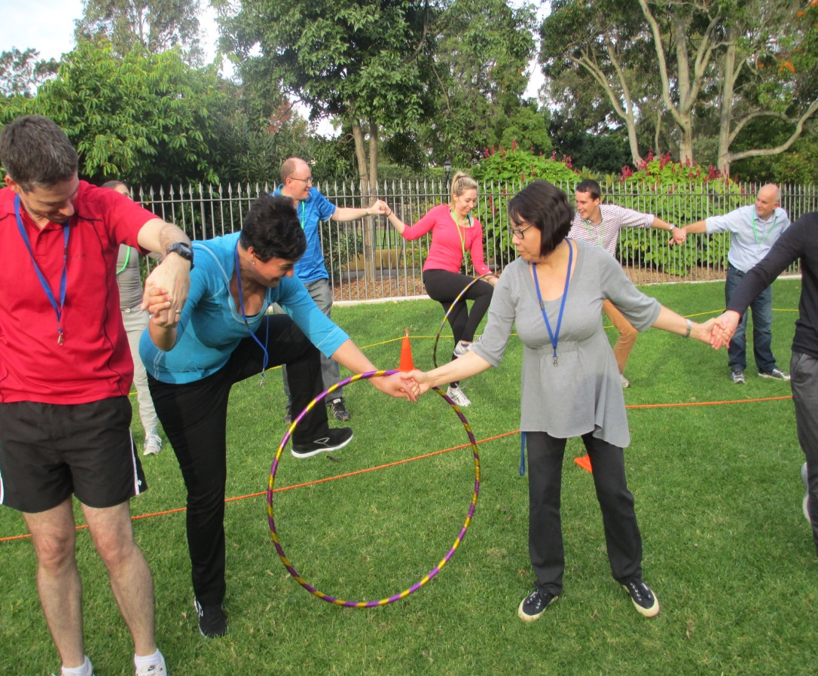
INSIDE ROPE
Risk management
Flexible
Time management
Team building
Competition
Goal
Competitive
Stress
.
Notes:
Pair middle one kettu . Azhikanam shafi sir

Slide 17
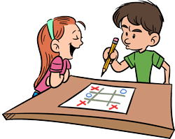
TIC TAC TOE
Honesty
Confidence
Commitment
Positive attitude
Focus
Planning
Time management
Team building
Concentration
Observation
.

Slide 18

MAN CATCHING
Planning
Relationship building
Curiosity
Leadership
Funny
Responsibility
Conviction
Remembrance
Quick capture
.
Notes:
Conviction uracha viswasam

Slide 19
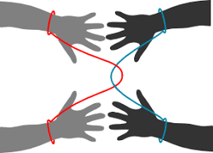
ROPE ESCAPE
Idea
Open minded
Humour
Relationship building
Likable
Risk management
Curiosity
Emotional control
Creativity
Think differently
.

Slide 20

INSIDE ROPE
Thinking out of the box
Positive attitude
Innovative
Humour
Leadership
Idea intuition
.

Slide 21

ONE MINUTE SILENT
Listening
Smart
Leadership
Focus
Value of time
Individual behaviour analysis
activity
.

Slide 22

ALPHABETIC SHAPES
Concentration
Flexible
Proactive
Risk
Listening
Time managent
Emotional control
Activity
.
Notes:
Proactive -convert positive action

Slide 23

WITHOUT CHAIR
Confidence
Commitment
Positive attitude
Patience
Courage
Conviction
Curiosity
Trust
Discipline
.
Notes:
Conviction dridaviswasam

Slide 24
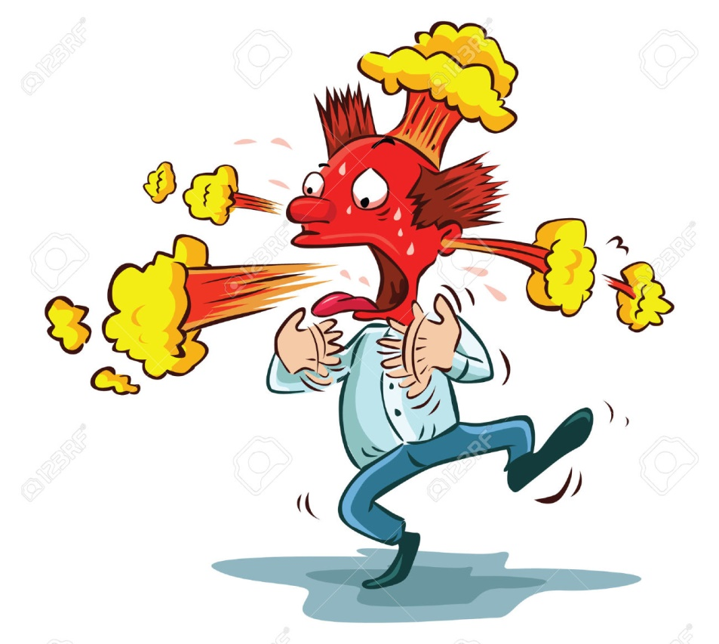
FIRE SWALLOW
Confidence
Competition
Happiness
Opportunity
Smart
Curiosity
Activity
.

Slide 25
SUDAS KANNOTH
POSITIVE COMMUNE
Soft skill training team
Thank You
sudaskannoth@gmail.com
944 711 4001

