Slide 1
Character Education Character Trait Compassion
www.carehrd.com

Slide 2
Compassionate Definition: Being genuinely concerned for the welfare of others.
www.carehrd.com

Slide 3
Compassionate Example
A person who is compassionate is ethical and genuinely concerned with the welfare of other people.
www.carehrd.com

Slide 4
Compassionate Example
A person who is compassionate shows that he/she cares about other people.
www.carehrd.com

Slide 5
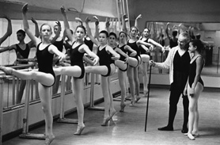
Empathetic Definition: Feeling an emotional response to the pain and pleasure of others.
www.carehrd.com

Slide 6
Empathetic Example
A person who is empathetic feels an emotional response to the pain and the pleasure of other people.
www.carehrd.com

Slide 7
Empathetic Example
A person who is empathetic has a generous spirit toward other people.
www.carehrd.com

Slide 8
Consideration Definition: Being kind, loving, and sensitive to others.
www.carehrd.com

Slide 9
Consideration Example
A considerate person is kind and loving.
www.carehrd.com

Slide 10
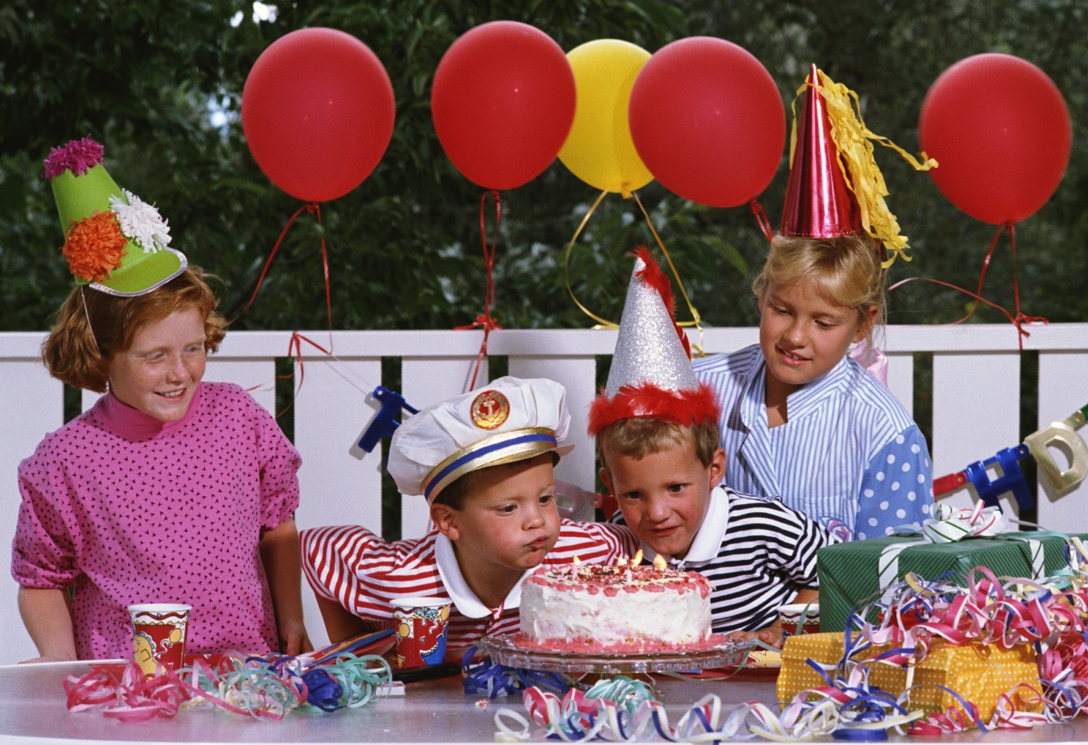
Consideration Example
A considerate person is sensitive to the needs of other people and helps people in need.
www.carehrd.com

Slide 11
Compassionate Words
Kindly
Kindhearted
Considerate
Caring
Gentle
Benevolent
Sympathetic
Empathetic
Feelings
Concerned
Kind
www.carehrd.com

Slide 12
“The Lion and the Shepherd” -Aesop
www.carehrd.com

Slide 13
Discussion Questions for “The Lion and the Shepherd”
Why do you think the shepherd helped the lion?
Can a person feel the emotions that someone else is feeling?
What does it mean to have empathy for someone?
If you are empathetic with a person, how does that make him feel?
With what person do you empathize the most?
www.carehrd.com

Slide 14
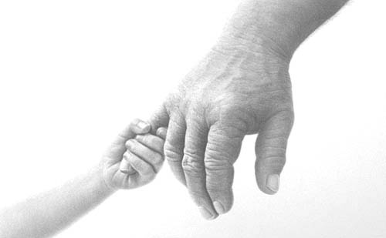
Compassion Defined: Compassion means being kind and thoughtful towards others.
www.carehrd.com

