Slide 1
POSITIVE COMMUNE (Soft skill training team) Presents
PC-TOTs
NON VERBAL COMMUNICATION
Faculty 2019 June 7,8,9
Sudas kannoth HOTEL RAINBOW SUITS
KANNUR

Slide 3
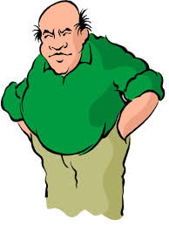
NON VERBAL COMMUNICATION
Proxemics
Kinesics
Posture
Gesture
Haptics
Eye contact
Voice modulation

Slide 4
NON VERBAL COMMUNICATION
Proxemics
Intimate space
Personal space
Social space
Public space

Slide 5
SUDAS KANNOTH
POSITIVE COMMUNE
Soft skill training team
Thank You
sudaskannoth@gmail.com
944 711 4001

