Slide 1
winning with
leadership!

Slide 2
about this
presentation….

Slide 3
you’ll hear :
The difference between ‘management’ and ‘leadership’
How to get your people ‘on board’
Ways to maximise people performance
Ideas to create the culture you want

Slide 4
What’s the difference
between
management
and
leadership?

Slide 5
managers
maintain the status quo
monitor situation
allocate resources
communicate targets
measure the results
feedback on the trends

Slide 6
leaders
strategic thinkers
look forward and create visions
challenge
motivate
inspire

Slide 7
“a leader's job is
to rally people
toward a
better future”
marcus buckingham

Slide 8
why is
leadership
so important?

Slide 9
“ The surplus society has a surplus of
similar companies, employing similar
people, with similar educational backgrounds,
working in similar jobs,
coming up with
similar ideas, producing similar things,
with similar prices, warranties,
and qualities.”

Slide 10
“when people leave companies,
they tend not to quit the company, they are more
likely to have quit the boss.”

Slide 11
“The talented employee may join a company because of its charismatic leaders, its generous benefits, and its world-class training programs, but how long that employee stays and how productive he is while he is there is determined by his relationship with his immediate supervisor"
Research from thousands of employees
Marcus Buckingham ‘First Break All The Rules’

Slide 12
trust in
management
is declining

Slide 13
“Only 36% of employees trust senior management to communicate effectively
“This drops to only 26% of employees with more than 15 years experience”
“Only 53% felt their organisation did
a good job of keeping employees
informed”

Slide 14
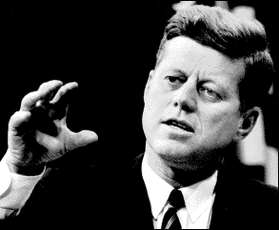
idea one
get that
‘vision
thing’

Slide 15
getting that ‘vision thing’
Creating a clear picture of the future that ‘stimulates, excites and inspires’
Getting everyone to ‘buy’ into it
Ensuring that everyone understands what’s expected of them
Turning it into meaningful goals and targets
Communicating progress towards it continuously
Celebrating successes
Working ‘On’ it consistently

Slide 16
on
strategic
operational
in
tactical

Slide 17
what does
a vision
look like?

Slide 18
a vision
Is not simply a set of financial figures
Is not a business plan
Is not a ‘pie in the sky’ idea
Is more than words in the MD’s annual speech
Is a picture of the future that we want
Includes customers, people and finances
Typically is a 2 year / 1 year / 6 month ‘thing’
Is a point of strategic focus for the leadership of the business
Is something for everyone to work towards

Slide 19
people tell
us they
need to
know

Slide 20
How is this vision relevant to me?
What specifically do you want me to do?
How will I be measured?
What consequences will I face?
What tools and support are available?
What’s in it for me?
How are we doing?

Slide 21
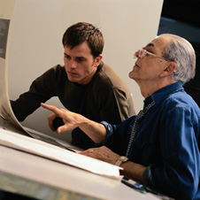
the leader’s role?

Slide 22
to help people answer these questions

Slide 23
idea two
value
Your
values

Slide 24
it’s not
what you
say……
it’s what you DO!

Slide 25
values can:
define the fundamental character of a business
help create the culture you want
create a sense of identity for the business
reduce game playing, politics and confusion
provide guidelines for managers and staff
provide guidance for acceptable and unacceptable behaviours

Slide 26
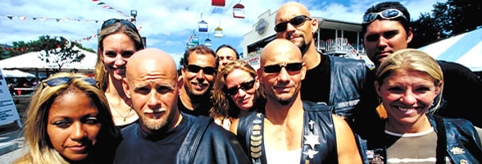
Harley Davidson’s Values:
Tell The Truth
Be Fair
Keep Your Promises
Respect The Individual
Encourage Intellectual Curiosity
Mutually Beneficial Relationships

Slide 27
45%
only
feel that their managers behave in a way which is consistent with company values
Source: mercer hr consulting

Slide 28
35%
only
feel that what their organisation says it values
is consistent with what it actually rewards
Source: mercer hr consulting

Slide 29
turn your values into ‘preferred behaviours’

Slide 30
TEAMWORK
Offers support – doesn’t wait to be asked
Strives to understand and contribute to departmental/team goals
Recognises the implications of their actions/inactions on others
Shows respect to the needs, feelings and views of others
Promotes ‘collective’ ownership across the business
Encourages contributions from all team members

Slide 31
be a role
model

Slide 32
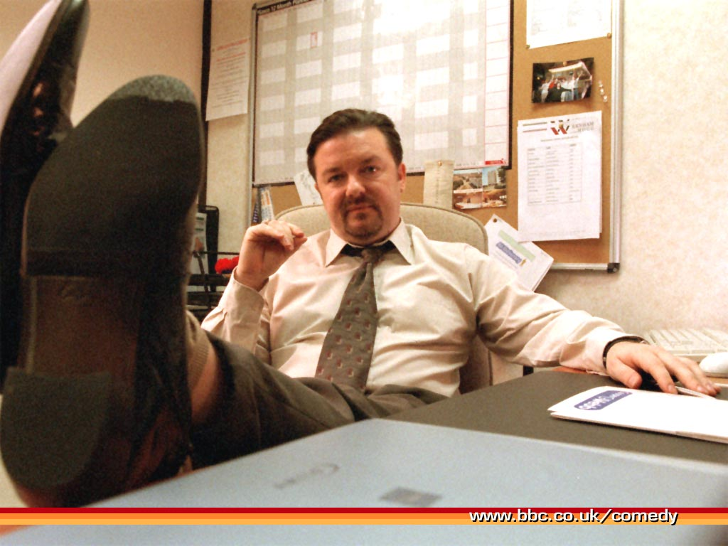
“There’s
no ‘I’ in
‘Team’,
but there
is a ‘Me’
if you
look hard
enough”
David Brent

Slide 33
idea three
get ‘engaged’

Slide 34
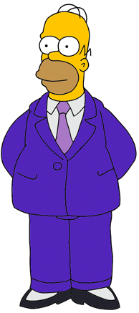
Only 17% are actively ‘engaged’
63% aren’t engaged
20% are actively ‘disengaged’
88% want to work hard and do
their best
50% worked just hard enough
to avoid being fired!
75% believe they could be
significantly more productive
Source: Gallup

Slide 35
the benefits of
an ‘engaged’
workforce

Slide 36
50%
more likely to have lower staff turnover
source: gallup

Slide 37
56%
more likely to have higher
than average customer loyalty
source: gallup

Slide 38
38%
more likely to have above
average productivity
source: gallup

Slide 39
27%
more likely to report
higher profitability
source: gallup

Slide 40
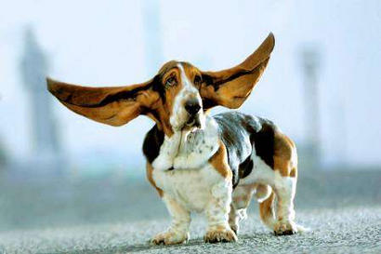
idea four
give your people a
damn good listening to

Slide 41
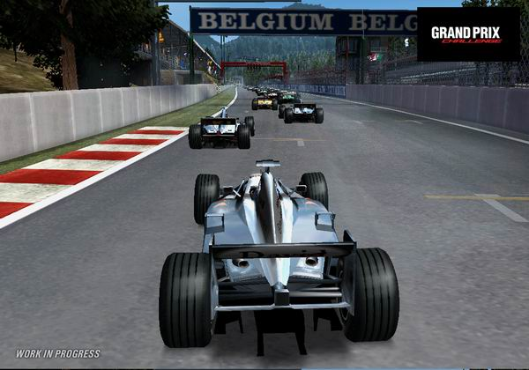
“The best
engineers
sometimes
come in
bodies
that can’t
Talk”
nolan bushnell,
founder of atari

Slide 42
ideas
for
action….

Slide 43
set up feedback systems that suit your team, not you
‘beat the brainwashing’ – ask your newcomers to spot your business ‘stupidities’
‘kill a stupid rule’ – commerce bank offers $50
‘experience days’
‘fiver down the pub’ fridays
‘pizzas and problems’
resist recruiting ‘replicants’

Slide 44
ask your team ‘what do you want from me?’

Slide 45
Stop
Start
Continue

Slide 46
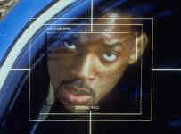
idea five
be an
‘enemy of
the status quo’

Slide 47
when two people
in business
always agree,
one of them is
unnecessary
william wrigley jr

Slide 48
four common traits:
leadership
systems and processes
culture
measurement

Slide 49
what processes do you have to encourage your people to ‘revolutionise’ your business?

Slide 50
“find great ideas,
exaggerate them, and
spread them like hell
around the business
with the speed of light”
Jan Carlzon, Head of Scandinavian Airlines

Slide 51
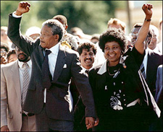
idea six
create other
leaders, not
followers

Slide 52
P
R
O
D
U
C
T
I
V
I
T
Y
‘PEAK
PERFORMER’
‘STAR’
H
I
G
H
‘MISMATCH’
‘PROBLEM
PERFORMER’
L
O
W
L O W
H I G H
UNUSED POTENTIAL

Slide 53
and
finally….

Slide 54
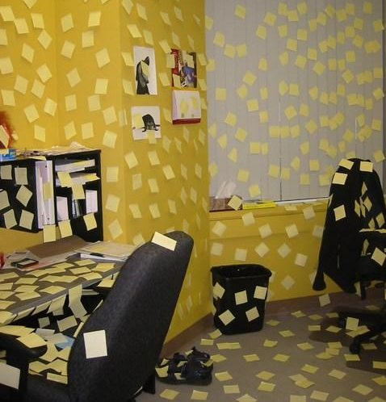
idea seven
take
action,
not notes

Slide 55
“Vision without action is hallucination”
Andy Law, St.Lukes

Slide 56
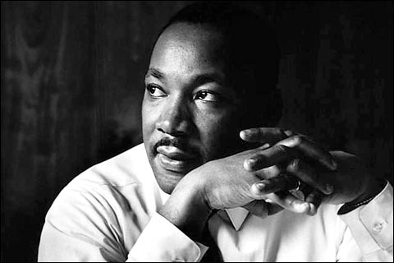
“take the first
step in faith. You
do not have to
see the whole
staircase.
Just take
the first
step.”
Martin Luther King

Slide 57
we can
all be
leaders

Slide 58
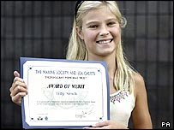
“Right, I'm going to leave you, I know there is going
to be a tsunami”
Tilly Smith, Age 10

Slide 59
don’t just stand there….. do something!
dick dastardly

