Slide 1
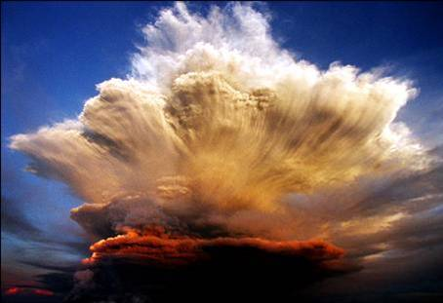
wish you
the strength
of all elements

Slide 2
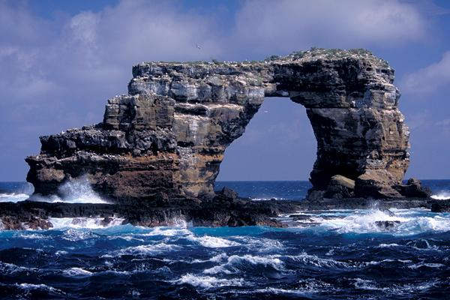
The one who takes your hand but touches your heart is a true Friend

Slide 3
We seldom think of
what we have,
but always think of
what we miss

Slide 4
Don ' t cry because it ' s over now, laugh because it happened

Slide 5
The more precisely you plan, the brighter destiny
will hit you

Slide 6
What happens, happens for
a reason

Slide 7
Make
an effort
so that the best things happen

Slide 8
The greatest events
aren't the loudest,
but the most quiet
hours

Slide 9
The most difficult lesson to learn is: Which bridge in life to use or which one
to break off

Slide 10
Everybody sees how you seem, however, only some know who you are

Slide 11
He who would like to have something he never had,
will have to do something well, that he hasn’t done yet

Slide 12
Perhaps God would want you to become acquainted with many different people in the course of your life, so that when you meet the right ones,
you can appreciate and be grateful for them

Slide 13
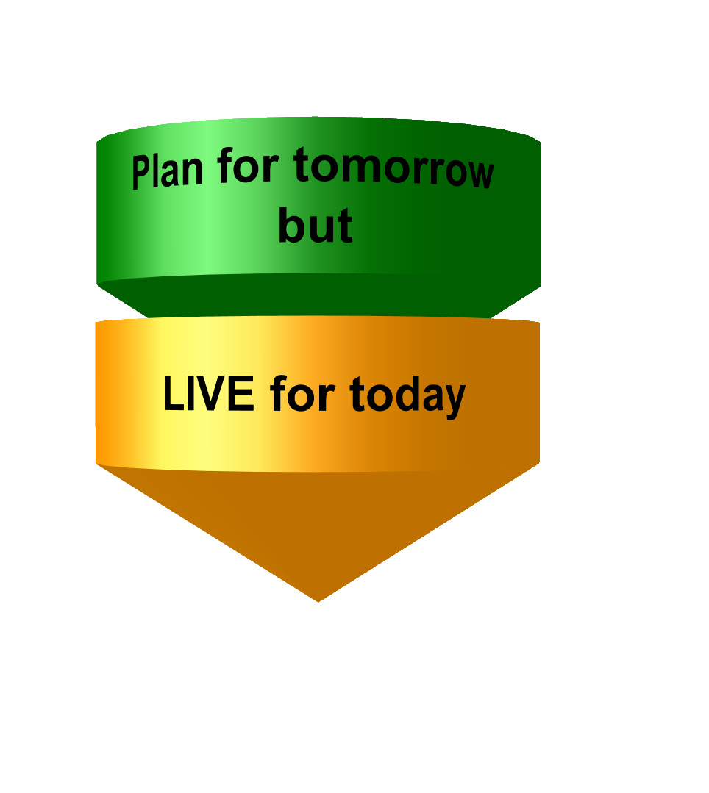

Slide 14
Love doesn't require two people look at each other, but
that they look together
in the same direction. (Antoine de Saint Exupery)

Slide 15
Life is drawing without an eraser

Slide 16
have great DAYS !

