Slide 1
“Not all Great speakers are born….. ….some are trained too.” Presenting is a Skill… Developed through training, practice, and experience.

Slide 2
THE 4 P’s of PRESENTATION
– PLAN
WHY
WHO
– PREPARE
WHAT
– PRACTICE
HOW
– PRESENT
WHEN
WHERE

Slide 3
PLAN -The Core Message
Why????
Reason For Presentation
Impact on Audience
What Action

Slide 4
REMEMBER YOUR 3E’s
EDUCATE
ENTERTAIN
EXPLAIN

Slide 5
PLAN -The Core Message
Who???? - Assess Your Audience
– “Success depends on your ability to reach your audience.” So Pitch to your audience:
– Size
– Demographics
– Knowledge Level
– Bias
– Motivation
REMEMBER:
Talk to Your Audience, rather than at them

Slide 6
Prepare -RESEARCH

Slide 7
PREPARE - Structure
INTRODUCTION
BODY
PREPARE - Structure
Tell them what you are going to tell them
SUMMARY
Tell them
Tell them what you told them

Slide 8
INTRODUCTION Tell them what you are going to tell them
N - Need
T - Title
R - Range
O - Objectives
I - Interesting

Slide 9
MAIN BODY Tell Them
• Structure the Theme
• 5 Need to know statements
• 5 Key words
• 5 Mini speeches / Excerpts
• Check Focus

Slide 10
SUMMARY Tell them what you told them
Tell them what you told them
Draw conclusions – capitalize
Point way forward
Closing statement -impressive
Give time for questions

Slide 11
PRACTICE
How????????? – practice, practice, practice……
– Strong Opening
– Clear Point
– Reduces nerves
– Improves performance
– Logical Flow
– “So What” test?
– Strong Ending
– Helps judge timing
– Get familiar with aids
– Avoid over rehearsing

Slide 12
PRACTICE – Delivery
– Vary Voice :
Voice Modulation to express emotion and emphasize point
– Body Language:
eye contact and articulation
– Other aids:
Slides, Handouts etc.
– Timing:
Not too long, Not too short – Edit
– Pace :
Fast enough not to bore, slow enough to be grasped

Slide 13
PRACTICE – Objection Handling
An objection is anything the prospect says or does that is an obstacle to smooth closing. i.e. interruptions, questions, point oppositions, doubts, clarifications.

Slide 14
They happen when………….
– All or part of the presentation was misunderstood
– Participant is not convinced
– Hidden reason (stall)

Slide 15
3 Steps to being a great Speaker
Vocal Techniques
– Loudness
– Pitch
– Rate
– Pause
Body Language
– Eye Contact, Gestures, Posture
Use of Space
– Can Everyone See You?
– Movement

Slide 16
5 Presentation Tips
1. Smile
2. Breath
3. Visual AID
4. Notes
5. Finish On Or Under Time

Slide 17
Keep Your Eyes on………
• Verbal fillers
– “Um”, “uh”, “like”
– Any unrelated word or phrase
• Movements that show nervousness
– Swaying, rocking, and pacing
– Hands in pockets/on dress
– Lip smacking
– Fidgeting
• Failure to being audience-centered

Slide 18
Always Remember that…..
Visual Aids are merely to………
Enhance Understanding
Add Variety
Support Claims
Create Lasting Impact
When they are used poorly they only serve to be…
A Distraction…Deliver Ineffective Presentation…… Reduce impact of topic

Slide 19
Polishing Presentation Skills
• Voice Modulation – Express Better
• Body Language – Kinetics

Slide 20
Voice Modulation
“Friends, Romans, countrymen, lend me your ears;
I come to bury Caesar, not to praise him.
The evil that men do lives after them; ”

Slide 21
Questions:
Why did every one have a different tone for the same sentence?
What did each tone deliver?
Uses of Tone as Non-Verbal communication?

Slide 22
USE….
Voice projection
Meaningful Pauses
Pitch
Consonants, Vowels
Speak S L O W L Y ….

Slide 24
Typical Eye Movement
Upper left
Upper right
Lower left
Lower right
Correct Eye Movement
Into the Eyes of the Audiences talking to them
through expressions while gauging them through their expressions

Slide 25
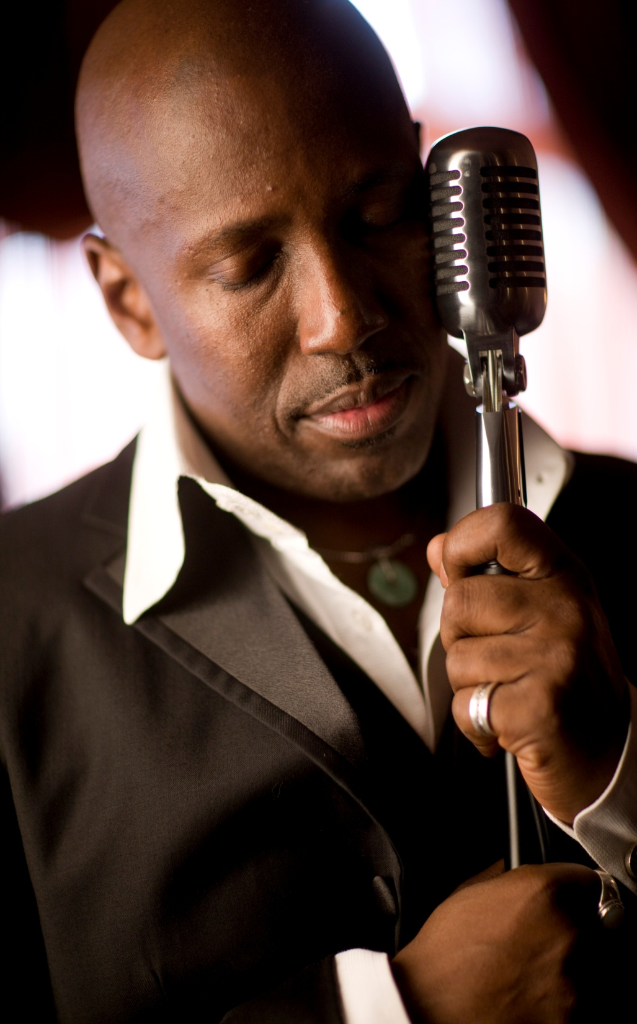
Remember………….
While Preparing your Time resources, ideally must be divided between
60%
Content Development
Objection handling
40%
Tone / Pitch
Body Language
AV / aids for Presentation

Slide 26
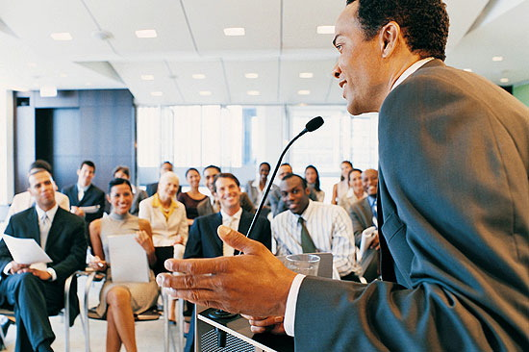
PRACTICE MAKES
PERFECT !!

