Slide 1
It is madness...

Slide 2
To hate all roses because you got scratched with one thorn...

Slide 3
To give up on your dreams because one didn’t come true...

Slide 4
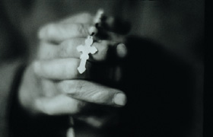
To lose faith in prayers Because one was not answered...

Slide 5
To give up on your efforts Because one of them failed...

Slide 6
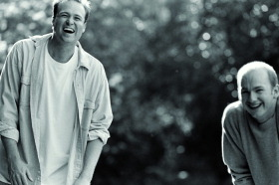
To condemn all your friends Because one betrayed you...

Slide 7
Not to believe in love Because someone was unfaithful or didn’t love you back...

Slide 8
To throw away all your chances to be happy
Because you did not succeed on the first attempt....

Slide 9
I hope that as you go on your way
You don’t give in to madness

Slide 10
Remembering always ...

Slide 11
Another chance may come up

Slide 12
Another friend

Slide 13
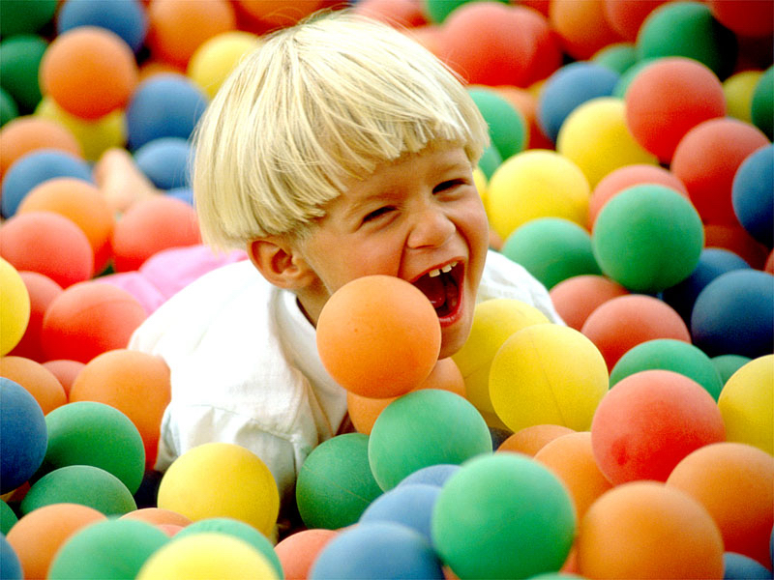
A renewed strength

Slide 14
Be persistent
Look for hapiness in every day

Slide 15
The sure path to failure is to give up! It is often through failure that future success come –
KEEP TRYING!
God bless you.

