Slide 1
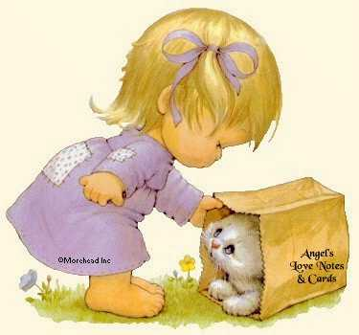
As you arrive to your work place...
Pray to God and ask his guidance!!

Slide 2
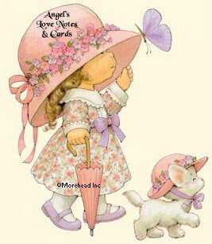
Greet your colleagues...
That is called friendship!!

Slide 3
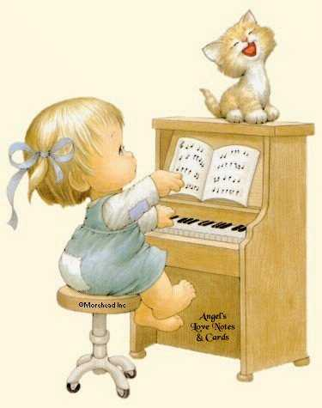
Give to everybody the best of yourself...
That is called
sincerity!!

Slide 4
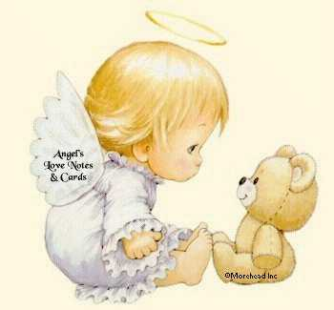
That is called reflection!!
Program and organize your day...

Slide 5
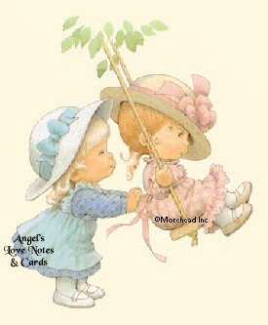
Now that you have planned everything begin to work...
That is called taking action!!

Slide 6
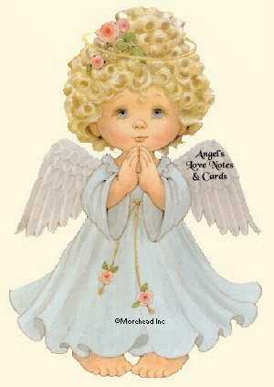
That is called faith!!
Trust that everything will be O.K….

Slide 7
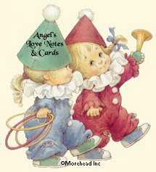
Work with happiness...
That is called enthusiasm!!

Slide 8
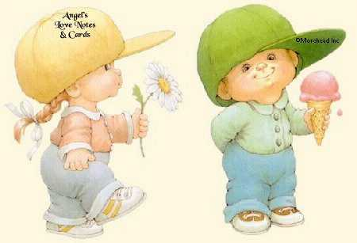
Give the best of yourself...
That is called
excellence!!

Slide 9
That is called compassion!
Help those with more difficulties than you...

Slide 10
Understand that not everybody is at your level...
That is called tolerance!!

Slide 11
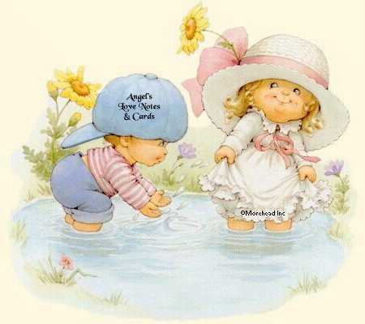
That is called humility!!
Receive praise with reticence...

Slide 12
That is called HRM!!
God is with you...

