Slide 1
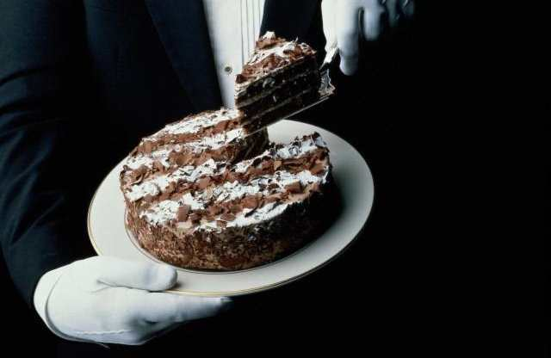
Piece of Cake...?

Slide 2
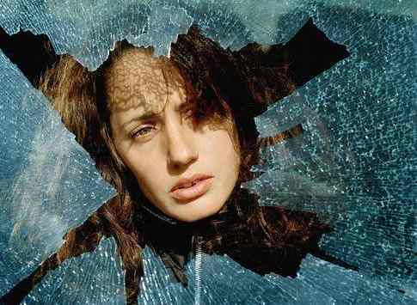
Sometimes we ask ourselves: What did I do to deserve this?

Slide 3
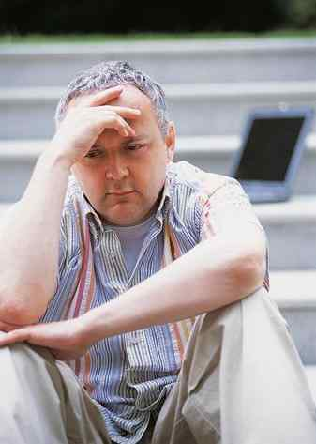
Why does God let these things happen to me?

Slide 4
Here is the explanation...

Slide 5
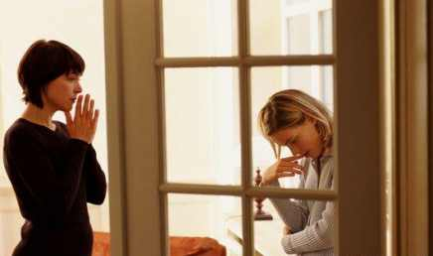
A daughter tells her mother how everything is going wrong for her; She probably failed her Math exam,

Slide 6
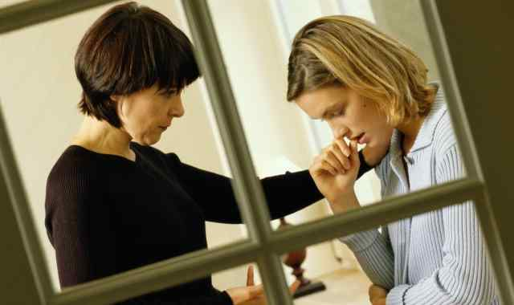
...Her boyfriend just dumped her... for her best friend.

Slide 7
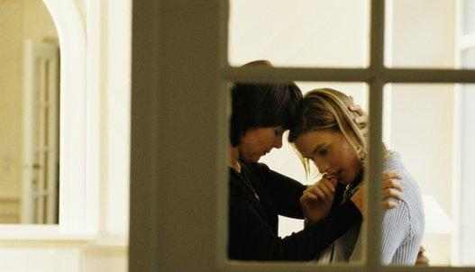
In times so sad, a good mother knows just the thing to cheer up her daughter... “I make a delicious cake.” In that moment themother hugged her daughter and walked her to the kitchen, while her daughter attempted to smile.

Slide 8
While the mother prepared the utencils and ingredients, her daughter sat across from her at the counter. Her mother asks, “Sweetheart, would you like a piece of cake?” Her daughter replies, “Sure,mom, you know how I love cake.”

Slide 9
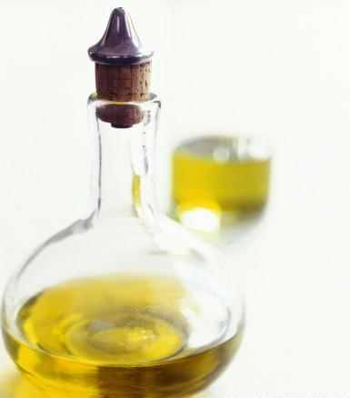
“Alright...” the mother said, “Drink some of this cooking oil.” Shocked, the daughter responded, “What?!? No way!!!

Slide 10
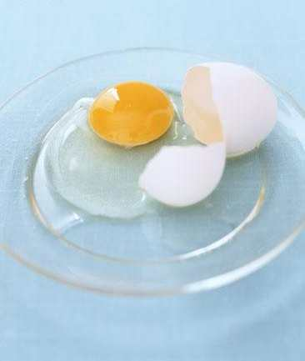
“How about a couple of raw eggs?” To this the daughter responded, “Are you kidding?”

Slide 11
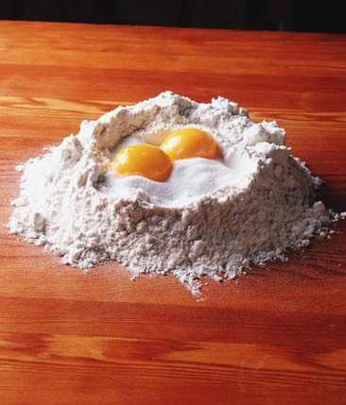
“How about a little flour?” “No, mom, I’ll be sick!”

Slide 12
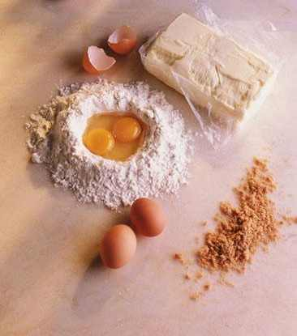
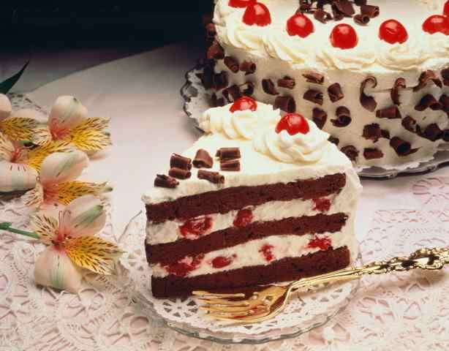
The mother responded, “All of these things are uncooked and taste bad, but if you put them together...
...They make a delicious cake!”

Slide 13
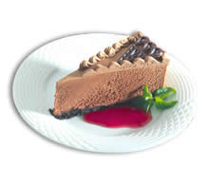
Have a Great Cake! Oops! I mean a Great DAY!

