Slide 1
ANYTHING IS
POSSIBLE

Slide 2
If there was ever a time to dare, to make a difference, to embark on something worth doing, IT IS NOW. Not for any grand cause, necessarily... but for something that tugs at your heart, something that's your inspiration, something that's your dream.

Slide 3
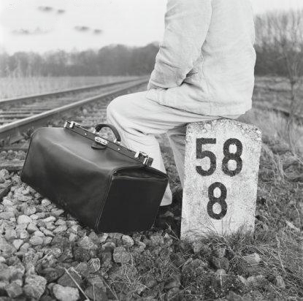
You owe it to yourself to make your days here count. HAVE FUN, DIG DEEP, STRETCH, DREAM BIG!

Slide 4
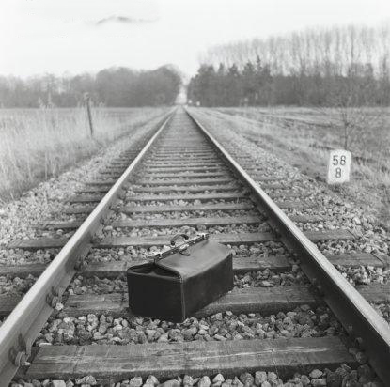
Know, though, that things worth doing seldom come easy. There will be good days. And there will be bad days. There will be times when you want to turn around, pack it up, and call it quits. Those times tell you that you are pushing yourself, that you are not afraid to learn by trying.

Slide 5
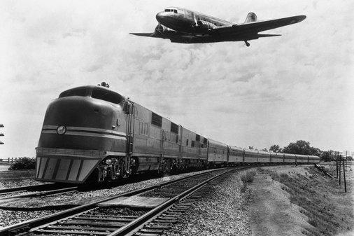
PERSIST Because with an idea, determination, and the right tools, you can do great things. Let your instincts, your intellect, and your heart, guide you.

Slide 6
TRUST Believe in the incredible power of the human mind. Of doing something that makes a difference. Of working hard. Of laughing and hoping. Of lazy afternoons. Of lasting friends. Of all the things that will cross your path this year.

Slide 7
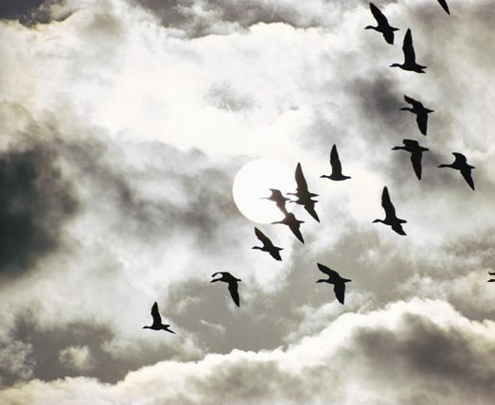
The start of something new brings the hope of something great, ANYTHING IS POSSIBLE.

